Slide 1
Digimap data in QGIS
Tom Armitage
EDINA Geo User Support
Guy McGarva
EDINA Geo User Support

Slide 2
Content
What data is available?
How do I use Data Download to get data for QGIS?
What formats should I pick for using in QGIS?
How do I load data into QGIS?
How do I style my data?
Tips:
Projections
Clipping smaller areas
Merging tilesResources

Slide 3
Digimap Home Page
Notes:
Everything is accessed from the Home Page. Your’s may look slightly different depending on what Collections your institution subscribes to. We Will mainly be looking at the Data Download application in the OS Collection.

Slide 4
What data is available from Digimap?
OS – Full range of OS maps and data available including OS MasterMap and OS OpenData
Historic – Detailed historic OS maps from 1843-1990s
Geology – Onshore and offshore geological datasets
Marine – Marine and coastal zone data
Environment – Land cover and land use datasets
All data can be used in QGIS in one form or another!
Notes:
Data is available from a variety of suppliers. We will mainly look at OS data but all data can be loaded in to ArcGIS.

Slide 5
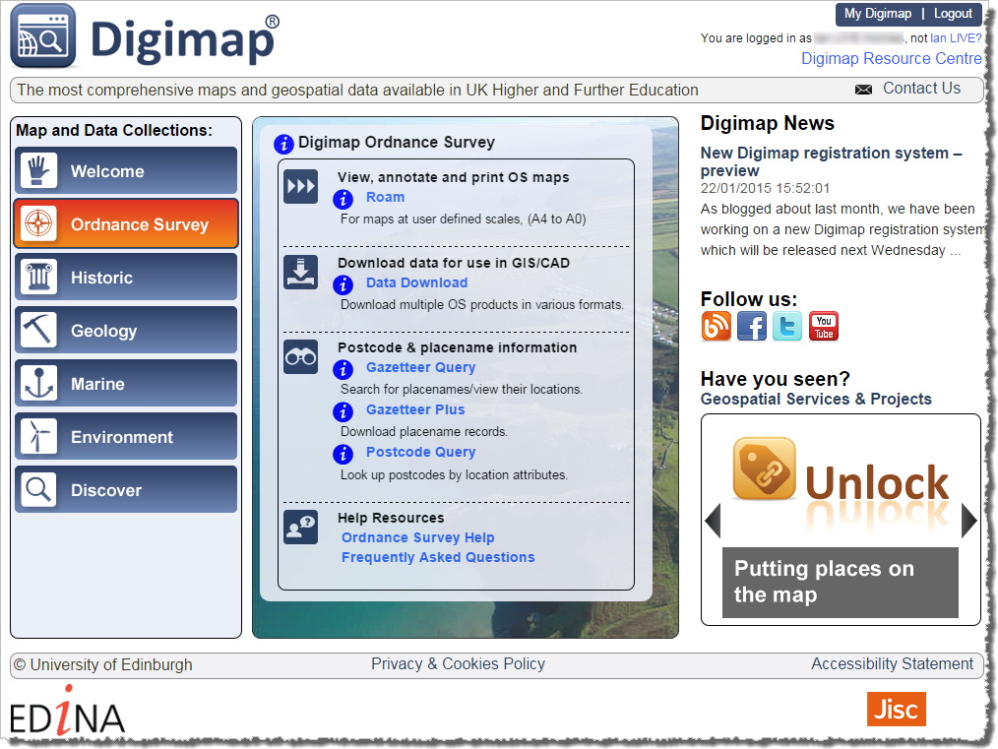
How do I download map data?
Data Download – download OS and other mapping data for use in QGIS
Notes:
First thing is to download data for use in ArcGIS. Obviously you can also use your own data or data from other sources in ArcGIS as well.
We will use the Data Downlaod application n the OS collection but all other work much the same (except Historic Download at the moment).

Slide 6
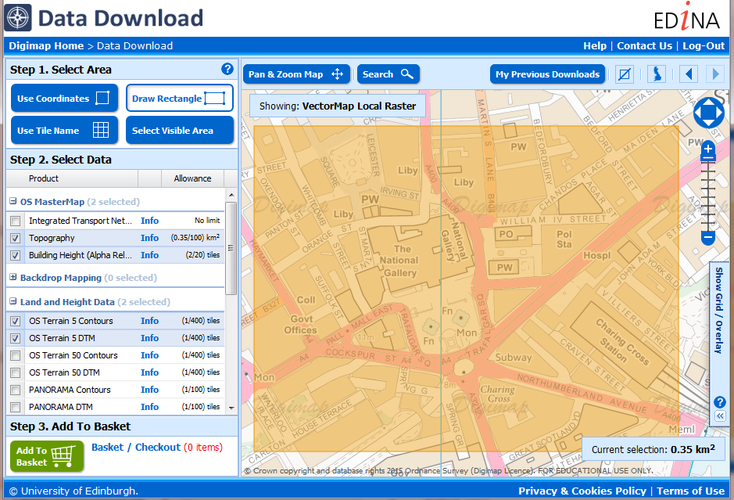
Using Data Download
Three steps:
Select area
Choose data
Add to basket - options to change format, version and layers
Notes:
It’s straightforward to use Data Download – ordering map data involves 3 steps:
Select your area on the map – there are 4 methods for selection. The shaded orange area you see here is our selected area.
Select the map data that you wish to download. You can open any category of map data by clicking on the name. Then it’s a matter of ticking the box next to any map data you wish to download. You can download as many as you like in an order, provided you do not exceed the allowances. There is an allowance for each map data product – in order that our servers can process orders as quickly as possible.
Third step is to add to basket. Once you click the add to basket button, your basket pops up on screen. You can then select from different formats, date versions and map layers, where available. Options will different depending on map product.

Slide 7
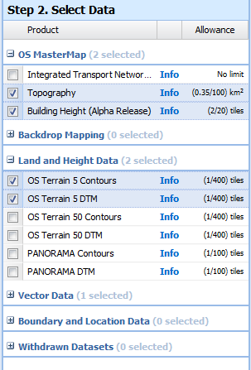
Data Download
All available OS map data products in Data Download
Download several map products in one order
6 categories of map data
3 steps to order map data

Slide 8
Data Download
Click + or on category name to open and see available map data products:
OS MasterMap – most detailed topographic mapping of GB, transport network map data
Background Mapping – raster maps at range of scales, all in TIFF format
Land and Height data – contours and Digital Terrain Models
Vector data – range of scales and formats
Boundary and Location data – administrative boundaries, postcode data, gazetteers
Withdrawn datasets

Slide 9
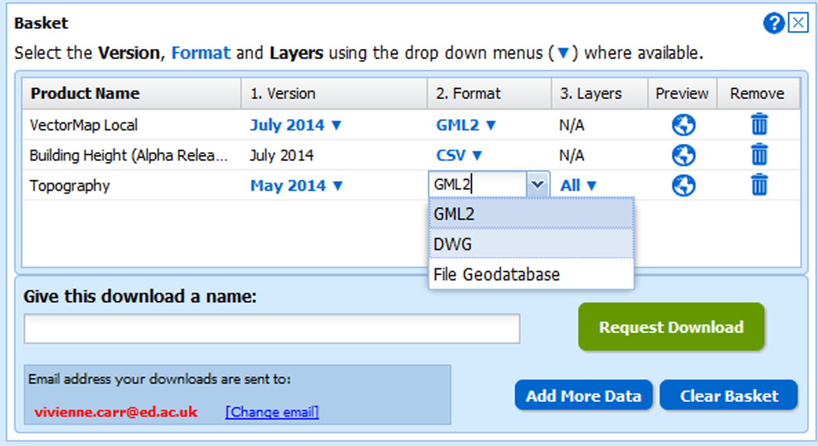
Basket options
Select version, format and layers in the basket.
Options vary between map data products.
Notes:
This is where you really start thinking about what GIS you are going to be using the data in. Pick the format that is easiest to use in your chosen GIS – or the format that gives you the information that you need.

Slide 10
What formats should I use for QGIS?
Shapefile – for vector if available
File Geodatabase – for vector if available
GML (for OS MasterMap and VML) – if needed
TIFF – for raster
ASC (for DTM)

Slide 11
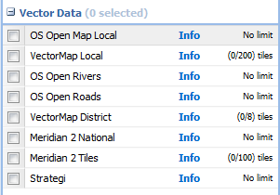
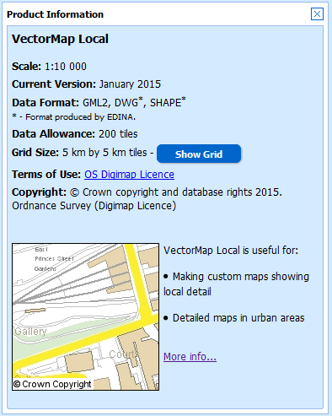
Shape file availability
Check the Information boxes.
Every product in Vector Data category available in Shape format.
The most up-to-date contours are also available as Shape.

Slide 12
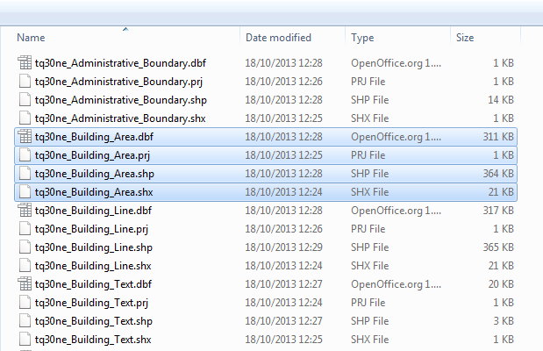
What do Shapefiles look like?
Remember to keep all constituent parts together - SHP, DBF, SHX, PRJ.
Image of folder containing VectorMap Local shape files.

Slide 13
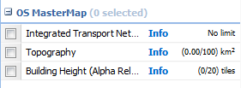
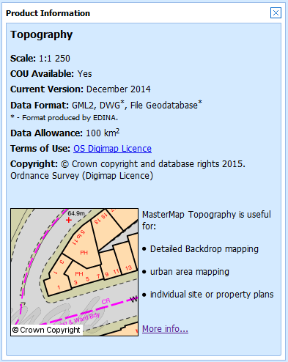
OS MasterMap Topography
Recommend you take File Geodatabase for use in QGIS.
Alternative: Take GML and convert to Shapefile using InterpOSe or the Ordnance Survey Translator plugin. (Experimental)
Why would I convert GML?
Can limit the actual feature types you import
Can merge several orders together
Notes:
For most users, File Geodatabase will be the most convenient for using in ArcGIS

Slide 14
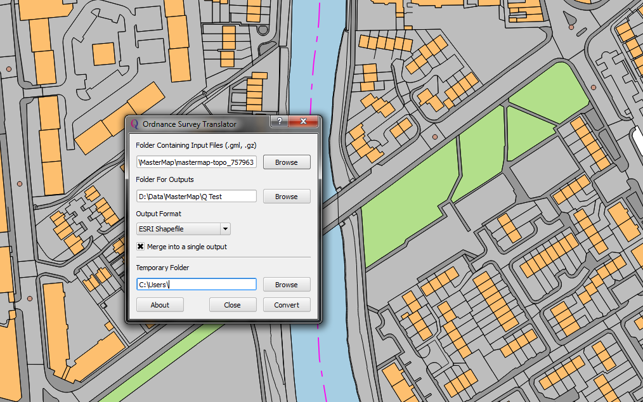
Use Ordnance Survey Translator to process GML
Creates a shapefile
Can process multiple Chunks and Multiple Orders
Notes:
Productivity Suite should be freely available if your institution subscribes to the Eduserv/Chest Agreement – which it will if you have ArcGIS available.
You should always use the latest version compatible with the version of ArcGIS you are using

Slide 15
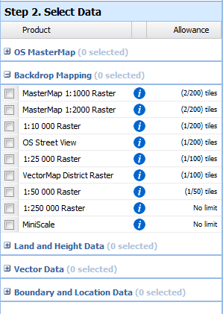
Raster data formats
TIFF
Raster data (backdrop mapping) all supplied in TIFF image format
Some TIFFs are supplied with a TFW file - a plain text World file
World Files contain the geographic coordinates, scale and rotation of TIFF map.
ASC
DTM and Gridded Bathymetry data
Notes:
Most raster data available in TIFF format. Keep TFW in same folder as TIFF file.
Some TIFF are ‘GeoTIFF’ with projection information embedded in the TIFF file itself.

Slide 16
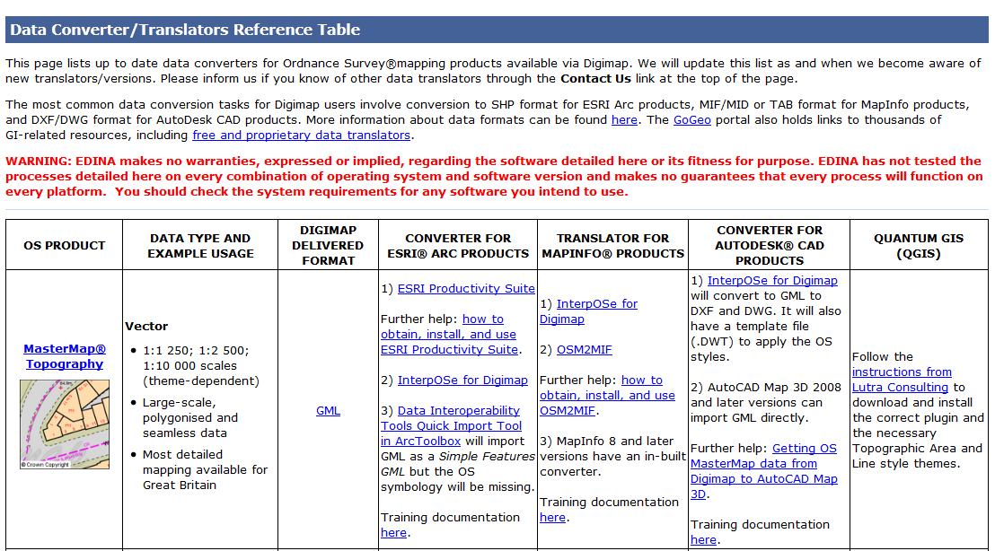
Formats and conversion guidance
http://digimap.edina.ac.uk/webhelp/os/data_information/data_formats/new_data_translators.htm

Slide 17
Download zip file contents
Within each zip file:
Folder for each map product
Contents text file
Citations text file
You must extract the data from the zip file before using the data in QGIS:
Either use the Windows ‘built-in’ uncompress option “Extract All” available when you right click on the zip file
Or use software such as 7-Zip or WinZip to extract the data from the zip file.
Notes:
You will get a zip file to download vis a link sent to you by email. Within the zip file there are several data folder and a contents and citations text file.
The data needs to be extracted from the zip file before using in any GIS.

Slide 18
Getting QGIS
Downloading QGIS
Available from www.qgis.org
Download page: http://www.qgis.org/en/site/forusers/download.html
Windows 32 bit, Windows 64 bit, Mac and Linux versions
There are Long Term Releases (LTRs) and Latest Versions (LVs)
LTRs are supported for 1 - 2 years
Have good help material and bug fixes
LVs have all the latest features
They have bug fixes but not all the features are well documented or stable
Notes:
Start ArcGIS and the first thing to do is use the Add Data button to add data.

Slide 19
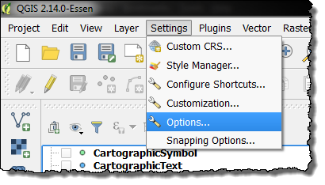
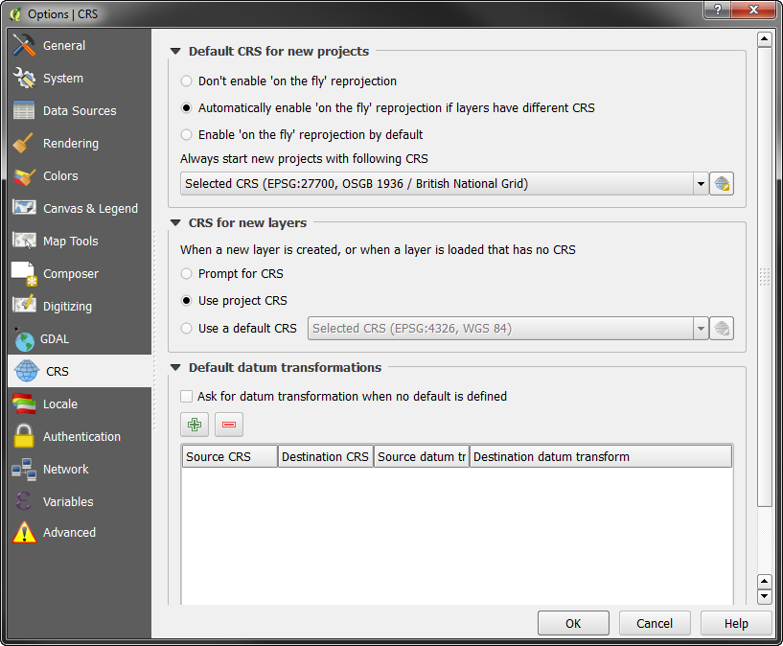
Setting up QGIS
Setting your CRS
If you are mostly use British Data then you can set the map to always start using British National Grid
Go to Settings → Options
Enable ‘on the fly’ reprojection
The EPSG code is 27700
Notes:
Start ArcGIS and the first thing to do is use the Add Data button to add data.

Slide 20
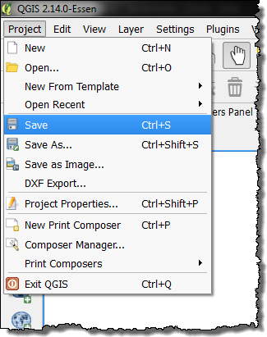
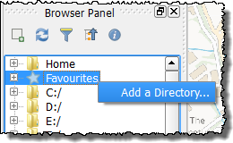
Setting up QGIS
Saving the Map
Map documents are saved as QGS files
These save only the styling, zoom levels and other changes you have made but NOT the data itself.
Adding a Favourite Folder
Right-Click on Favourites and browse to you data folder
Drag files in rather than add them using the buttons
Notes:
Start ArcGIS and the first thing to do is use the Add Data button to add data.

Slide 21
Adding Data
Add data using the buttons down the side with the green plus Symbols.
Three key ones you need to know for Digimap data are:
Add Raster Data
Add Vector Data
Add CSV Data

Slide 22
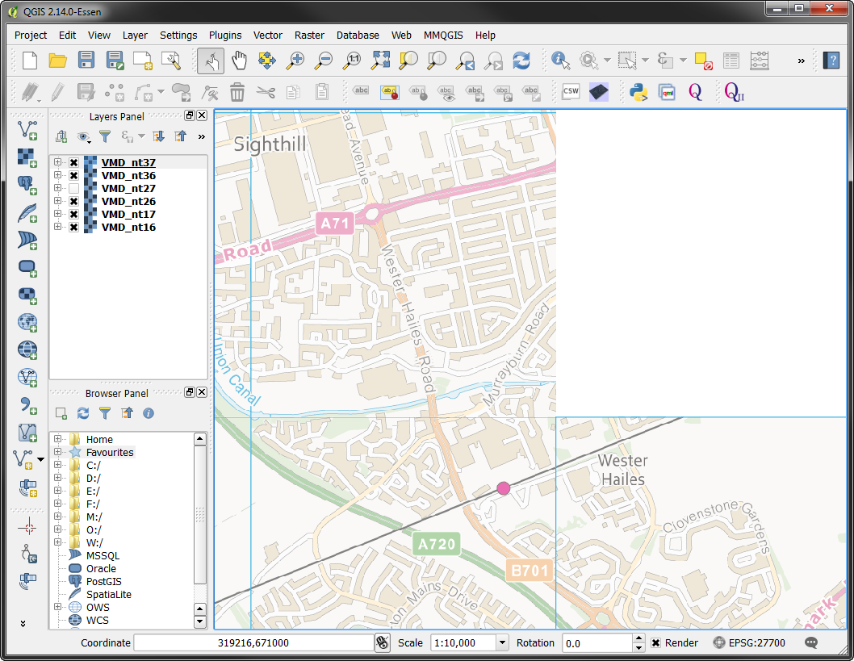
Adding VMD Raster Data
Click on the Add Raster Button:
Browse to your data use Ctrl or Shft to select multiple raster tiles at one time
Notes:
Data should display automatically. If it is not visible, right click on a Layer and click “Zoom to Layer”

Slide 23
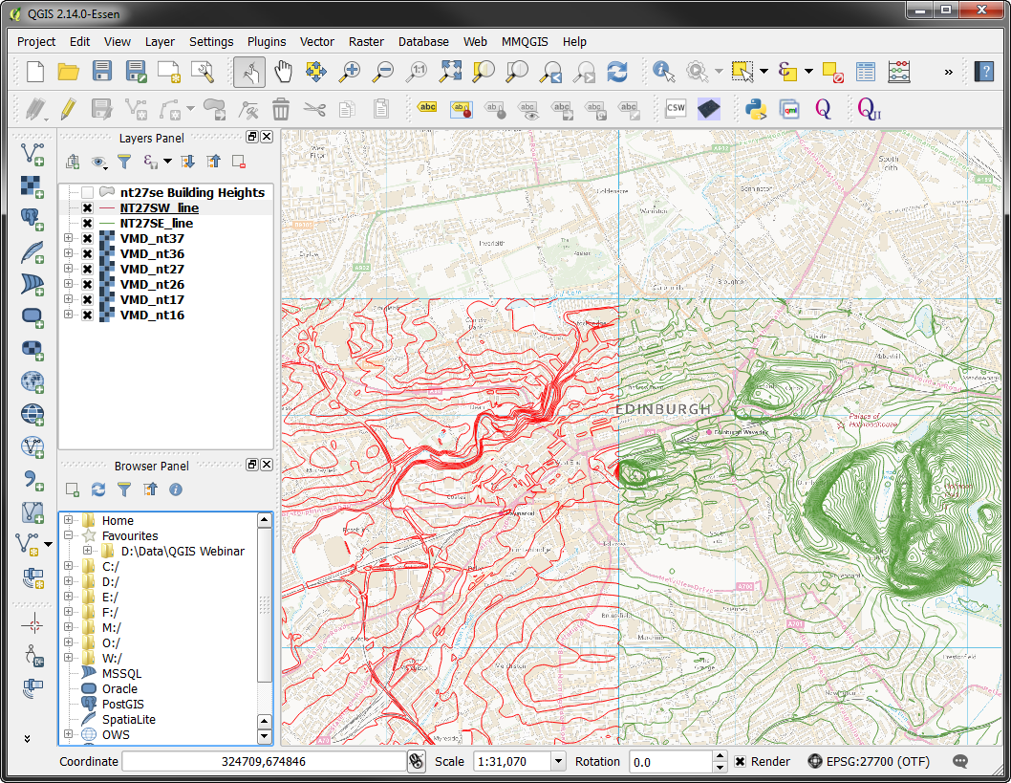
Adding Shapefile Data
Click on the add vector data button:
Click Browse and locate your shapefile
Click Open:
Notes:
Data should display automatically. If it is not visible, right click on a Layer and click “Zoom to Layer”

Slide 24
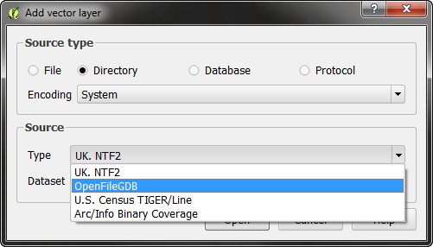
Adding File Geodatabase Data
The File Geodatabase format from EDINA can be opened in QGIS as well as ArcGIS
Click Add Vector Layer:
Choose Directory as the Source Type
Pick OpenFileGDB
Browse to .gdb file
Click Open
Notes:
Data should display automatically. If it is not visible, right click on a Layer and click “Zoom to Layer”

Slide 25
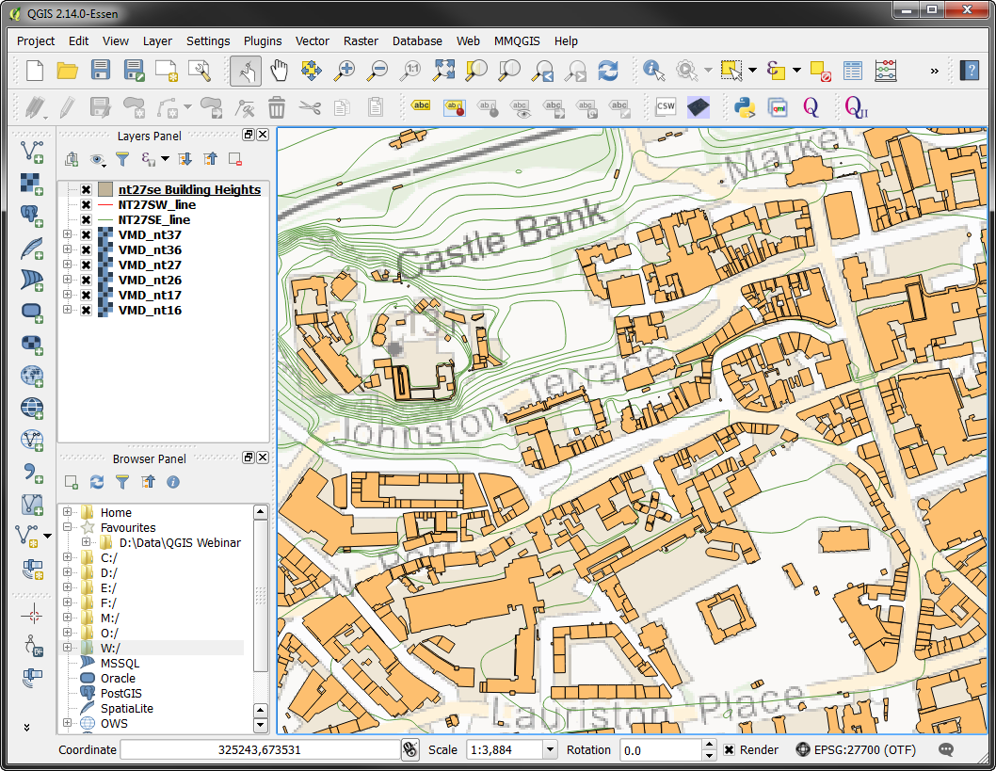
Adding File Geodatabase Data
Notes:
Data should display automatically. If it is not visible, right click on a Layer and click “Zoom to Layer”

Slide 26
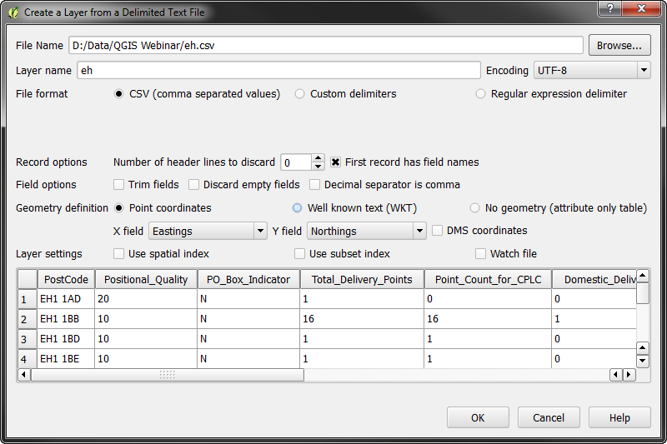
Adding CSV Data
Click on the add csv data button:
Click Browse and locate your csv data
Select the columns that contain spatial data:
Notes:
Data should display automatically. If it is not visible, right click on a Layer and click “Zoom to Layer”

Slide 27
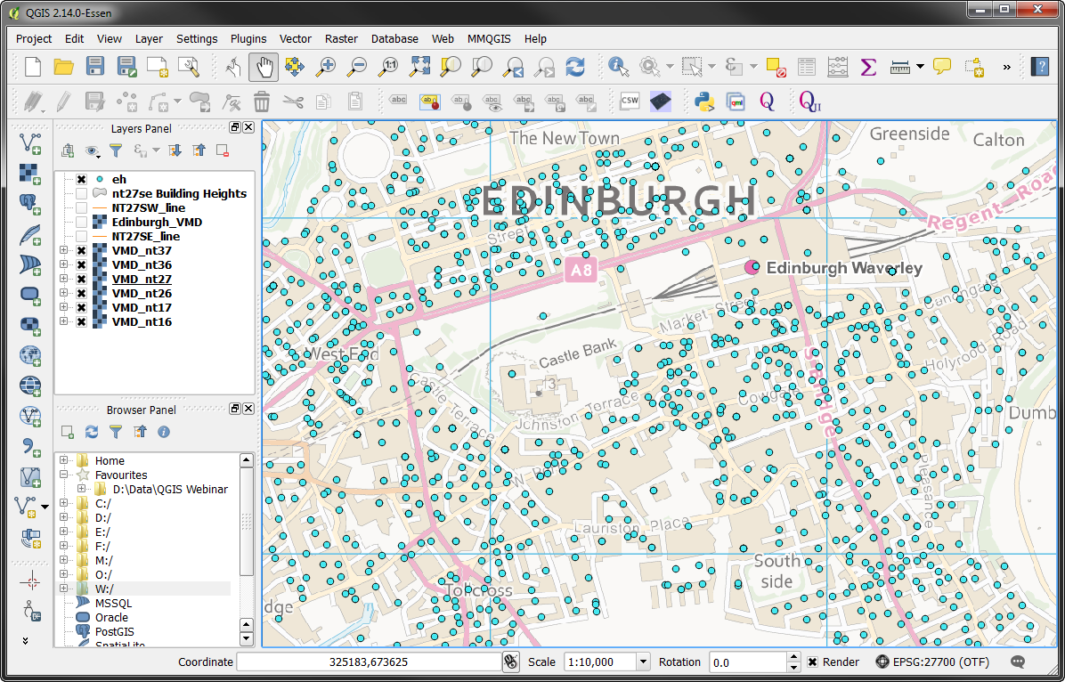
Adding CSV Data
The points will be displayed on the map:
Notes:
Data should display automatically. If it is not visible, right click on a Layer and click “Zoom to Layer”

Slide 28
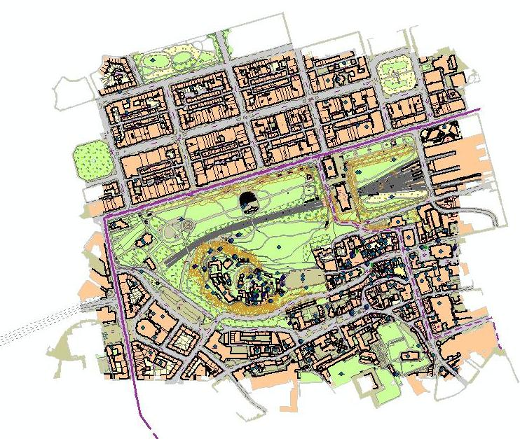
Styling Vector Data in QGIS
Vector data (e.g. OS MasterMap, OS VectorMap Local) will not have the same appearance as it does in Digimap, when viewed in QGIS
May want to consider styling the data to emphasise certain things on the map, or to try and match the OS cartographic style
Notes:
By default, data loaded into ArcGIS will have minimal styling. You need to set up styling to make it look like a map.

Slide 29
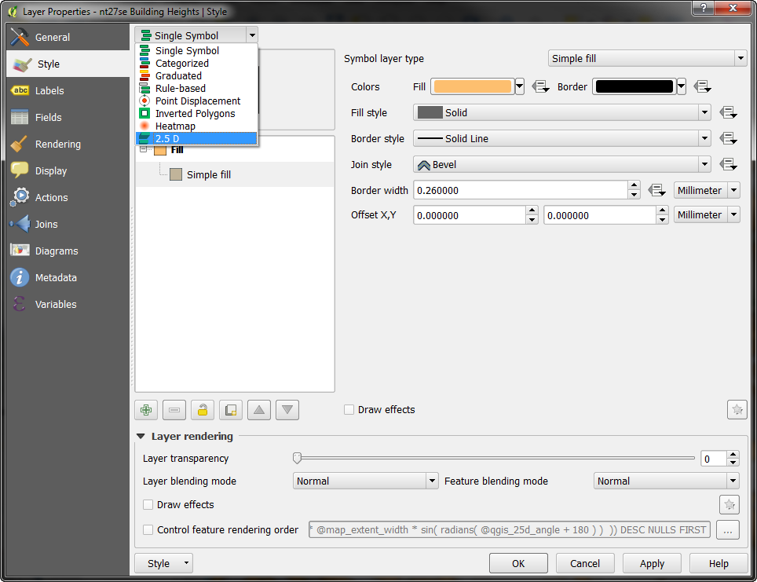
Styling options
In QGIS – do this in Style tab of map layer properties:
You can apply your own style to all features or base a scheme on categories or values in the attribute data.
There is even 2.5D and heatmap options

Slide 30
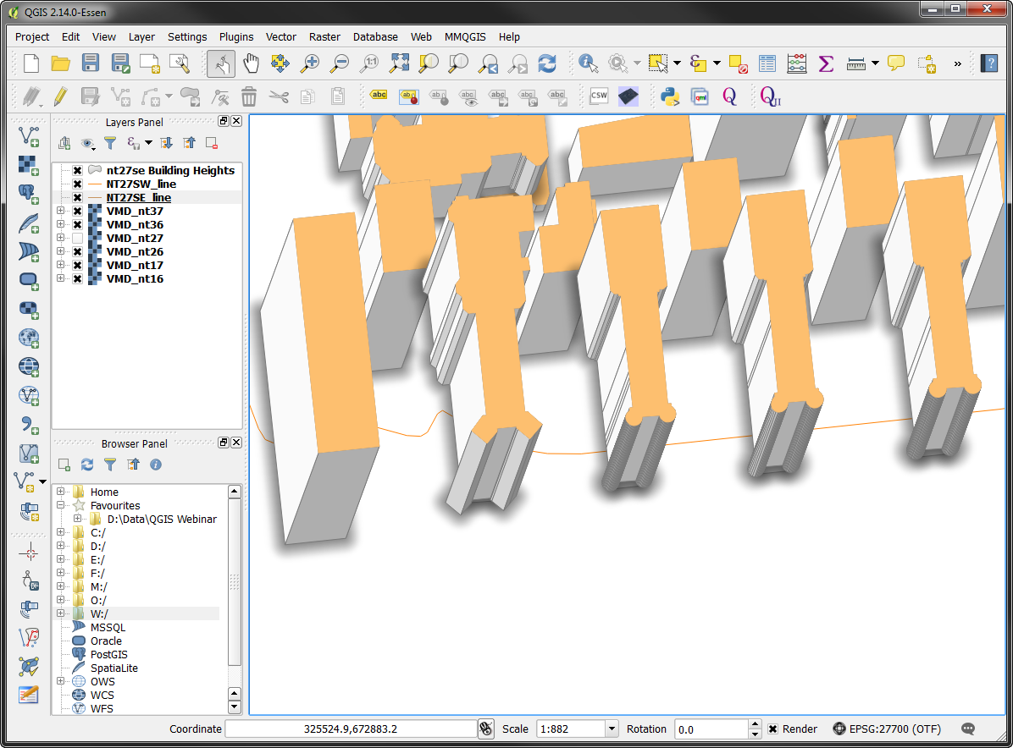
Styling options

Slide 31
Style files
Digimap provides style files for some vector data products
Look on the product information page
Click More Info on the Data Download Information box
Some products have the Symbology file in the download zip

Slide 32
Common Geoprocessing Tools
Merge Vector Tiles
Merge Raster Tiles
Clip

Slide 33
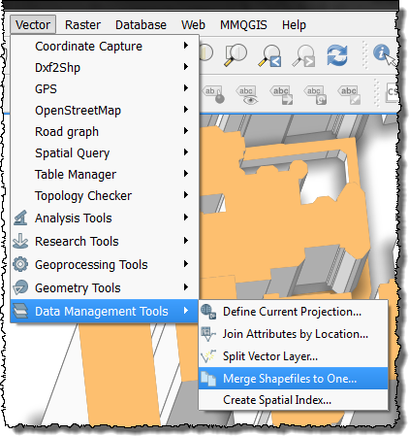
Vector data – Merge tool
Where your download area covers multiple tiles, possible to merge the tiles into one
Image: OS Terrain contours before merging (SE England)

Slide 34
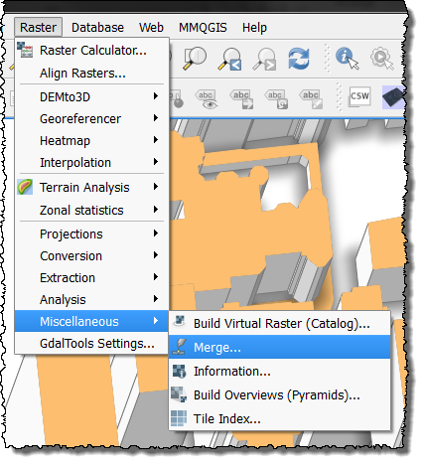
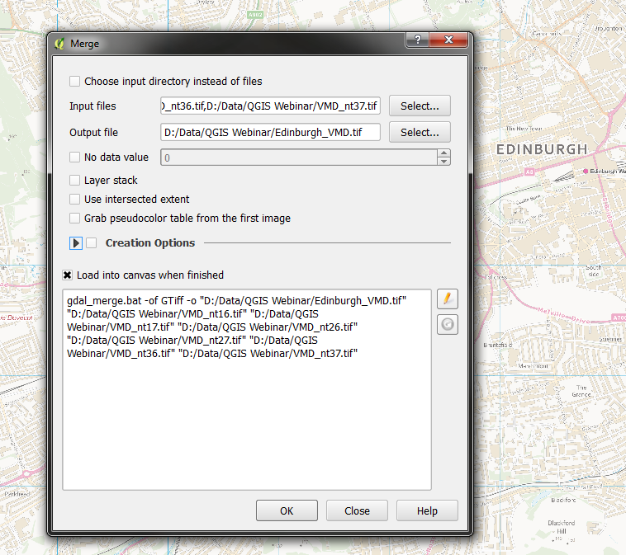
Raster data – Merge tool

Slide 35
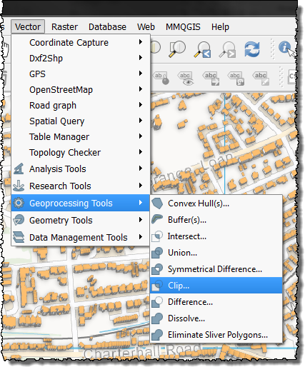
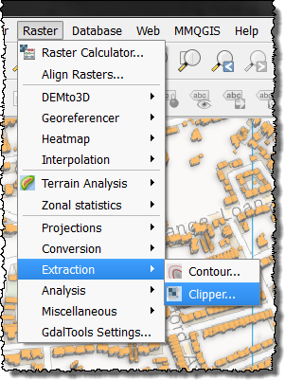
Clip tool
Where tiles are provided in large sizes e.g. 100 x 100 km, possible to clip them to smaller area
To use the vector clip tool, necessary to have a file of the smaller area to use as the guide

Slide 36
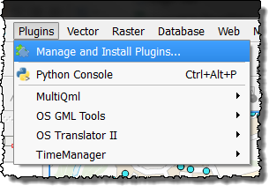
Plugins
QGIS has extended functionality through its Plugins
Some are loaded by default e.g. Heatmap
They are accessed from the plugin menu
Here are some of our favourites:

Slide 37
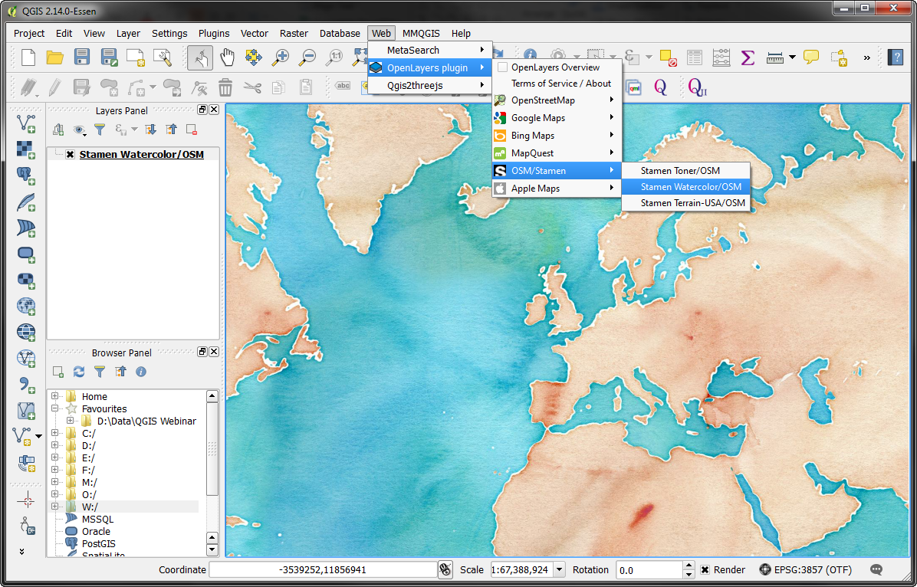
Openlayers Plugin
Allows you to display data from the web, like Google or Bing maps or OpenStreetMap data in a range of styles:

Slide 38
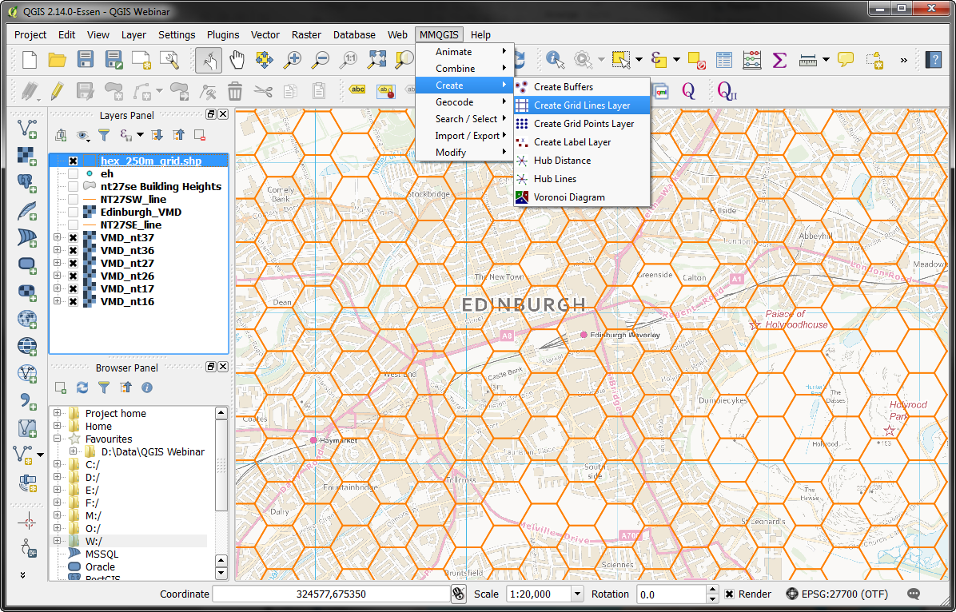
MMQGIS
Many different features to explore but we like the create grid layer, great for creating hexagons:

Slide 39
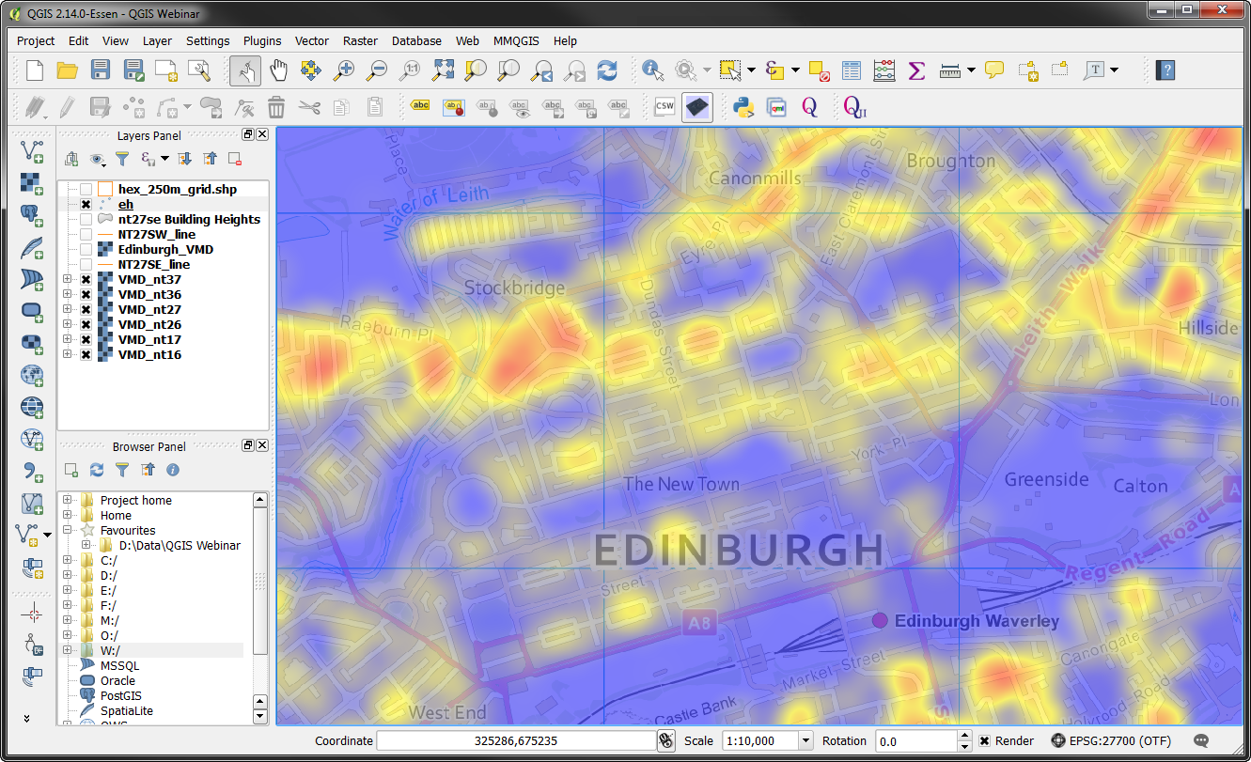
Heatmap
Adds the ability to view datasets as a heatmap
Select it from the Style tab, this is postcodes weighted by domestic delivery points

Slide 40
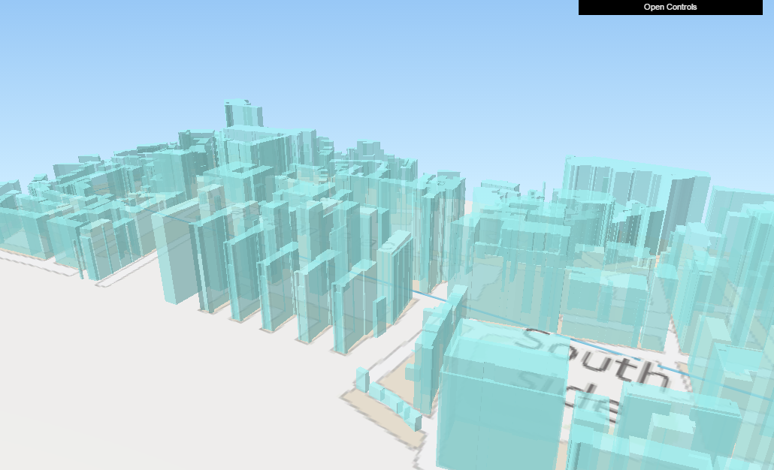
QGIS2ThreeJS
This opens in a web browser so can be shared easily

Slide 41
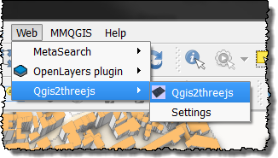
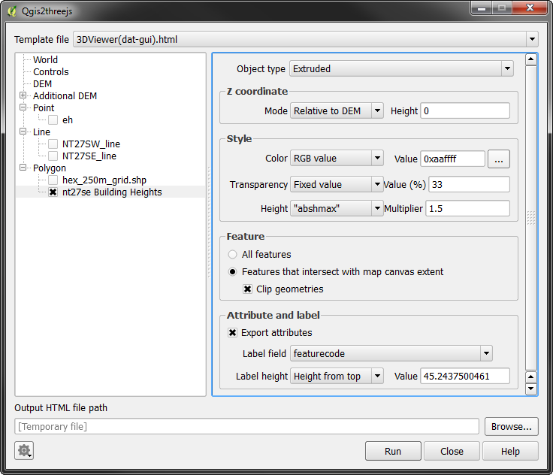
QGIS2ThreeJS
Adds the ability to create a 3D scene from your data
It is relatively easy to set up

Slide 42
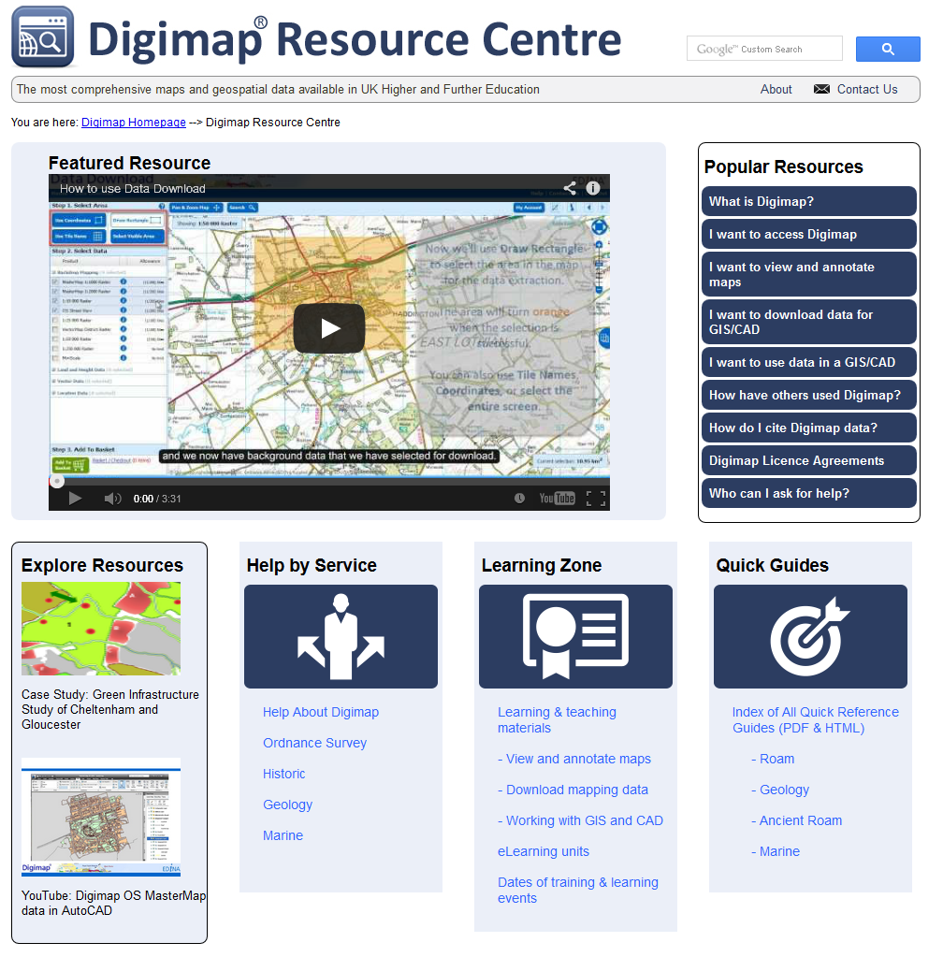
Resources
Digimap Resource centre – access help pages, guides, FAQs, videos, case studies and more.

Slide 43
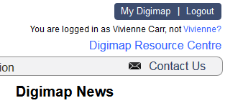
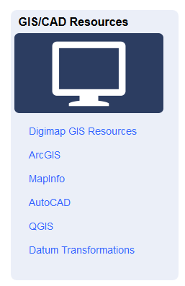
Help pages
Digimap Resource centre: http://digimap.edina.ac.uk/webhelp/resources/index.html

Slide 44
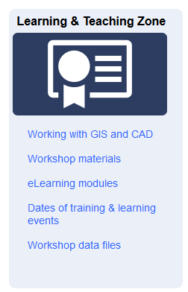
PDF exercises
Exercises available for download
PDF step by step
Some with data provided

Slide 45
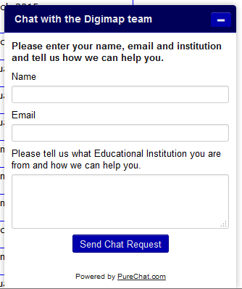
Chat
Usually manned in office hours.

Slide 46
Poll
Today’s webinar:
I learnt something new
I didn’t learn anything new
Was a good use of my time
Was a poor use of my time
Other

