Slide 1
Environment Digimap Webinar
Guy McGarva & Tom Armitage
EDINA Geoservices Support
9th December2015
We will begin at 1pm

Slide 2
Content
What data is available in Environment Digimap?
What can I do with Environment Roam?
How do I use Environment Download?
What can I do with data?
Copyright and Resources

Slide 3
Poll
What is the one thing you most want to learn today?
What data is available in Environment Digimap?
How do I get the data from Environment Digimap?
How do I create a map in Environment Digimap?
Other

Slide 4
Environment Digimap Service
JISC funded service
Land Cover data from Centre for Ecology and Hydrology (CEH)
The Land Utilisation Survey of Britain by Dudley Stamp
Raster and Vector CEH data available for different years
Environment Roam: view print and annotate maps
Environment Download: download raster and vector data for use in GIS

Slide 5
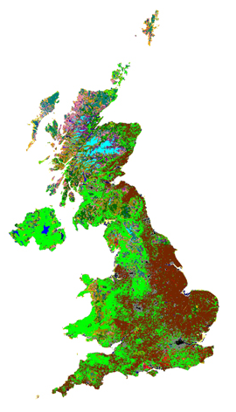
What data is available?
For Mapping and Download:
CEH (Centre for Ecology and Hydrology) data
Land Cover Map 2007
Vector
Raster (gridded) 25m and 1km
Land Cover Map 2000
Vector
Raster (gridded) 25m and 1km
Land Cover Map 1990
Raster (gridded) 25m and 1km
For Mapping only:
- Dudley Stamp Land Utilisation Survey of the 1930s Land Use maps at scales 1:625,000 and 1:63,360
UK Coverage

Slide 6
Data Characteristics
Vector data (polygons represent parcels of land)
Scale: Minimum Mappable Unit for land cover parcels: 0.5ha. (5,000 sq metres)
Supply Format: ESRI® Shapefile format
Coverage: UK
Raster data (Broad Habitat for each pixel)
Scale: 25m and 1km pixel size
Supply Format: GeoTiff (2000, 2007), ArcInfo Raster (1990)
Coverage: UK (includes NI)

Slide 7
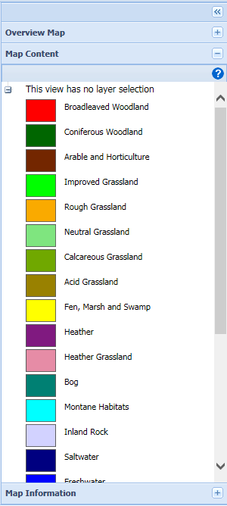
Environment Roam (demo)
Legend available in Map Content tab

Slide 8
Environment Roam
By default shows the Land Cover 2007 map
Can zoom in/pan/search etc.
Change Basemap to show 2000, 1999 and Dudley Stamp 1930s
Use Opacity slide to fade background
Print map to PDF, JPG or PNG at user defined scale
Add Legend to printed map

Slide 9
Change data being viewed
Use “Basemaps” to view a different product

Slide 10
e.g. to Dudley Stamp maps

Slide 11
Print maps to PDF, PNG, JPG

Slide 12
But if you want the data…
You need to download the data for analysis and use in a GIS or CAD system
Where you can:
use your own colours
query the data
combine it with other datasets
overlay it with terrain data (DTM), geology data, soil data etc.
Use..

Slide 13
Environment Download (demo)
Select Area and Products

Slide 14
Select multiple products at the same time
Note: they come in different formats and some are quite large as some are national datasets.

Slide 15
First email is confirmation of order

Slide 16
Click on button in second email

Slide 17
From Environment Download click the Download button

Slide 18
Zip file will contain multiple folders

Slide 19
Add the data to your GIS (demo)
Vector data will have attributes for each land parcel
Load layer file supplied with the data to get the correct colours

Slide 20
Raster data
Load up the Layer file supplied with the data to get the correct representation and category names
Less attributes

Slide 21
Poll
What software do you use regularly with map data? Tick ALL that apply.
QGIS
AutoCAD/AutoCAD Map 3D
ArcGIS
Other

Slide 22
Permitted Uses
Summarised as for Educational Purposes:
Teaching, academic research, limited internal business use
Includes institutional publicity
Public lectures
Conference demonstrations
Private study/personal development including student societies work
Teaching practice (B.Ed. PGCE etc)
Excludes:
Institutional estate management
Running the institution as a business
Courses for commercial gain
Notes:
Limited internal business use e.g. can put a ‘How to Find the College’ map in the prospectus or on your website but cannot use it for estate planning.

Slide 23
Publication
You can publish Licensed Data and materials which contain Licensed Data
Subject to some restrictions which are detailed in each licence Includes various publications
Copyright acknowledgement required:
For 2007 data: LCM2007 © and database right NERC (CEH) 2011. All rights reserved. Contains Ordnance Survey data © Crown copyright and database right 2007. © third party licensors.
For 2000 and 1999 data: © NERC (CEH)
Included on all maps printed from Digimap Collections.
Remember to include copyright acknowledgement if you download data from Digimap and create maps!

Slide 24
Quick Questions
Where can I find a legend?
See our Help pages:
http://digimap.edina.ac.uk/webhelp/environment/data_information/landcover_data.htm or print one from Roam
Can I compare land cover over time?
“Owing to improvements in satellite mapping technology and data collection methods, comparisons of the 1990, 2000 and 2007 datasets to detect change over time must be treated with caution. Many changes appear because of the improvements in the methodologies used to create the data and do not necessarily reflect actual change on the ground.”

Slide 25
Support
Lists of Frequently Asked Questions:
http://digimap.blogs.edina.ac.uk/digimap-q-a/
Your site representative:
http://digimap.edina.ac.uk/webhelp/digimapsupport/service_info/site_rep_list.htm
EDINA Help Desk:
edina@ed.ac.uk
0131 650 3302

Slide 26
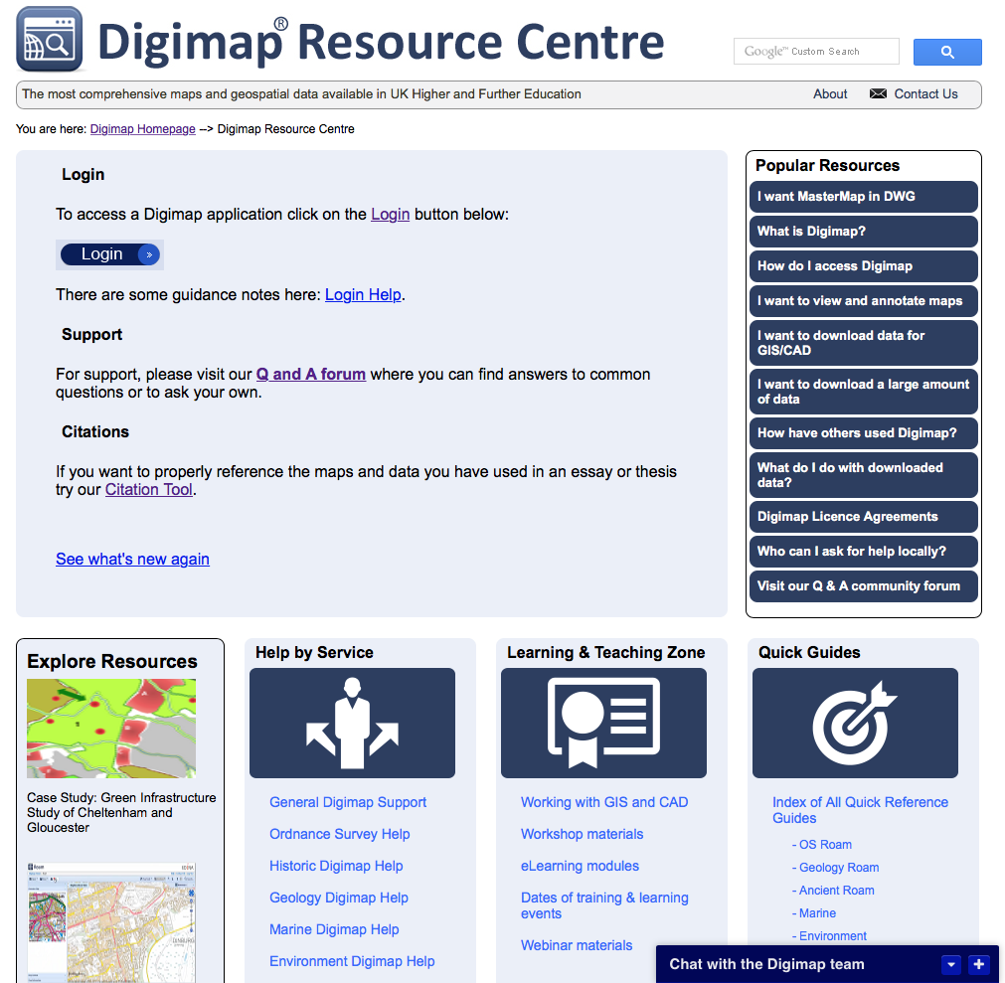
Resources
Digimap Resource centre – access help pages, guides, FAQs, videos, case studies and more.
Resources list in blue section of your booklet
http://digimap.edina.ac.uk/webhelp/resources/index.html

Slide 27
Final Poll
Today’s webinar:
I learnt something new
I didn’t learn anything new
Was a good use of my time
Was a poor use of my time
Other

