Slide 1
Learn about… Using CAD with Digimap data
Ian Holmes and Guy McGarva
EDINA Geoservices Support
15 November 2017

Slide 2
Follow-up
After the webinar, we will send you links to:
Webinar Recording (YouTube)
Slides
Transcript of all Questions and Answers
Feedback form

Slide 3
Content
Datasets available in CAD format
How to access the data
Using the data in AutoCAD

Slide 4
Poll
What is your current status at your institution?
Undergraduate
Postgraduate
Support staff
Academic staff
Other

Slide 5
What data is available in CAD format?
Vector datasets | CAD formats
MasterMap Topography Layer Standard - full colour style Plan - outline style | DWG
MasterMap Sites Layer | DWG
MasterMap Building Height Attribute (BHA) | DWG
VectorMap Local | DWG
Strategi | DXF
Meridian 2 | DXF
http://bit.ly/OS_Formats

Slide 6
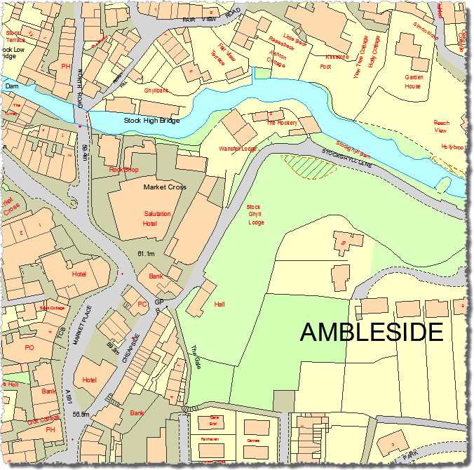
OS MasterMap Topography Layer
MasterMap Topogaphy Layer (DWG format)
Most detailed mapping from OS
Good for large scale projects covering small areas
Fully polygonised covering the whole of GB
Maps the type of features found on the ground
Two flavours:
Full colour (polygons)
Plan/outline (line work)
© Crown Copyright and Database Right 2017. Ordnance Survey (Digimap Licence)

Slide 7
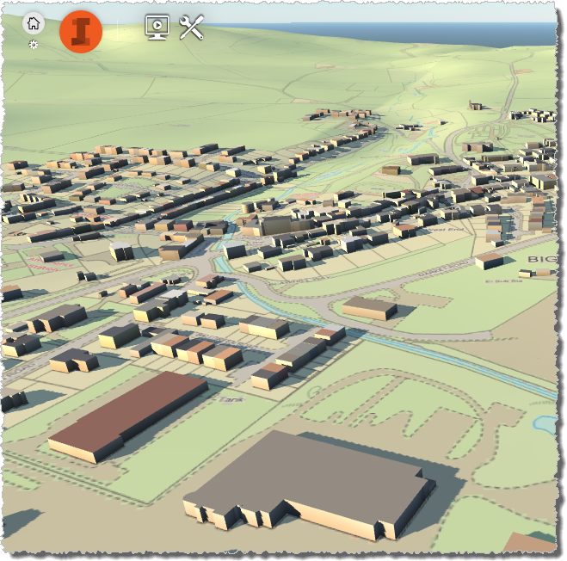
Building Height Attribute
Released by OS in March 2014
Last updated December 2014
Alpha release – no guarantee error free
Incomplete coverage, currently only major towns and cities: http://bit.ly/BuildingHeightsCoverage
In future will be included in Topography layer
© Crown Copyright and Database Right 2017. Ordnance Survey (Digimap Licence)

Slide 8
Building Height Attribute
Base height: AbsHMin
‘Roof’ height: AbsH2
All attributes included as Xdata
Need to use with a DTM surface otherwise buildings will be floating in mid air

Slide 9
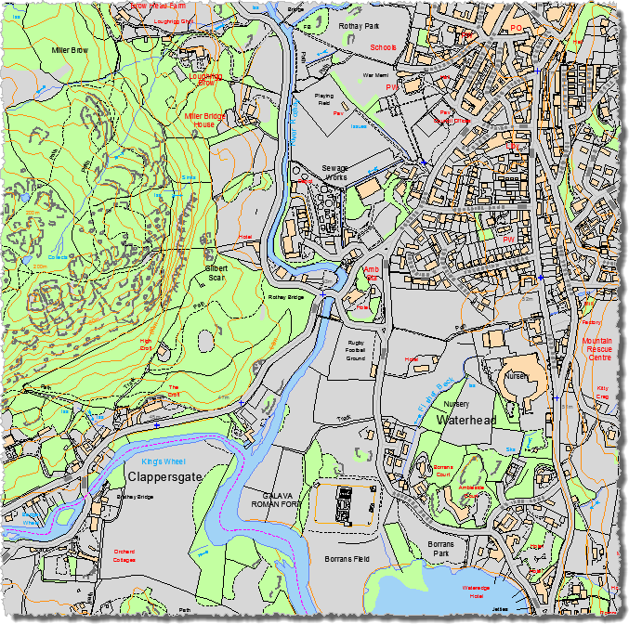
VectorMap Local data
VectorMap Local (DWG format)
Designed for display at 1:10,000 scale
Good for smaller scale, town level projects
Includes contours and spot heights
© Crown Copyright and Database Right 2017. Ordnance Survey (Digimap Licence)

Slide 10
What data is available in CAD format?
Height (terrain) datasets | CAD formats
Terrain 5 DTM | ASC and XYZ
Terrain 5 Contours | DWG
Terrain 50 DTM | ASC
Terrain 50 Contours | SHP or GML
*Land-Form PROFILE DTM and contours | DXF
*Land-Form PANORAMA DTM and contours | DXF
* Land-Form PROFILE and PANORAMA have been withdrawn by Ordnance Survey and are no longer updated.
http://bit.ly/OS_Formats

Slide 11
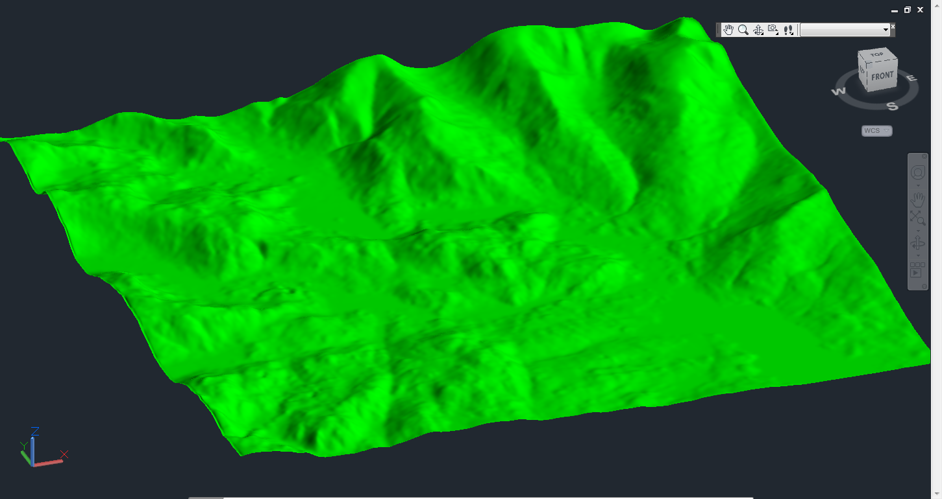
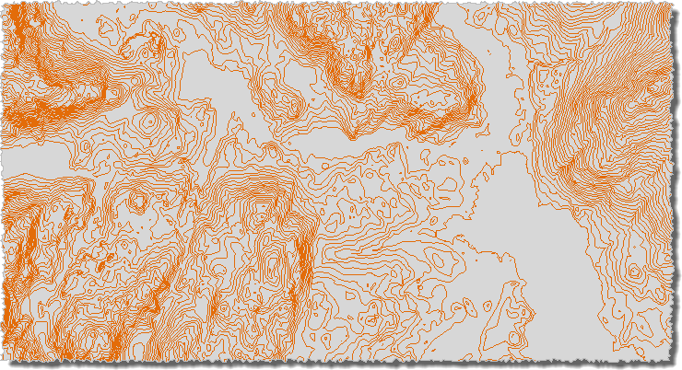
Height Data
Terrain 50 DTM
Various Raster (DTM) and Vector (contour) datasets available:
Terrain 5
Contours at 5 metre interval
DTM with 5m cell size
Terrain 50
Contours at 50m interval [not available in native CAD format]
DTM with 50m cell size
Land-Form PROFILE [DXF] – withdrawn by OS
Land-Form PANORAMA [DXF] – withdrawn by OS
© Crown Copyright and Database Right 2017. Ordnance Survey (Digimap Licence)
Terrain 50 Contours
© Crown Copyright and Database Right 2017. Ordnance Survey (Digimap Licence)

Slide 12
What data is available in CAD format?
Backdrop mapping | CAD formats
MasterMap Topography Layer Raster | TIFF
VectorMap Local Raster | TIFF
1:25,000 Colour Raster | TIFF
1:50,000 Colour Raster | TIFF
VectorMap District Raster | TIFF
Aerial imagery | JPEG
http://bit.ly/OS_Formats

Slide 13
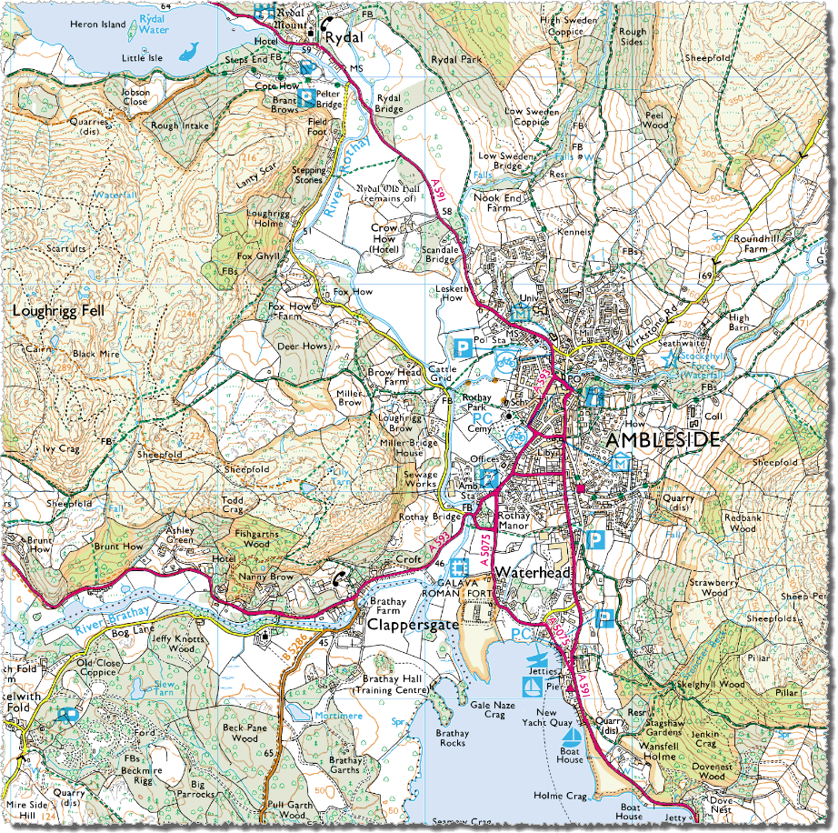
Backdrop mapping
1:25,000 Colour Raster
10 products available
Raster maps – useful as backdrop
All in TIFF image format
Largest scale is raster version of MasterMap Topography Layer at 1:1,000
Smallest scale is MiniScale at 1:1,000,000
© Crown Copyright and Database Right 2017. Ordnance Survey (Digimap Licence)

Slide 14
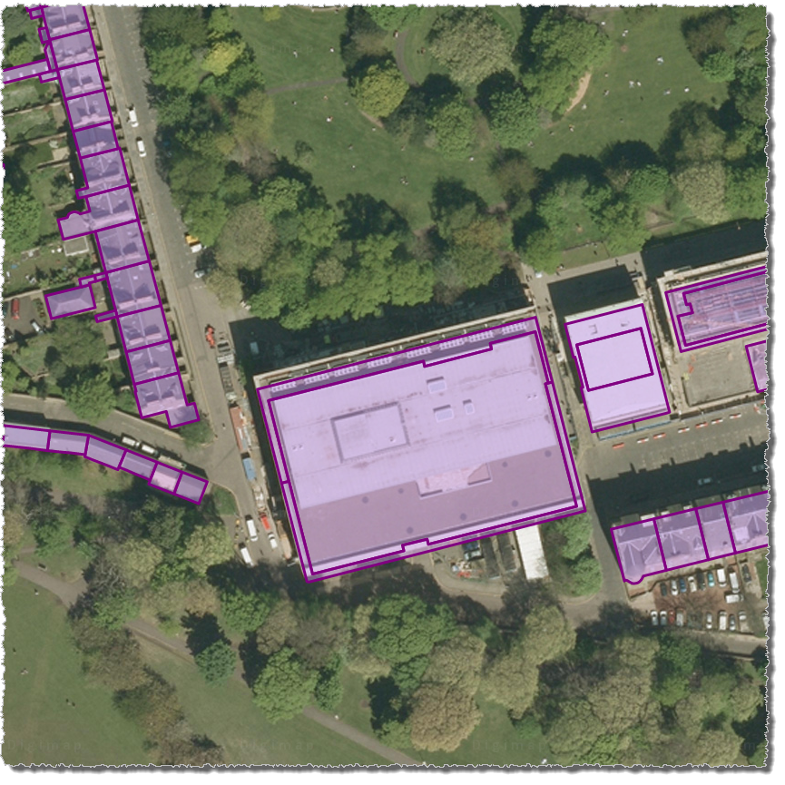
Aerial Imagery
Aerial imagery with buildings from OS MasterMap
25cm resolution vertical aerial imagery
JPEG format
Various fly dates
© Getmapping Plc
© Crown Copyright and Database Right 2017. Ordnance Survey (Digimap Licence)

Slide 15
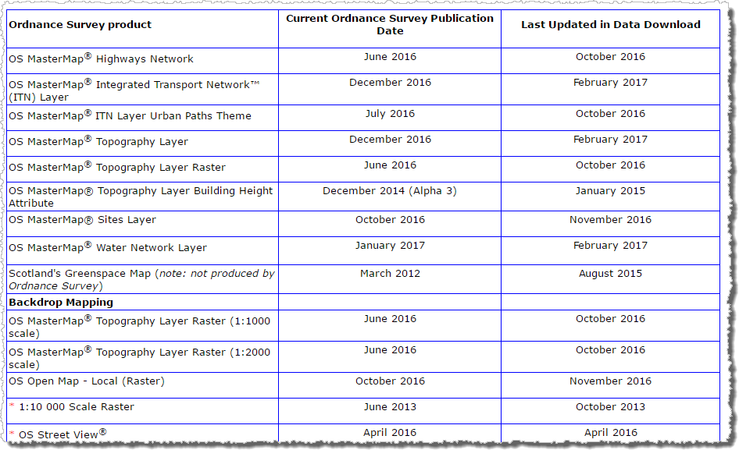
Update Frequency
Digimap > OS Help > Data Information > Data update dates
http://bit.ly/OSUpdates

Slide 16
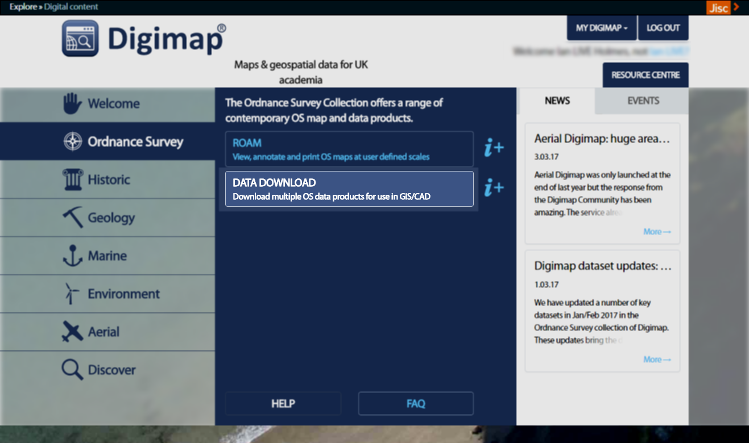
Where do I get the data?
Ordnance Survey > Data Download
Download OS mapping data for use in GIS/CAD

Slide 17
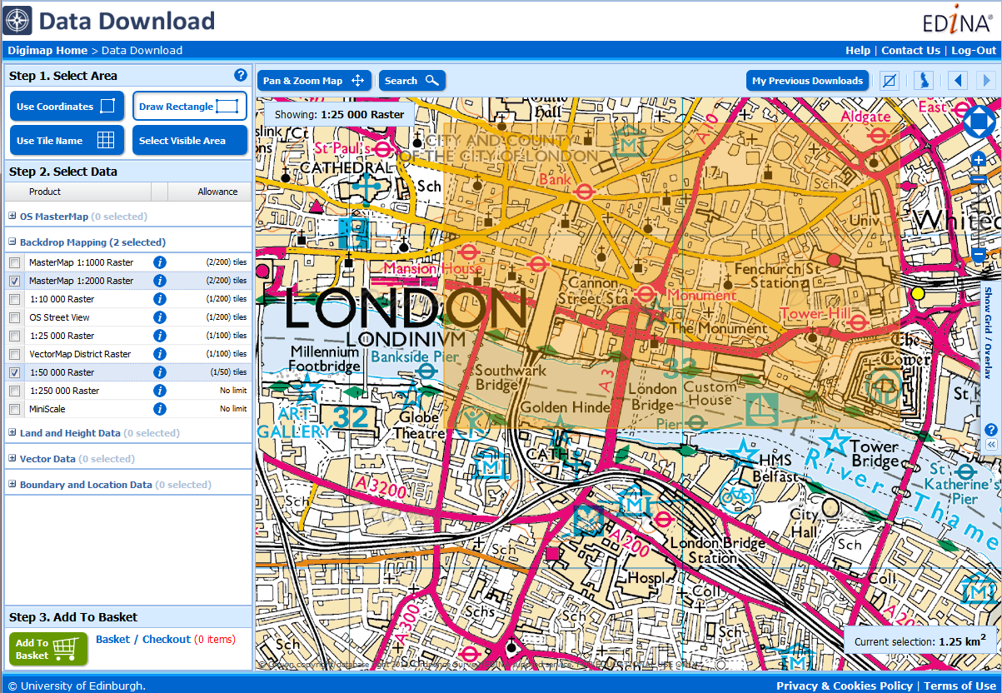
Data Download
All available OS map data
Download several map products in one order
5 categories of map data
3 steps to order map data

Slide 18
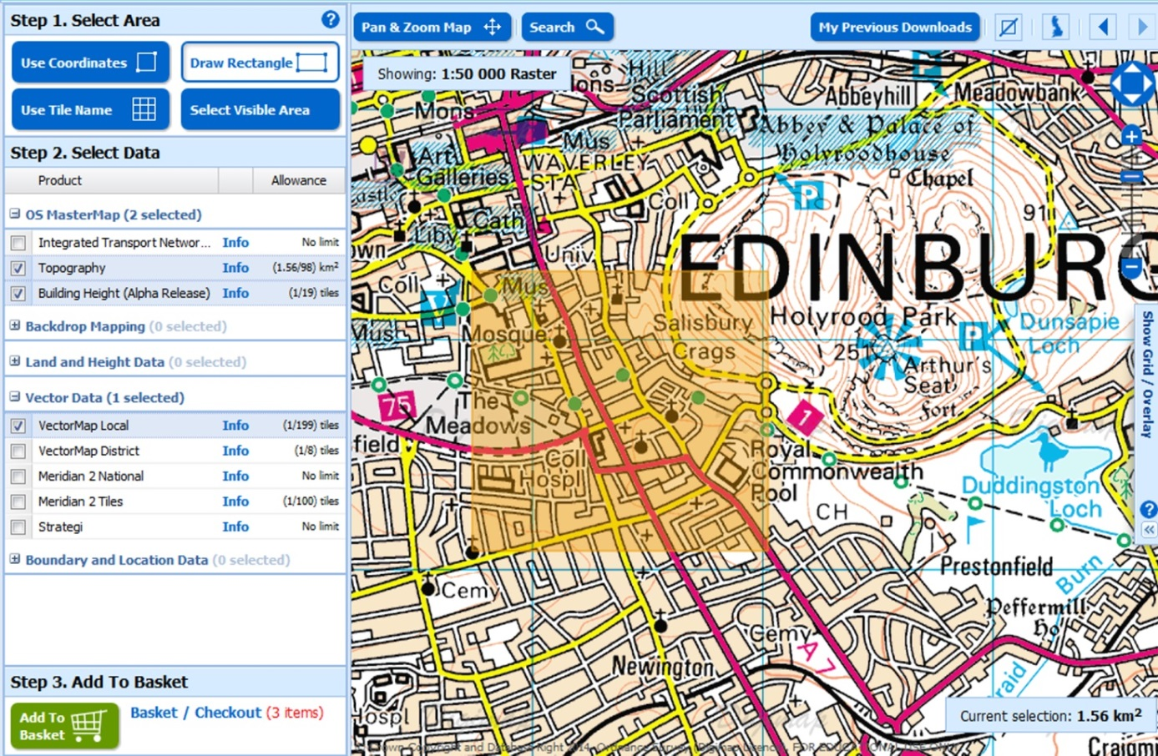
Using Data Download
Three step process:
Select area
Choose data
Add to basket
Options to change format, version and layers
Notes:
It’s straightforward to use Data Download – ordering map data involves 3 steps:
Select your area on the map – there are 4 methods for selection. The shaded orange area you see here is our selected area.
Select the map data that you wish to download. You can open any category of map data by clicking on the name. Then it’s a matter of ticking the box next to any map data you wish to download. You can download as many as you like in an order, provided you do not exceed the allowances. There is an allowance for each map data product – in order that our servers can process orders as quickly as possible.
Third step is to add to basket. Once you click the add to basket button, your basket pops up on screen. You can then select from different formats, date versions and map layers, where available. Options will different depending on map product.

Slide 19
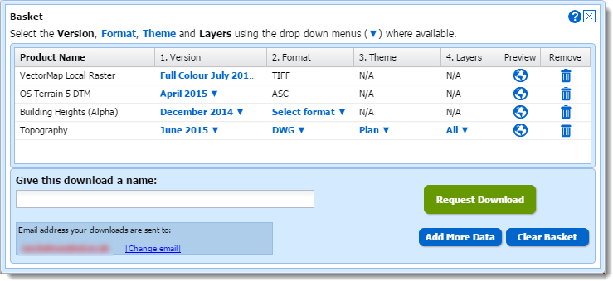
Basket options
Dataset options:
Version – dataset version as released by Ordnance Survey
Format – note different datasets available in different formats
Theme – some datasets are available in different styles e.g. full colour and line drawing
Layers – use this to download some features from the full dataset, e.g. just building features from OS MasterMap Topography Layer

Slide 20
Poll
What software do you use regularly with map data? Tick ALL that apply.
AutoCAD
AutoCAD Map 3D
VectorWorks
ArcGIS
Other

Slide 21
How do I use the data?
Viewing MasterMap Topography Layer
Two styles: full colour and plan/outline
Attributes stored as Extended Attribute Data (Xdata)
Viewing MasterMap Building Height Attribute
Buildings floating in mid air
Attach Terrain 5 contours
Lots of work done to ensure all datasets align correctly
All data in British National Grid
All data uses metres as unit of measurement
3D visualisation with Building Height Attribute in InfraWorks

Slide 22
Add OS MasterMap topography to AutoCAD
DWG format:
Will open directly in AutoCAD products
Includes default OS representation
Attributes stored as Extended Attribute Data (Xdata), which is not easy to interrogate
GML format:
Can be imported in to AutoCAD
Minimal representation
Control over which features are imported
More detailed attribute analysis possible
Can control the order in which layers are drawn

Slide 23
3D visualisation with Building Height Attribute (BHA)
Download the following from Digimap:
Building Height Attribute in DWG format;
DTM surface (e.g. Terrain 5 or Terrain 50);
Any other backdrop mapping as required (e.g. Aerial Imagery or MasterMap Raster).
Can be viewed in a variety of packages including AutoCAD Map 3D or InfraWorks.

Slide 25
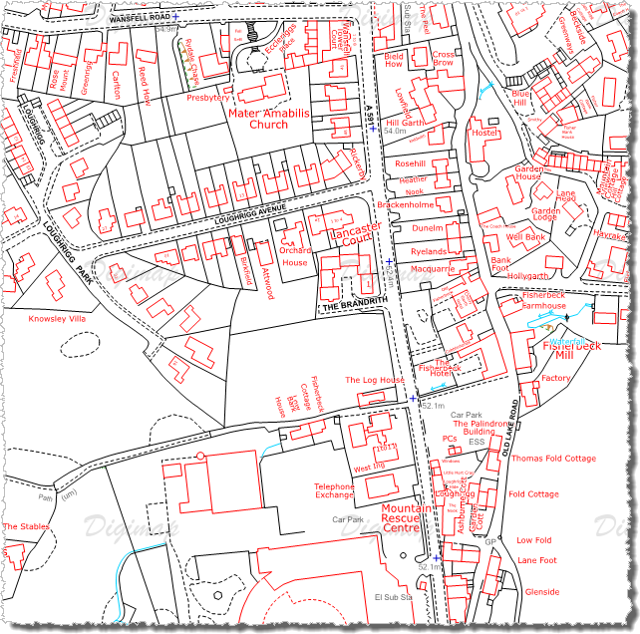
Recent developments
OS Terrain 5 DTM in XYZ format
Standardised all DWG data to use British National Grid so that they overlay correctly
Release of Aerial Digimap
Release of Lidar Digimap
If there is anything you would like to see added to the service, please send your suggestions to edina@ed.ac.uk!

Slide 26
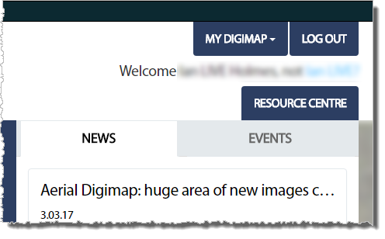
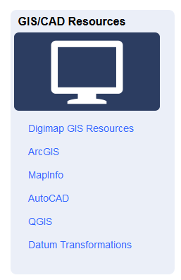
Resources
Digimap Resource centre: http://digimap.edina.ac.uk/webhelp/resources/index.html

Slide 27
AutoCAD pages

Slide 28
Questions?

