Slide 1
Learn about… Lidar Digimap
Ian Holmes and Tom Armitage
EDINA Geoservices Support
6 June 2018

Slide 2
Follow-up
After the webinar, we will send you links to:
Webinar Recording (YouTube)
Slides
Transcript of all Questions and Answers
Feedback form

Slide 3
Content
Overview of LiDAR data
LiDAR datasets available
How to access the data
Uses of LiDAR data

Slide 4
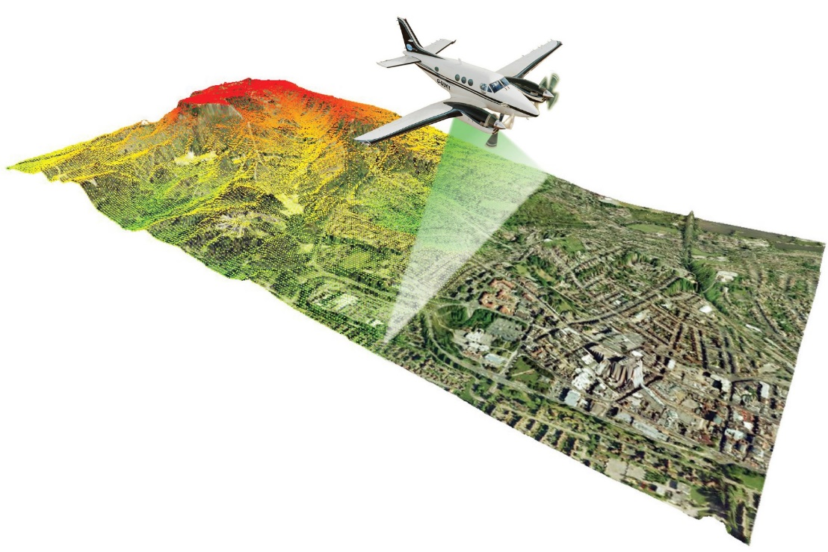
What is LiDAR data?
LiDAR = Light Detection And Ranging
Airborne process firing pulsed lasers at the ground and measuring the reflected pulses
Different materials have different reflection properties making it possible to measure both the bare ground surface and the vegetation canopy/top of man-made features
Image credit: www.pobonline.com

Slide 5
LiDAR availability
Available for the whole of GB
Data collected for flood risk modelling by three government agencies:
England – Environment Agency (EA)
Scotland – Scottish Environmental Protection Agency (SEPA)
Wales – Natural Resources Wales (NRW)
Approx. data coverage:
72% of England (EA)
20% of Scotland (SEPA)
70% of Wales (NRW)
Variable resolution:
25cm, 50cm, 1m and 2m
[OS Terrain 5 is 5m resolution]

Slide 6
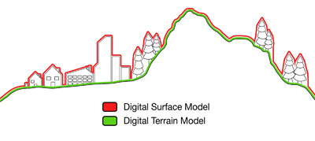
LiDAR Data: Digital Terrain Models (DTM)
Bare earth terrain model (all vegetation and buildings etc. stripped off)
Two versions:
Composite – latest available data for each area
By Year – specific data captured each year

Slide 7
LiDAR Data: Digital Surface Models (DSM)
Surface model showing all vegetation and man-made structures such as buildings, bridges etc.
Two versions:
Composite – latest available data for each area
By Year – specific data captured each year

Slide 8
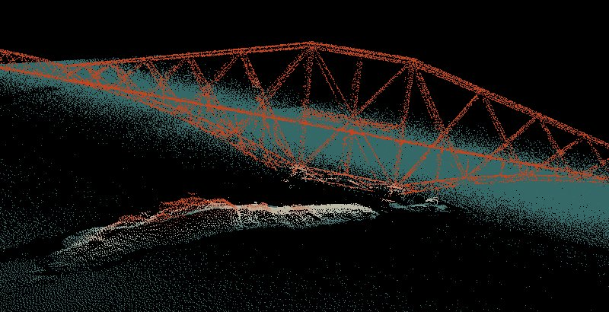
LiDAR Data: Point Clouds
Raw data captured during scanning process
Series of 3D points in space
Source data used to derive DTM and DSM
Crown copyright Scottish Government, SEPA and Scottish Water (2014).

Slide 9
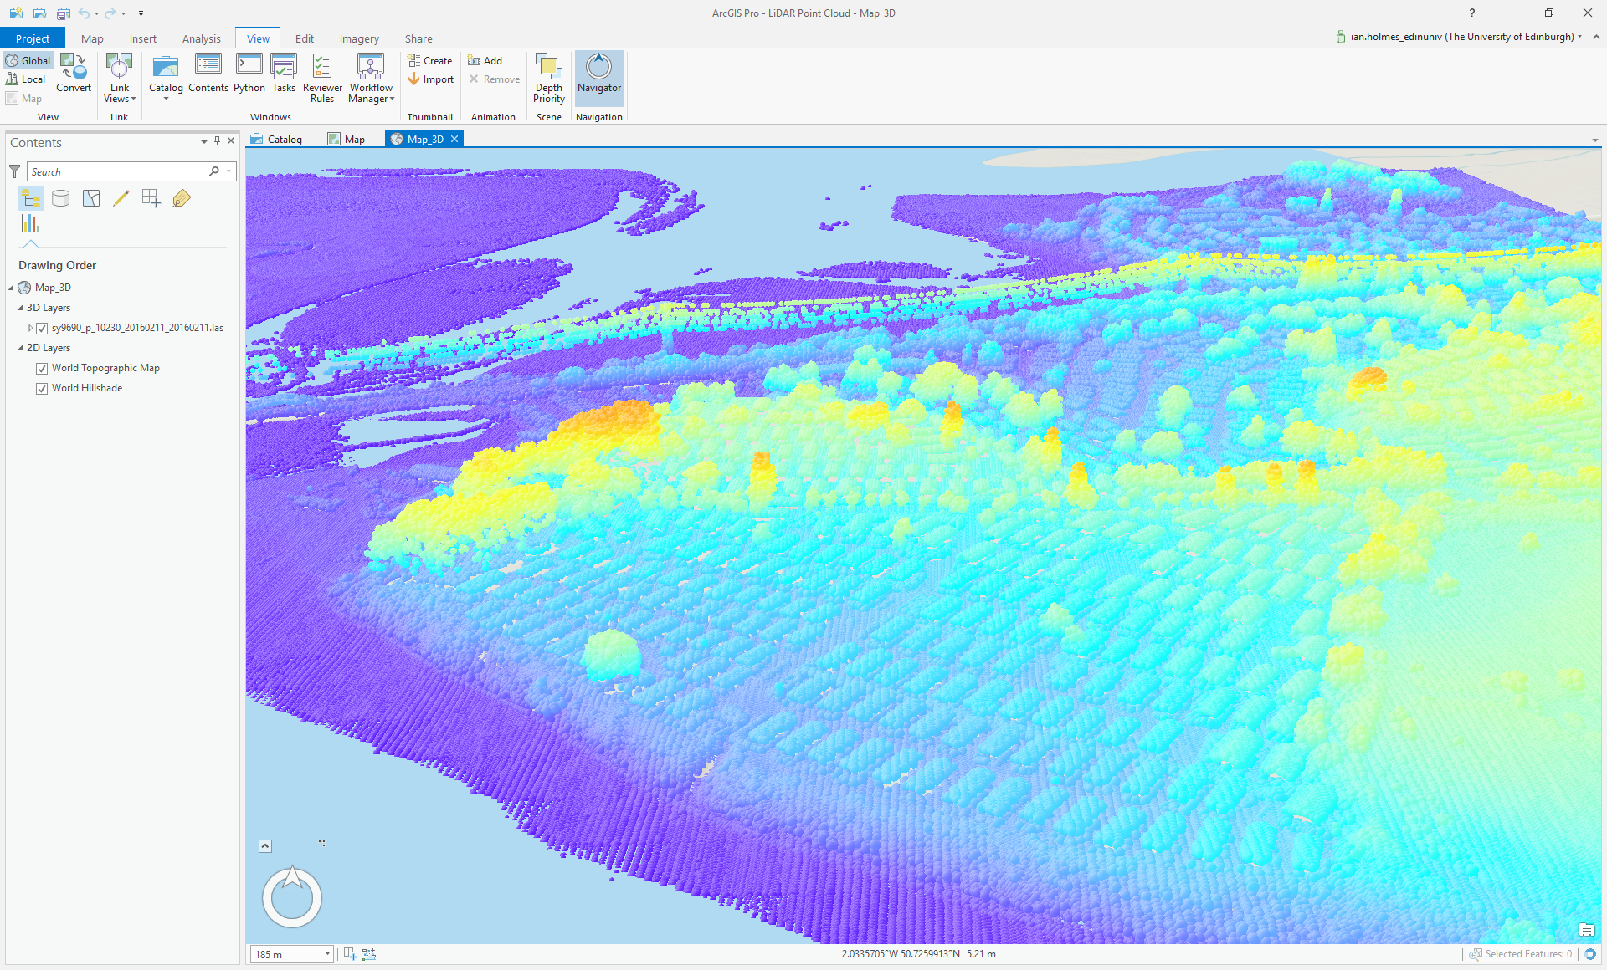
Point Cloud in ArcGIS Pro

Slide 10
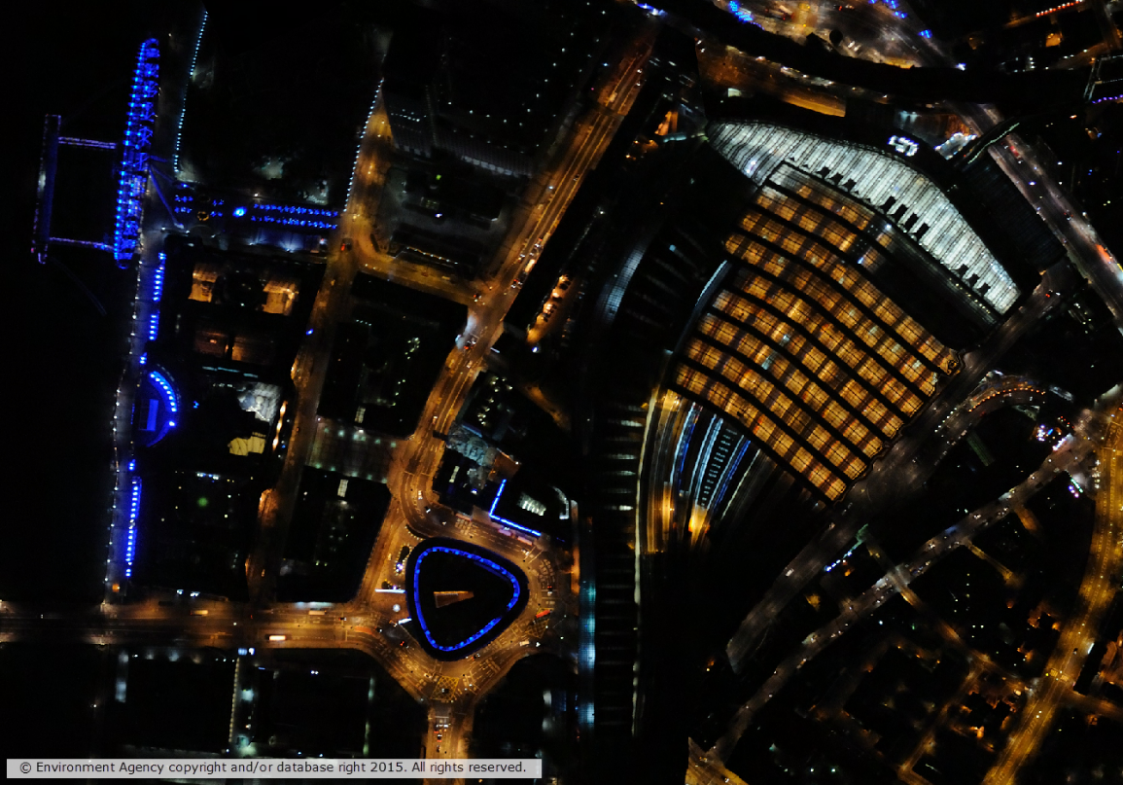
LiDAR Data: Vertical Aerial Photography
Captured during LiDAR scanning
Patchy coverage
Four versions:
True colour (RGB)
4-band (RGBN)
Near Infra-Red (NIR)
Night Time

Slide 11
Poll
What software do you use regularly with map data? Tick ALL that apply.
AutoCAD
Revit
ArcGIS
QGIS
Other

Slide 12
LiDAR data formats
Digital Terrain Model: ASC
Digital Surface Model: ASC
Point Cloud: LAZ (compressed LAS format)
Vertical Aerial Photography: ECW

Slide 13
Uses of LiDAR data
Flood modelling and coastline management
detailed data required for accurate modelling and loss calculations
Forest management, arboriculture and planning
LiDAR provides accurate tree height information
Tree height can be used to infer root expanse and compared to proximity of buildings for insurance
Archaeology
LiDAR can ‘see’ through vegetation allowing features buried beneath to be clearly visible
Vegetation studies e.g. identify tree canopy
features >2.5m at least 2m away from a building
3D modelling for scenario planning and property view shed analysis
Combine with building polygons such as OpenMap – Local to generate accurate 3D buildings

Slide 14
Future plans
Environment Agency set to capture all of England by 2020 (at least 2m resolution)
Ensure latest available data in Digimap

Slide 15
Further information sources
Using the ASCII data in QGIS: http://geophyswithsnuffler.blogspot.co.uk/2015/11/processing-uk-environment-agency-lidar.html
QGIS LiDAR training materials (free): http://www.pushingthesensors.com/teaching-materials/
Using Point Cloud data in ArcGIS: http://communityhub.esriuk.com/geoxchange/2016/5/12/using-the-environment-agency-lidar-point-cloud-data-with-the-arcgis-platform

Slide 16
Questions?

