Slide 1
Adding Fieldwork Data to Maps
Tom Armitage & Ian Holmes
GIS Trainers & Geoservices Support

Slide 2
Contents
Before you go into the field
Adding data to Digimap Roam
Exporting Annotations
Downloading Basemaps
Georeferencing & Digitising

Slide 3
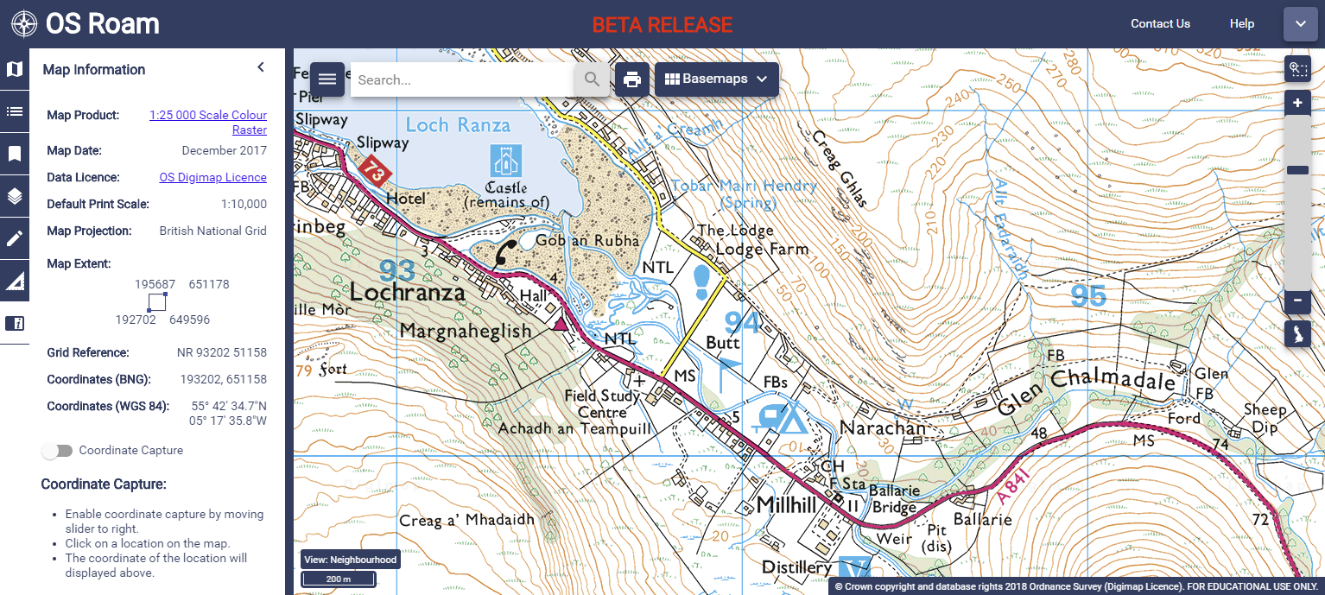
Before you go into the field
Digimap can be useful for locating points of interest:
Notes:
Developed over 17 years adding development s and collections. Most recent one being Aerial and Lidar data. For which there has been significant demand
GOOD TO KNOW HOW LONG WHOEVEVER YOU HAVE BEEN TALKING TO HAVE BEEN TAKING SERVICES
Calibre providers of data with whom we have an established relationship

Slide 4
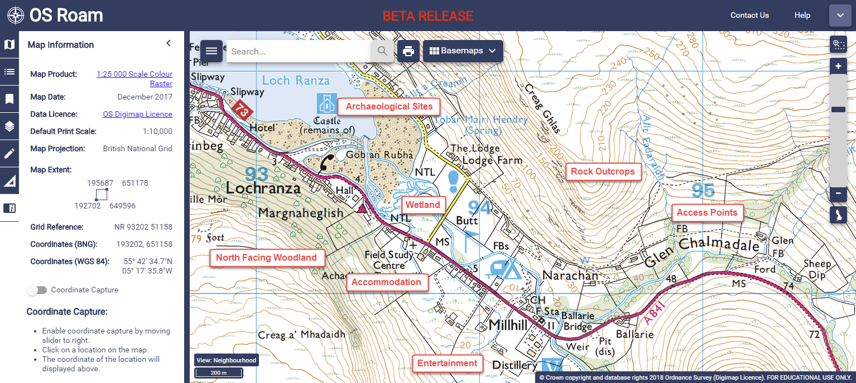
Before you go into the field
Digimap can be useful for locating points of interest:
Notes:
Developed over 17 years adding development s and collections. Most recent one being Aerial and Lidar data. For which there has been significant demand
GOOD TO KNOW HOW LONG WHOEVEVER YOU HAVE BEEN TALKING TO HAVE BEEN TAKING SERVICES
Calibre providers of data with whom we have an established relationship

Slide 5
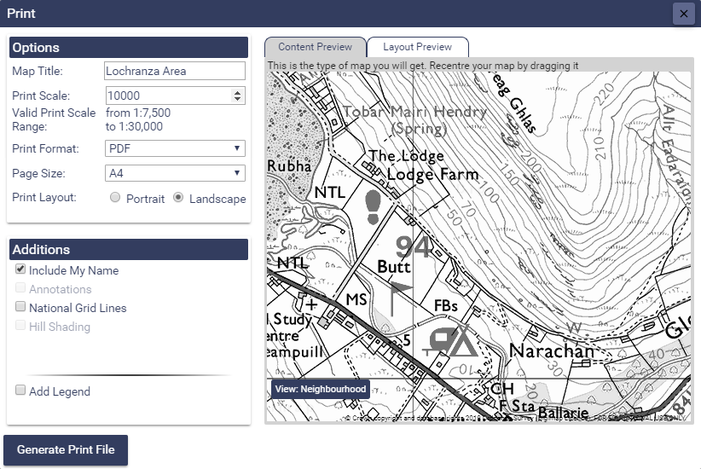
Before you go into the field
You can use the Print to create maps to take into the field:
Notes:
Developed over 17 years adding development s and collections. Most recent one being Aerial and Lidar data. For which there has been significant demand
GOOD TO KNOW HOW LONG WHOEVEVER YOU HAVE BEEN TALKING TO HAVE BEEN TAKING SERVICES
Calibre providers of data with whom we have an established relationship

Slide 6
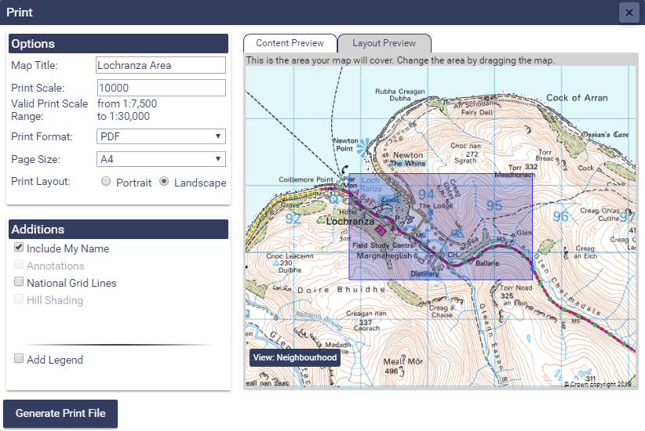
Before you go into the field
You can use the Print to create maps to take into the field:
Notes:
Developed over 17 years adding development s and collections. Most recent one being Aerial and Lidar data. For which there has been significant demand
GOOD TO KNOW HOW LONG WHOEVEVER YOU HAVE BEEN TALKING TO HAVE BEEN TAKING SERVICES
Calibre providers of data with whom we have an established relationship

Slide 7
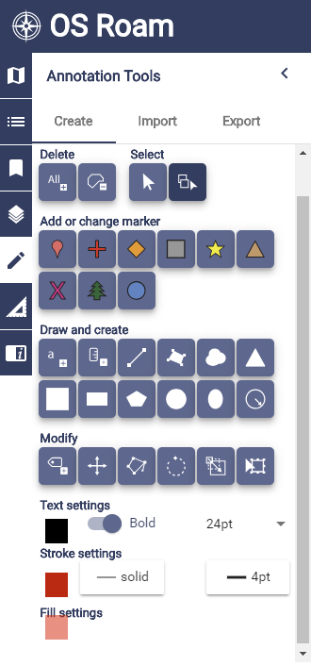
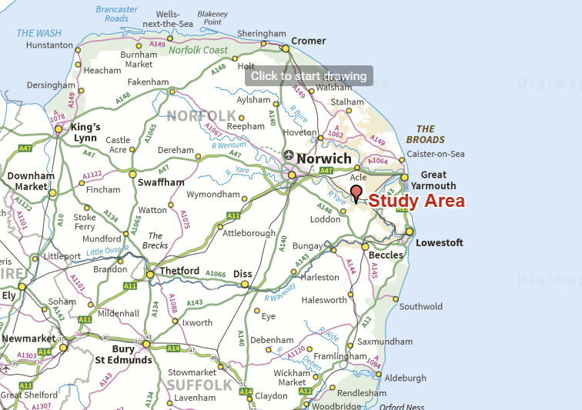
Adding data to Digimap Roam
Collect Data
Add to Roam using the Annotation Tools
Overview Maps
Notes:
Developed over 17 years adding development s and collections. Most recent one being Aerial and Lidar data. For which there has been significant demand
GOOD TO KNOW HOW LONG WHOEVEVER YOU HAVE BEEN TALKING TO HAVE BEEN TAKING SERVICES
Calibre providers of data with whom we have an established relationship

Slide 8
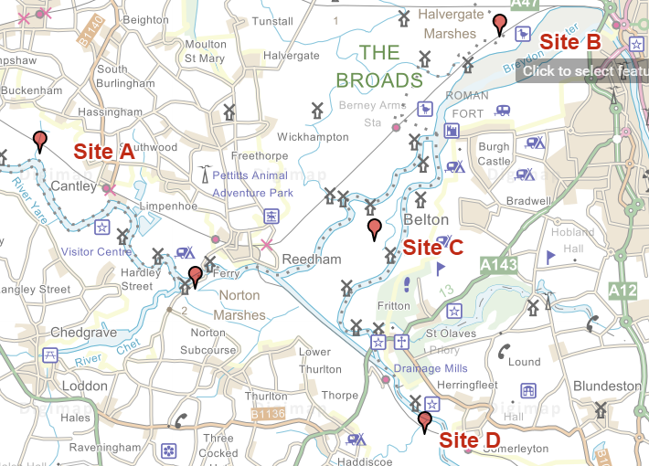
Adding data to Digimap Roam
Collect Data
Add to Roam using the Annotation Tools
Location Maps
Notes:
Developed over 17 years adding development s and collections. Most recent one being Aerial and Lidar data. For which there has been significant demand
GOOD TO KNOW HOW LONG WHOEVEVER YOU HAVE BEEN TALKING TO HAVE BEEN TAKING SERVICES
Calibre providers of data with whom we have an established relationship

Slide 9
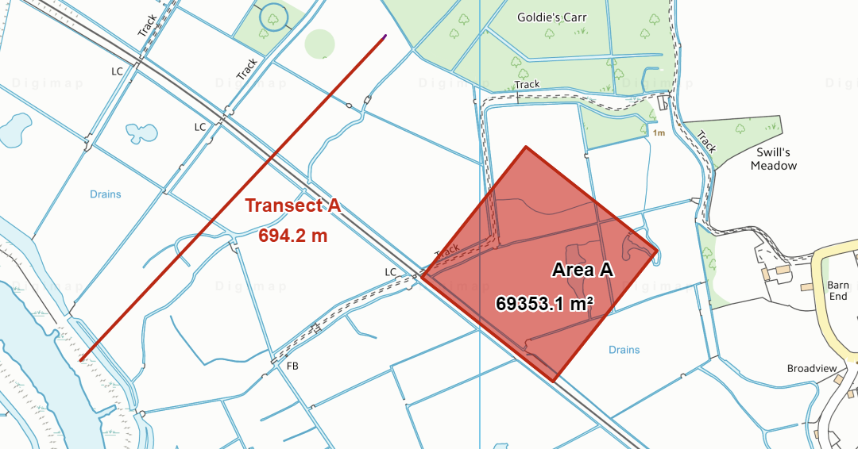
Adding data to Digimap Roam
Collect Data
Add to Roam using the Annotation Tools
Site Maps
Notes:
Developed over 17 years adding development s and collections. Most recent one being Aerial and Lidar data. For which there has been significant demand
GOOD TO KNOW HOW LONG WHOEVEVER YOU HAVE BEEN TALKING TO HAVE BEEN TAKING SERVICES
Calibre providers of data with whom we have an established relationship

Slide 10
Adding data to Digimap Roam
Save Annotations
View them with Other Data
Notes:
Developed over 17 years adding development s and collections. Most recent one being Aerial and Lidar data. For which there has been significant demand
GOOD TO KNOW HOW LONG WHOEVEVER YOU HAVE BEEN TALKING TO HAVE BEEN TAKING SERVICES
Calibre providers of data with whom we have an established relationship

Slide 11
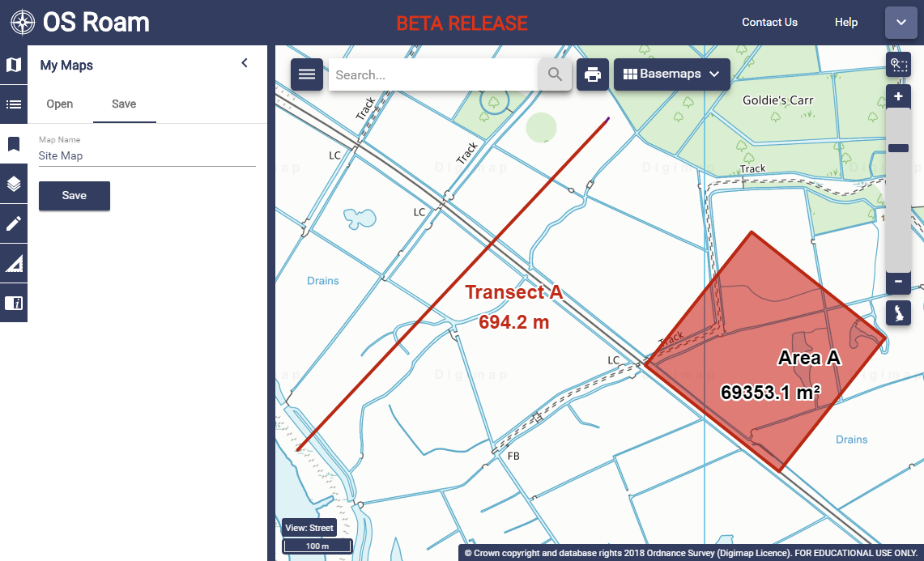
Adding data to Digimap Roam
Notes:
Developed over 17 years adding development s and collections. Most recent one being Aerial and Lidar data. For which there has been significant demand
GOOD TO KNOW HOW LONG WHOEVEVER YOU HAVE BEEN TALKING TO HAVE BEEN TAKING SERVICES
Calibre providers of data with whom we have an established relationship

Slide 12
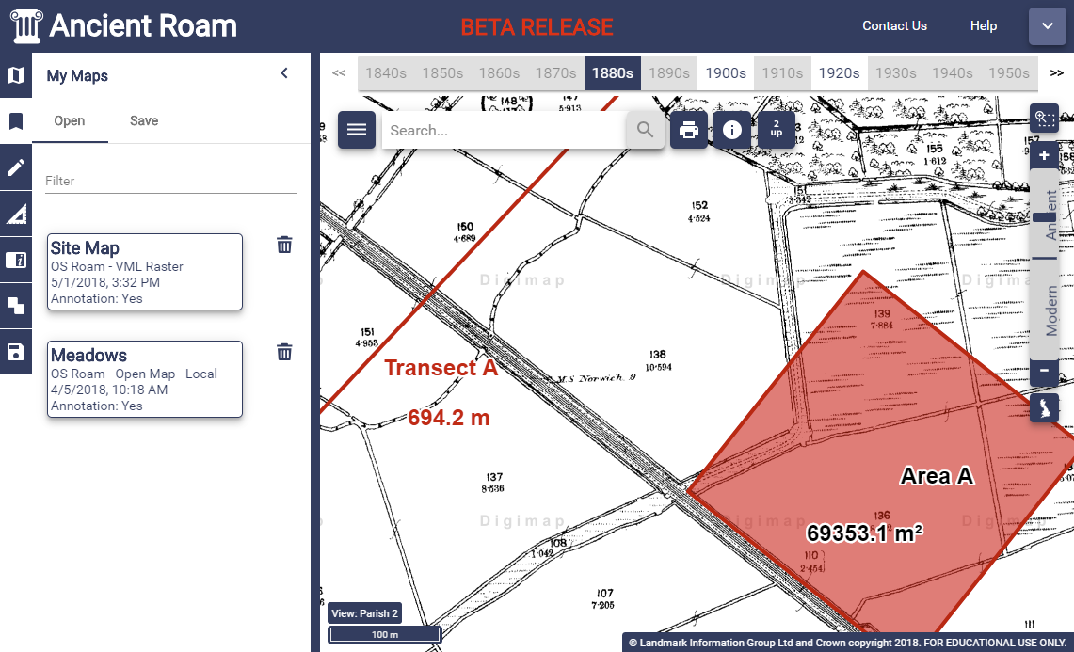
Adding data to Digimap Roam
Notes:
Developed over 17 years adding development s and collections. Most recent one being Aerial and Lidar data. For which there has been significant demand
GOOD TO KNOW HOW LONG WHOEVEVER YOU HAVE BEEN TALKING TO HAVE BEEN TAKING SERVICES
Calibre providers of data with whom we have an established relationship

Slide 13
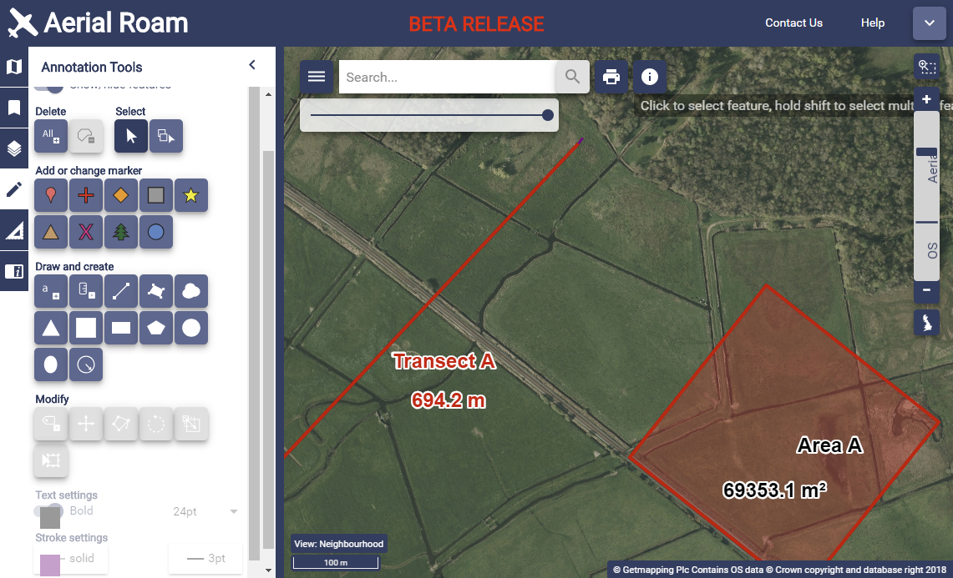
Adding data to Digimap Roam
Notes:
Developed over 17 years adding development s and collections. Most recent one being Aerial and Lidar data. For which there has been significant demand
GOOD TO KNOW HOW LONG WHOEVEVER YOU HAVE BEEN TALKING TO HAVE BEEN TAKING SERVICES
Calibre providers of data with whom we have an established relationship

Slide 14
Adding data to Digimap Roam
Importing Data to Roam
Shapefile from a GIS
KML from Google Earth
GPX from your GPS device
CSV from a Spreadsheet
GeoJson from another Web Map
Notes:
Developed over 17 years adding development s and collections. Most recent one being Aerial and Lidar data. For which there has been significant demand
GOOD TO KNOW HOW LONG WHOEVEVER YOU HAVE BEEN TALKING TO HAVE BEEN TAKING SERVICES
Calibre providers of data with whom we have an established relationship

Slide 15
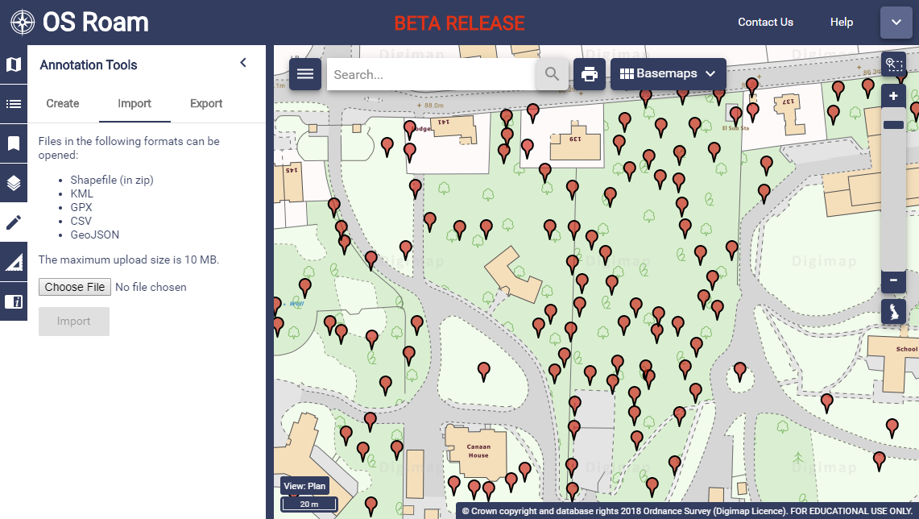
Adding data to Digimap Roam
Importing Data to Roam
Notes:
Developed over 17 years adding development s and collections. Most recent one being Aerial and Lidar data. For which there has been significant demand
GOOD TO KNOW HOW LONG WHOEVEVER YOU HAVE BEEN TALKING TO HAVE BEEN TAKING SERVICES
Calibre providers of data with whom we have an established relationship

Slide 16
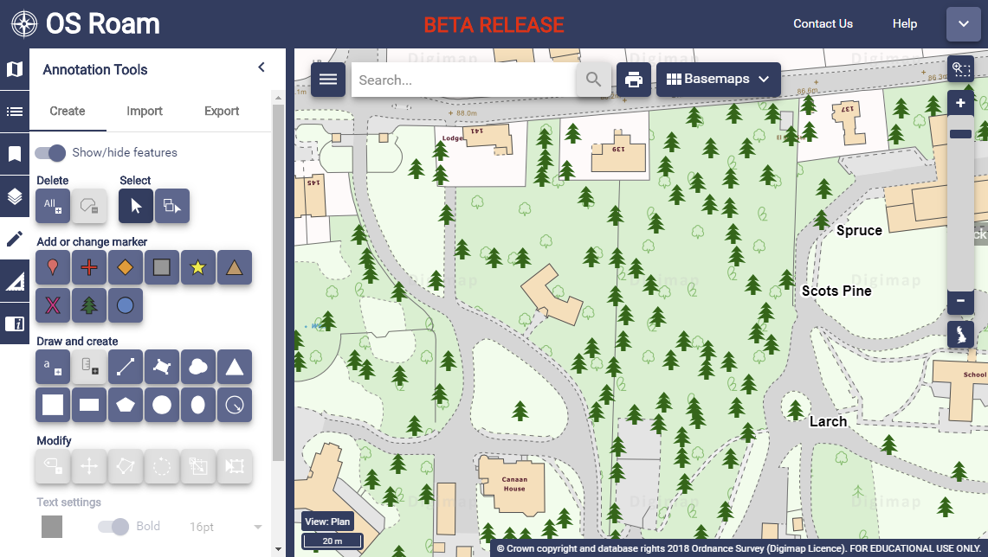
Adding data to Digimap Roam
Notes:
Developed over 17 years adding development s and collections. Most recent one being Aerial and Lidar data. For which there has been significant demand
GOOD TO KNOW HOW LONG WHOEVEVER YOU HAVE BEEN TALKING TO HAVE BEEN TAKING SERVICES
Calibre providers of data with whom we have an established relationship

Slide 17
Exporting data from Digimap Roam
Exporting Data From Roam
Shapefile for a GIS
KML for Google Earth
GeoJson for another Web Map
Notes:
Developed over 17 years adding development s and collections. Most recent one being Aerial and Lidar data. For which there has been significant demand
GOOD TO KNOW HOW LONG WHOEVEVER YOU HAVE BEEN TALKING TO HAVE BEEN TAKING SERVICES
Calibre providers of data with whom we have an established relationship

Slide 18
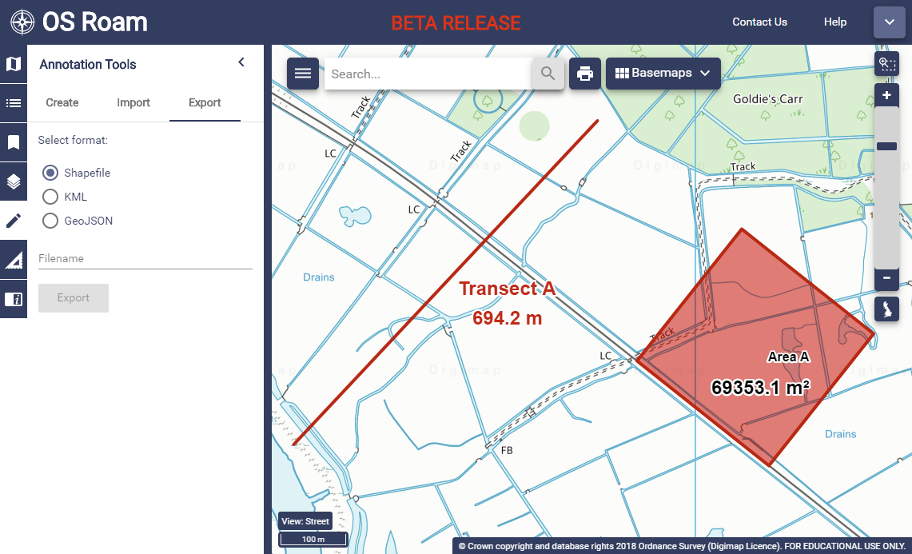
Exporting data from Digimap Roam
Notes:
Developed over 17 years adding development s and collections. Most recent one being Aerial and Lidar data. For which there has been significant demand
GOOD TO KNOW HOW LONG WHOEVEVER YOU HAVE BEEN TALKING TO HAVE BEEN TAKING SERVICES
Calibre providers of data with whom we have an established relationship

Slide 19
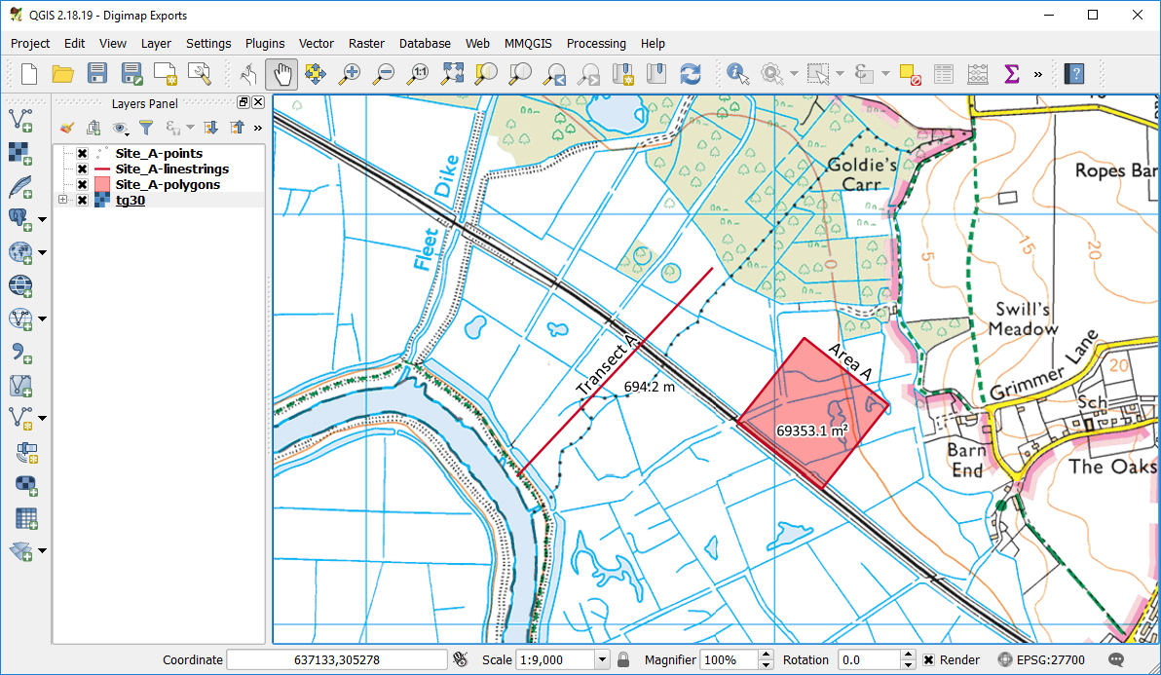
Digimap Annotation in a GIS
Notes:
Developed over 17 years adding development s and collections. Most recent one being Aerial and Lidar data. For which there has been significant demand
GOOD TO KNOW HOW LONG WHOEVEVER YOU HAVE BEEN TALKING TO HAVE BEEN TAKING SERVICES
Calibre providers of data with whom we have an established relationship

Slide 20
Downloading Basemaps
Use any Collection
Useful Context
Can be muted or made Grey Scale in GIS
Useful datasets:
Raster Basemaps from OS
Historic Maps
Aerial Imagery
DTM data from OS and Lidar to make 3D maps
Marine Charts
Notes:
Developed over 17 years adding development s and collections. Most recent one being Aerial and Lidar data. For which there has been significant demand
GOOD TO KNOW HOW LONG WHOEVEVER YOU HAVE BEEN TALKING TO HAVE BEEN TAKING SERVICES
Calibre providers of data with whom we have an established relationship

Slide 21
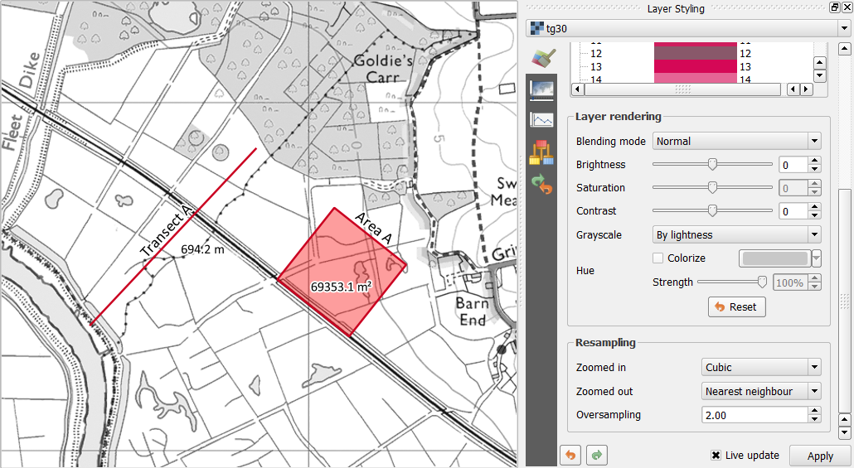
Downloading Basemaps
Notes:
Developed over 17 years adding development s and collections. Most recent one being Aerial and Lidar data. For which there has been significant demand
GOOD TO KNOW HOW LONG WHOEVEVER YOU HAVE BEEN TALKING TO HAVE BEEN TAKING SERVICES
Calibre providers of data with whom we have an established relationship

Slide 22
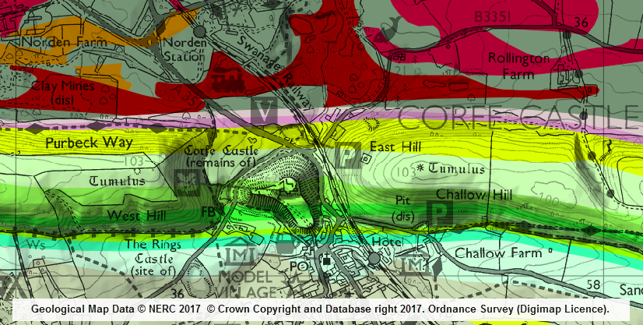
Downloading Basemaps
Notes:
Developed over 17 years adding development s and collections. Most recent one being Aerial and Lidar data. For which there has been significant demand
GOOD TO KNOW HOW LONG WHOEVEVER YOU HAVE BEEN TALKING TO HAVE BEEN TAKING SERVICES
Calibre providers of data with whom we have an established relationship

Slide 23
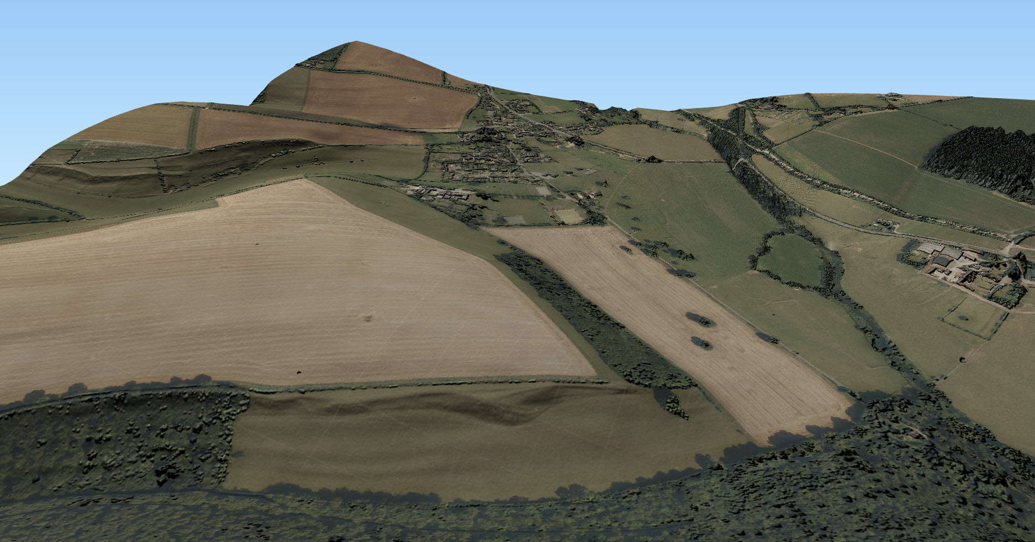
Downloading Basemaps
© Getmapping Plc © Environment Agency copyright and/or database right 2015. All rights reserved.
Notes:
Developed over 17 years adding development s and collections. Most recent one being Aerial and Lidar data. For which there has been significant demand
GOOD TO KNOW HOW LONG WHOEVEVER YOU HAVE BEEN TALKING TO HAVE BEEN TAKING SERVICES
Calibre providers of data with whom we have an established relationship

Slide 24
Georeferencing and Digitising
Scan your field map
Add the map to a GIS
Reference the field map to a basemap
Capture the data from the paper map to a digital dataset.
Notes:
Developed over 17 years adding development s and collections. Most recent one being Aerial and Lidar data. For which there has been significant demand
GOOD TO KNOW HOW LONG WHOEVEVER YOU HAVE BEEN TALKING TO HAVE BEEN TAKING SERVICES
Calibre providers of data with whom we have an established relationship

Slide 25
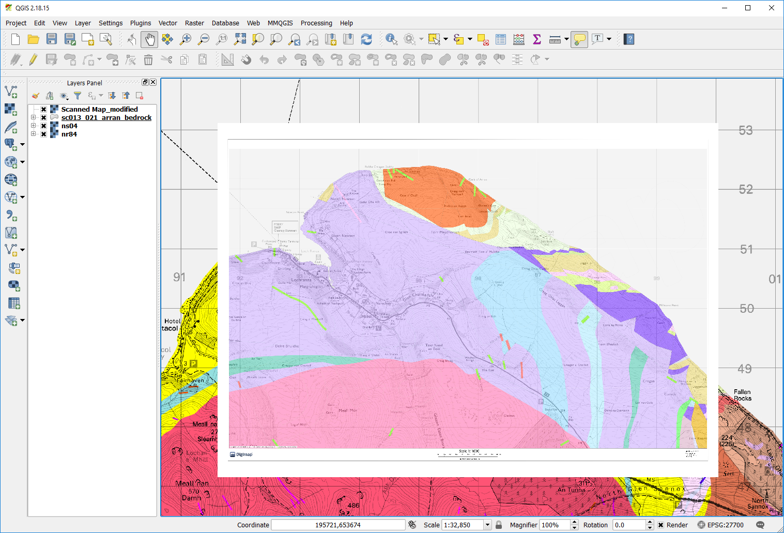
Georeferencing and Digitising
Notes:
Developed over 17 years adding development s and collections. Most recent one being Aerial and Lidar data. For which there has been significant demand
GOOD TO KNOW HOW LONG WHOEVEVER YOU HAVE BEEN TALKING TO HAVE BEEN TAKING SERVICES
Calibre providers of data with whom we have an established relationship

Slide 26
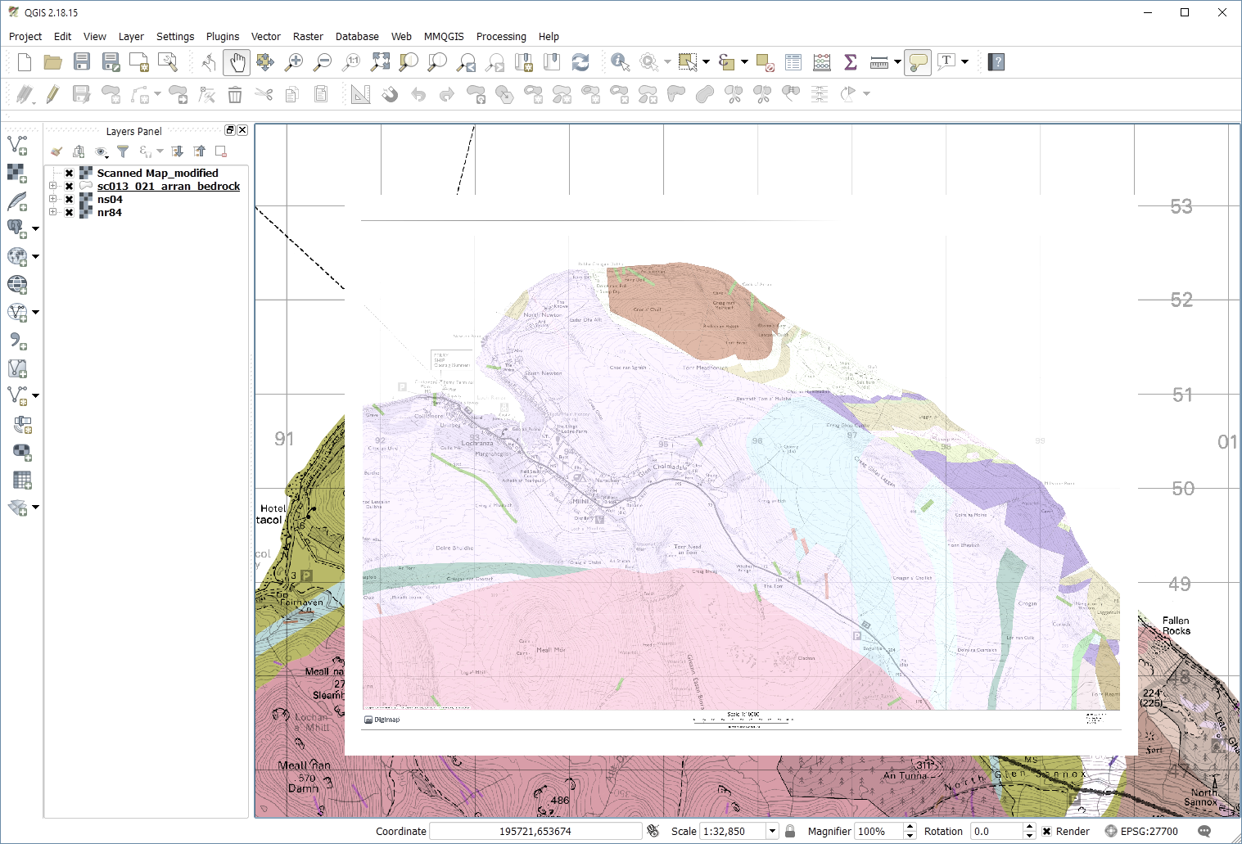
Georeferencing and Digitising
Notes:
Developed over 17 years adding development s and collections. Most recent one being Aerial and Lidar data. For which there has been significant demand
GOOD TO KNOW HOW LONG WHOEVEVER YOU HAVE BEEN TALKING TO HAVE BEEN TAKING SERVICES
Calibre providers of data with whom we have an established relationship

Slide 27
Summary
Digimap is ideal for:
Planning your fieldwork
Capturing field data
Exporting to a GIS
Providing the basemaps for capture and analysis in GIS software
Notes:
Developed over 17 years adding development s and collections. Most recent one being Aerial and Lidar data. For which there has been significant demand
GOOD TO KNOW HOW LONG WHOEVEVER YOU HAVE BEEN TALKING TO HAVE BEEN TAKING SERVICES
Calibre providers of data with whom we have an established relationship

