Slide 1
Webinar: Learn about… Aerial Digimap
Ian Holmes and Tom Armitage
EDINA Geoservices Support

Slide 2
Follow-up
After the webinar, we will send you links to:
Recording (YouTube)
Q&A transcript
Link to the Aerial information page
Feedback form

Slide 3
Poll
Please indicate your current status at your institution:
Support Staff
Academic Staff
Undergraduate
Postgraduate
Other (please enter information in Question area)

Slide 4
Data
New venture with Getmapping
25cm resolution vertical aerial photography – most detailed national coverage available
243,869 1km tiles, JPEG format, 1.7TB
Regular updates

Slide 5
Updates
2015 data:
~33,000 tiles updated
~30% of the total area
2016 data (Scotland only at this stage):
~20,000 tiles updated
~25% of the total area
2016 data for Wales and England still to come
2017 data:
~?? tiles updated
~??% of the total area

Slide 6
Archaeology
Easy way of visualising complete sites in their entirety and within their landscape
Aerial photography is one of the most important ways of discovering new archaeological sites
Using detailed imagery it is possible to discern things that are not visible at ground level e.g.
Slight differences in ground levels create shadow marks
Buried ditches hold more water and buried walls hold less water than undisturbed ground

Slide 7
Ecology, Agriculture and Land Use
Allows larger areas to be studied without the need for time-consuming and costly site visits
Useful for conservation and habitat identification, enabling more focussed site visits
Measurements of specific land uses

Slide 8
Urban Planning and Infrastructure
Provides a clear overview of large areas of land
Vital when examining existing infrastructure
Aid in the assessment of urban expansion plans regarding change to existing land use
Assess visual impact of new developments through 3D modelling

Slide 9
Architecture and Landscape Design
Detailed imagery can reveal architectural secrets hidden at street level
Aerial photography can be combined with additional datasets to provide realistic 3D models:
OS Terrain 5 DTM (most detailed terrain model)
OS MasterMap Building Height Attribute (heighted buildings)
OS MasterMap Highways and Water Networks

Slide 10
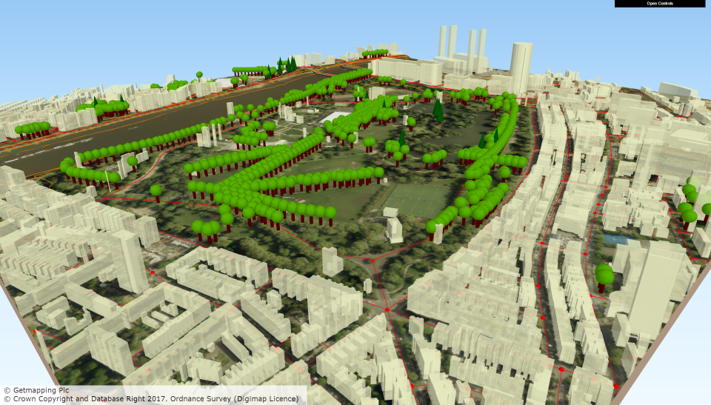
Using the data in QGIS
OS MasterMap Building Height Attribute
25cm aerial imagery
OS Terrain 5
Positioned trees from OS MasterMap Topography Layer
OpenRoads road network

Slide 11
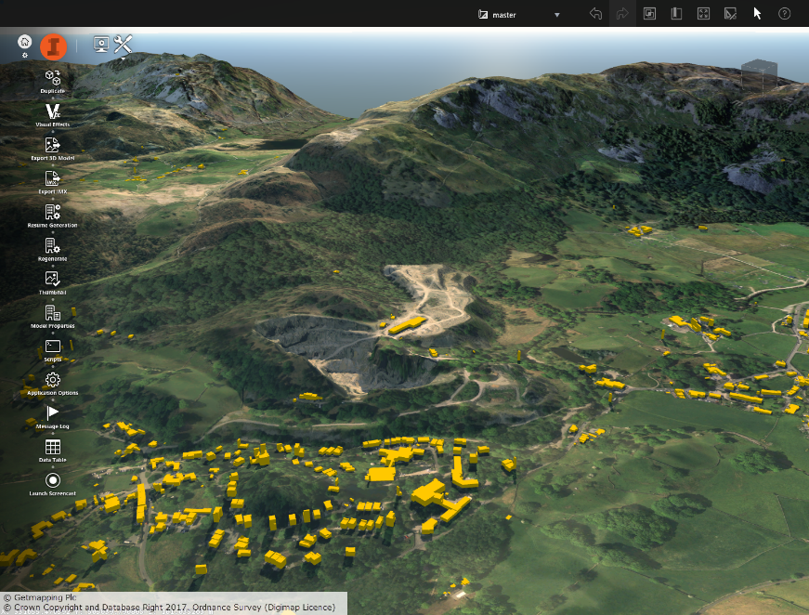
Using the data in CAD (InfraWorks)
OS MasterMap Building Height Attribute
25cm aerial imagery
OS Terrain 5

Slide 12
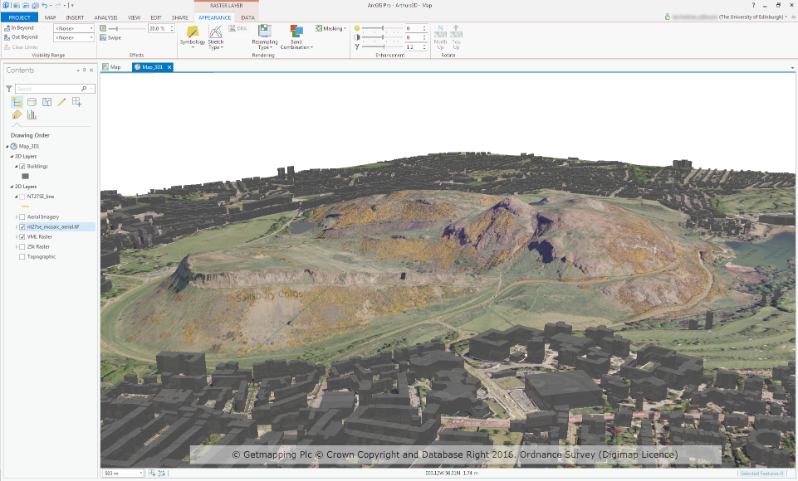
Using the data in ArcGIS Pro
OS MasterMap Building Height Attribute
25cm aerial imagery
VectorMap Local Raster
OS Terrain 5

Slide 13
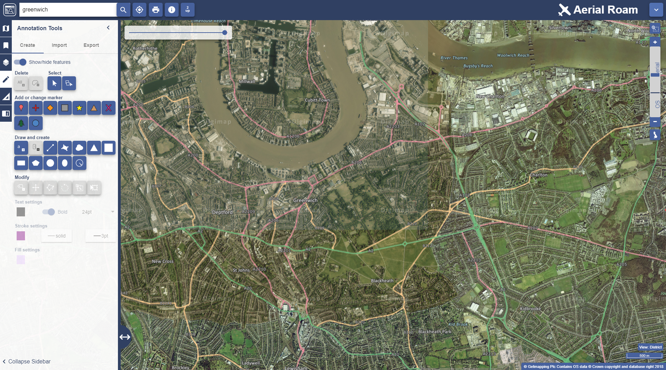
Aerial Roam

Slide 14
Poll
Does your institution currently subscribe to Aerial Digimap?
Yes
No
Don’t know

Slide 15
Aerial Roam
Top three zoom levels show OS Open Data
Get Feature Information tool displays date image was taken
Backdrop mapping visible using opacity slider
Road/Place Name overlay available in the Overlays menu
Standard functionality:
import/export annotations
open/save map
annotation and measurement tools

Slide 16
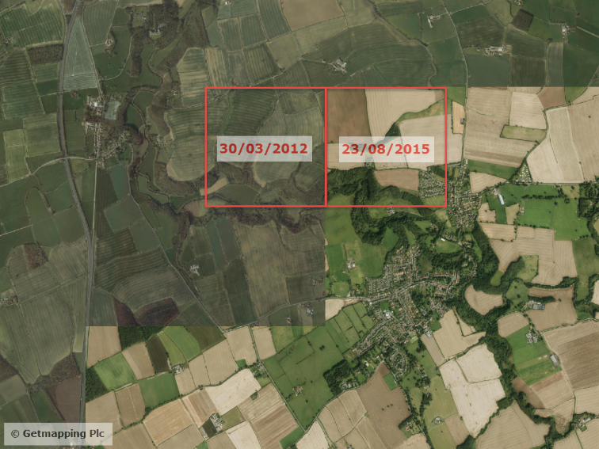
Mosaic – hard edges

Slide 17
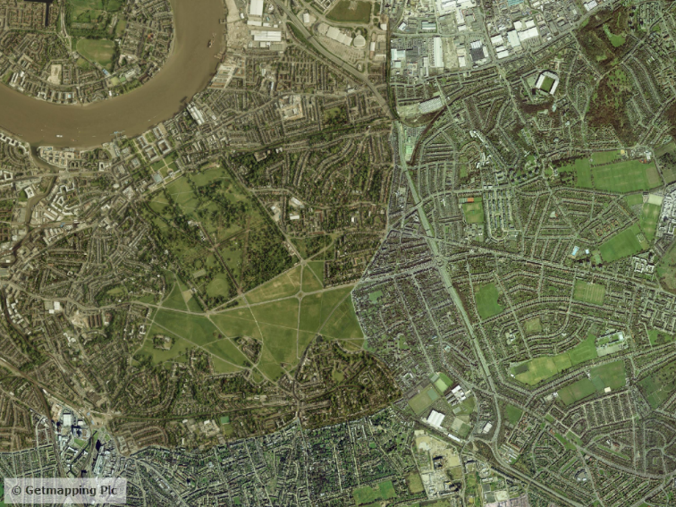
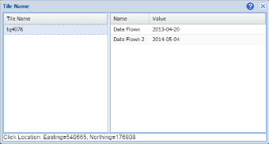
Mosaic – following features

Slide 18
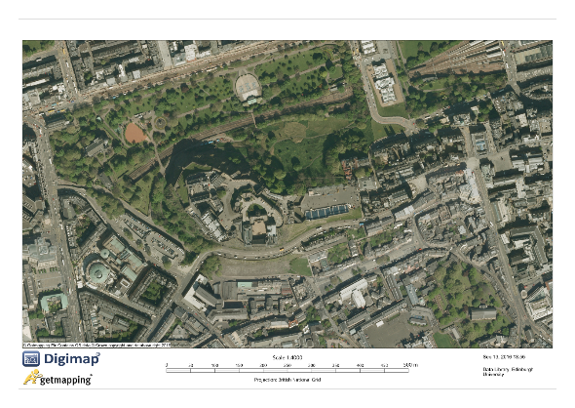
Printing
Max paper size A3
Max print scale: 1:175,000
A3 print at 1:175,000 opens 2600 1km images

Slide 19
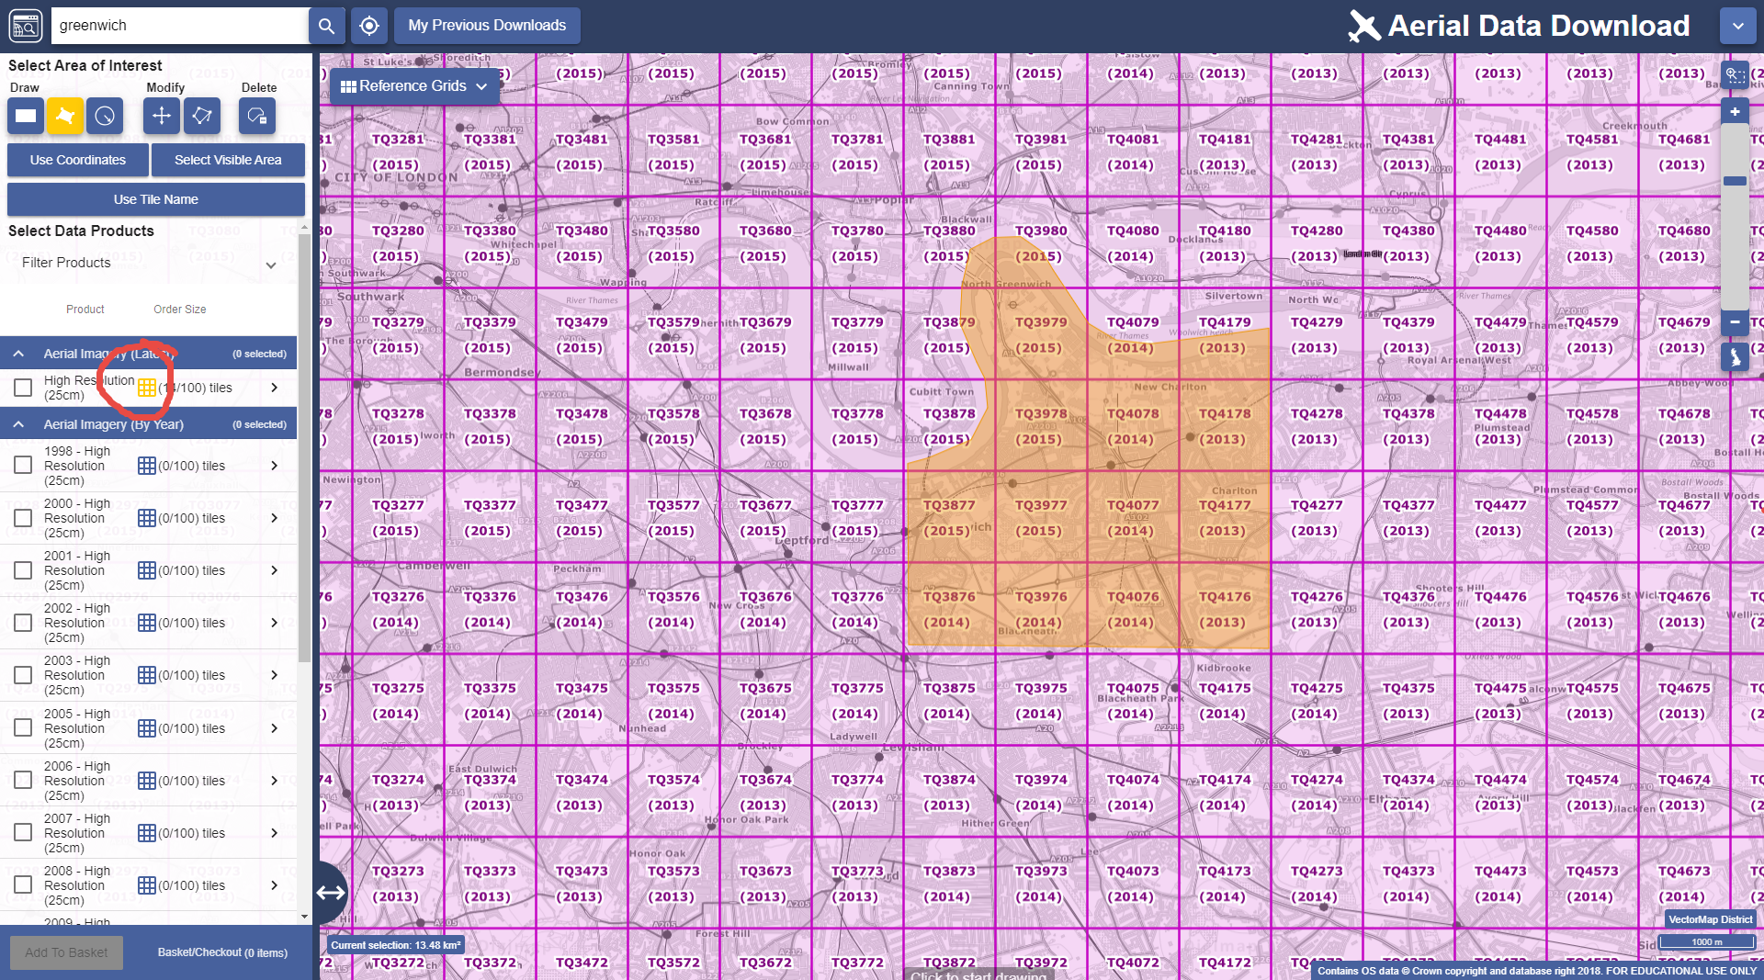
Aerial Download

Slide 20
Aerial download
100km² download limit, ~700MB download size
Can take multiple orders
Download latest data or specific versions

Slide 21
LiDAR Digimap
Bundled with Aerial Digimap (no additional cost)
Variety of open data:
Point Cloud (England and Scotland only)
Digital Terrain Model (DTM) and Digital Surface Model (DSM):
Environment Agency – England
SEPA – Scotland
Natural Resources Wales – Wales
Aerial Imagery (Environment Agency - England only)

Slide 22
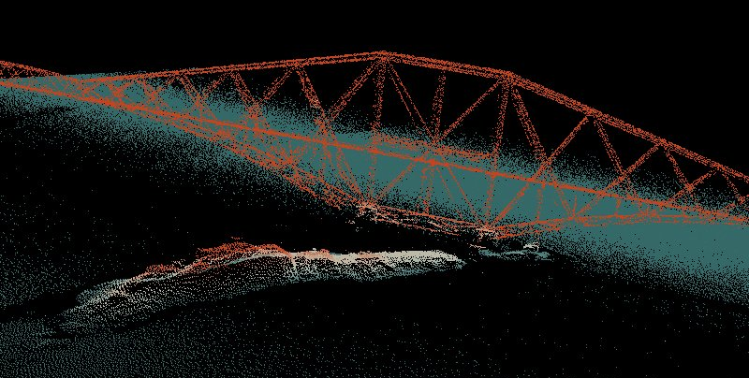
Point Cloud
Raw LiDAR data format
England and Scotland only

Slide 23
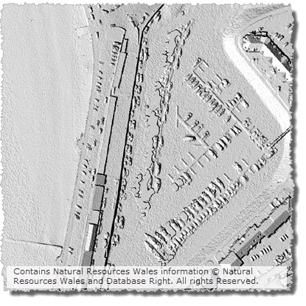
Digital Surface Model
Surface, including vegetation and man made features

Slide 24
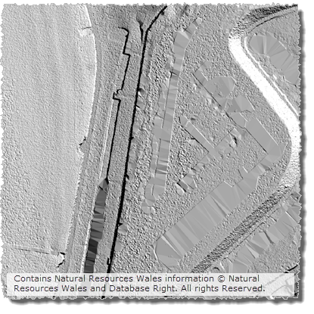
Digital Terrain Model
Bare-earth model representing the surface of the earth with vegetation and man made features removed

Slide 25
Environment Agency Aerial imagery
Data format: ECW (enhanced compressed wavelet)
Four types of imagery available:
True colour – red, green, blue (RGB)
Near Infra-Red (NIR)
4-band (RGBN)
Night time
Access free to all subscribers to Aerial Collection

Slide 26
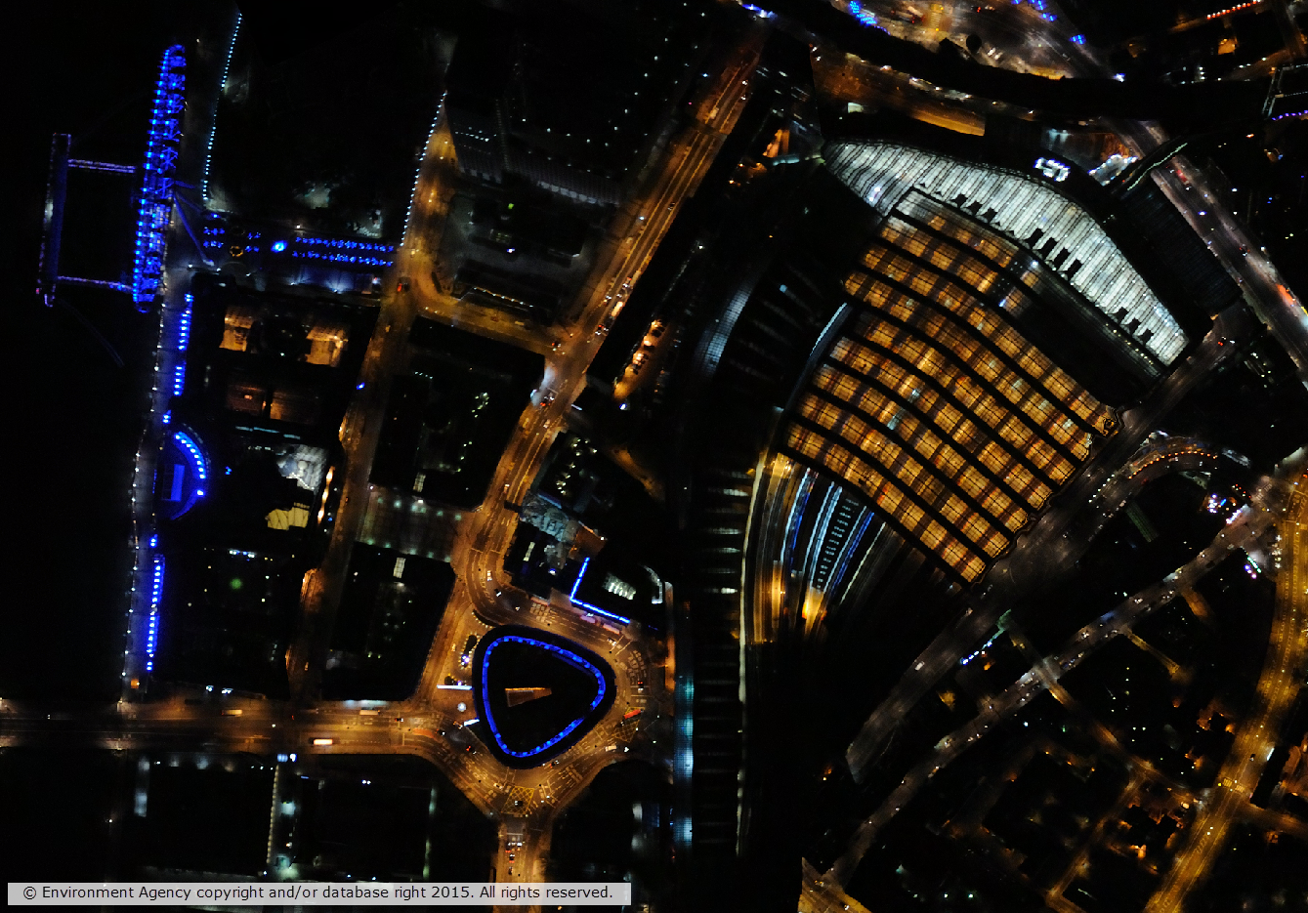

Slide 27
Getting Aerial Digimap
Institution subscription with EDINA, not JISC
Annual price range: £485- £2500 (plus VAT), based on institutional HE band
Users: speak to your local Digimap Site Rep (http://bit.ly/DigimapSiteReps)
Site Representatives: all subscription information available at http://bit.ly/AerialDigimapSubs
edina@ed.ac.uk

