Slide 1
Digimap Ordnance Survey Collection Copyright and Terms of use
24 February 2016
Emma Diffley, EDINA Geo User Support

Slide 2
Content
Licensed data and Open Data
What is the End User Licence Agreement?
Who can use the service?
What can I do with the licensed data?
Can I publish my maps on the web?
Your questions
Can I share data?
What are the obligations and restrictions?
Licence Termination
Where can I get support with copyright questions?
What do support staff need to do?
Your questions

Slide 3
Licensed Data versus OpenData
All map data in Digimap OS Collection is created and supplied by Ordnance Survey, Britain’s national mapping agency.
Data only covers England, Scotland and Wales
Northern Ireland has it’s own Ordnance Survey of Northern Ireland (also known as Land and Property Services)
Today covers the terms and conditions of Licensed Data.
Some OS map products also available under the OS OpenData scheme.
covered by a different licence, the OpenGovernment licence (OGL)
Commercial use permitted
http://www.nationalarchives.gov.uk/doc/open-government-licence/version/3/
There is no overlap. Data are either covered by the Digimap licence or the OpenGovernment Licence.

Slide 4
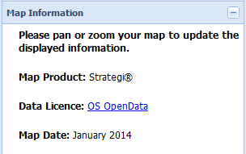
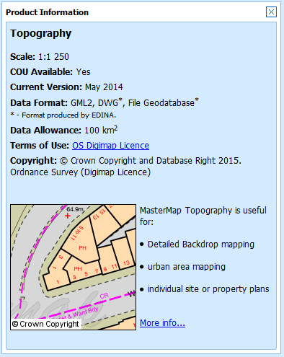
How do I know if it’s Licensed Data or OpenData?
Roam service:
Information is available in the Map Information panel.
Data Download service:
Find out in Product Information boxes.
Click on Info next to product name in Select Data panel.
Text file sent with each download detailing which licence covers each data product.

Slide 5
Licence Agreements
Licence structure is as follows:
Master Agreement between OS and Jisc Collections
Sub-Licence Agreement between Jisc Collections and the Institution
Rights, responsibilities and obligations on the Subscribing Institution
End User Licence Agreement (EULA) between end users and Ordnance Survey
Rights, responsibilities and obligations on the end user
The licence runs until 31 July 2016

Slide 6
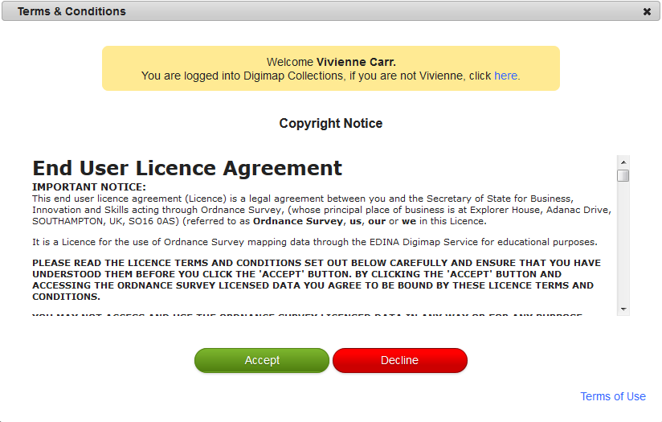
What is the End User Licence Agreement (EULA)?
The EULA contains the terms and conditions under which every user of the data is bound
Users accept the terms of the EULA every time they access Digimap OS Collection
View the full agreement, along with FAQs, on Digimap Resource Centre:
http://digimap.edina.ac.uk/webhelp/digimapsupport/access/licence_agreements.htm
FAQs are updated when the need arises

Slide 7
End User Licence Agreement Structure
Legal agreement between the user and the Secretary of State for Business, Innovation and Skills acting through Ordnance Survey
Allows access and use of the OS Licensed Data
Solely for Educational Use or Limited Administrative Use

Slide 8
Who can use the Licensed Data?
Authorised User – an individual who:
is authorised by an institution to have access to its information services via Secure Authentication
has completed EDINA’s registration process for the Digimap service and has accepted the terms of the licence AND is:
a current student,
member of staff (whether permanent, temporary or retired)
consultant or contractor of the Institution who is employed for purposes of teaching or undertaking research
Note there are qualifications of this definition…

Slide 9
Qualifications
Users do not quality as Authorised Users for the duration of extended periods abroad (extended period is more than one academic term).
Students and staff members registered at an overseas campus do not qualify as Authorised Users (but will qualify for the duration of any period spent studying in the UK at that institution).
Consultants or contractors only qualify for the period necessary to fulfil the teaching or research for which they were engaged.

Slide 10
Some clarifications…
Distance learning students only qualify as Authorised Users if they are in the UK.
Institutions must decide whether an individual is eligible for “membership” status at that institution and issue authorisation credentials accordingly.
If your institution won’t vouch for you and issue you with login details, you cannot become an Authorised User.
You automatically cease to be an Authorised User when you leave the UK.

Slide 11
End User Licence Agreement
Structure
Section 3 – Permitted Use
Section 4 – Public Sector Data Sharing Rights
Section 5 – Obligations/restrictions
Section 6 – Ownership and Acknowledgment of Intellectual Property Rights
Section 8 – Automatic Termination of this licence
Section 11 – Warranties and Limitations of Liability
Appendix 1 - Definitions

Slide 12
Permitted uses
Educational Use:
teaching, learning, academic and sponsored research and/or private study (includes distance learning from within the UK, not from overseas)
Limited Administrative Use:
publish mapping images in promotional literature or web, to show campus location/extent, event locations, directions, promote subscription to Digimap service
Incorporate mapping images in Youtube videos, for demonstration or promotion of the service

Slide 13
What can I do with the Licensed Data?
Note: this is not exhaustive! Contact EDINA if in any doubt that your proposed use of the OS data is permitted.
Incorporate the data into academic works, presentation materials, research works and teaching materials
Publish maps in journals (no size limits specified); images must be no larger than necessary to fulfil the purpose of the map
Display, view, interrogate, manipulate, modify, search and otherwise use the Licensed Data
Print copies of the Licensed Data

Slide 14
What can I do with the Licensed Data?
Download and store data to any Device (EULA section 3.1)
Supply copies of data to other Authorised Users (same and different institutions) (EULA section 3.1.3)
Supply copies of data to and receive data from PSMA (England & Wales) or OSMA (Scotland) members (public sector mapping agreements) (EULA section 4)
Create a Navigational Product/Service as part of your course provided the resultant service is only available to Authorised Users for the current academic year (EULA section 3.4)
Deposit electronic copies of maps in institutional repositories (EULA section 3.2 and 3.3.5)

Slide 15
Can I publish my maps?
Yes, on paper and in electronic form, including on the Web
Provided mapping images are:
in raster format only
not georeferenced
no larger than necessary
include additional information
And provided that:
adequate steps taken to ensure third parties cannot access, use and extract any OS data from such materials
Social media
you can post map images to Twitter and YouTube, but not Facebook.
Books – require separate licence

Slide 16
Vector vs Raster
From the End User Licence Agreement definitions:
Raster Format/Image
means a mapping image made up of millions of individual pixels in a grid, where the information stored within each pixel corresponds to the colour or value of that pixel only.
Otherwise known as a bitmap and/or a static map image, a raster image has no 'intelligence‘, has no relation to the adjacent pixels.
Vector Format/Image
means a representation of the mapping made up of individual, geographic or cartographic features comprising points, lines, areas and attributes, (including cartographic text), relating to the real world.
In contrast to a Raster Image, vector data is a flexible and intelligent form of data which can be edited, modified and scaled without affecting the basic feature itself.

Slide 17
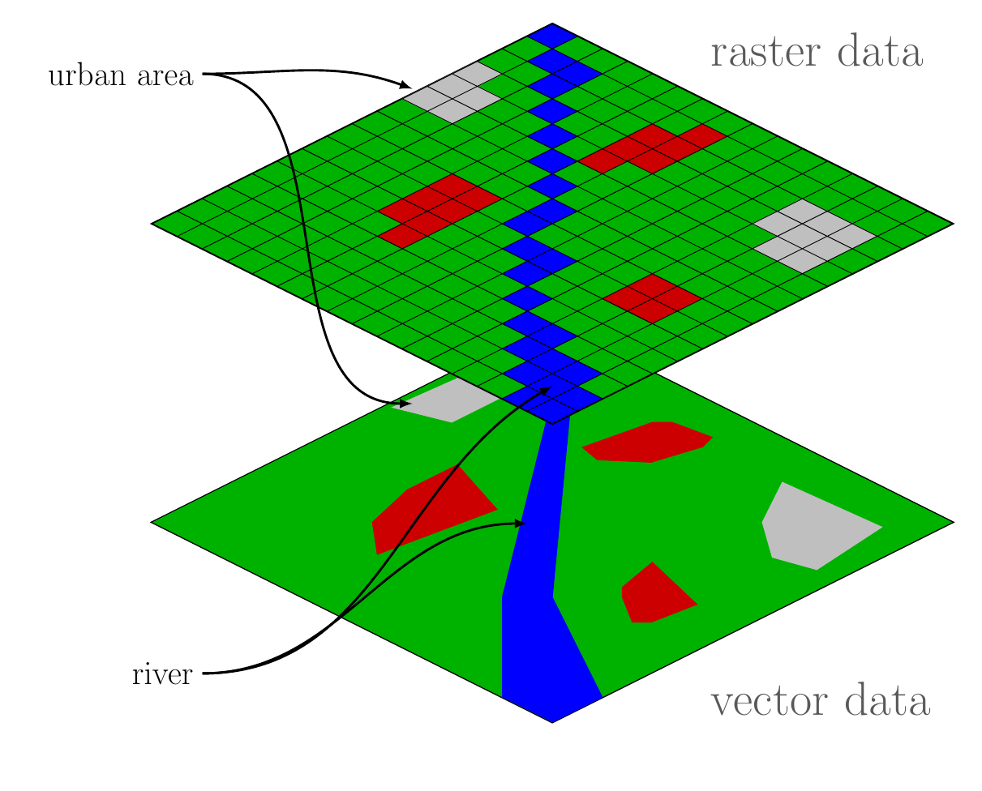
Vector v Raster

Slide 18
Can I share data?
Yes, you can share data with other Authorised Users
You can share with users from your institution and other institutions
You are obliged to keep a written record of:
the names and addresses of the receiving/supplying party
what Ordnance Survey Licensed Data was received / supplied
when the Ordnance Survey Licensed Data was received /supplied
if asked, you will need to provide your records.
Must NOT share Points of Interest data

Slide 19
Can I supply data to my research sponsors?
Commercial sponsor
can supply final report with any map images, not data (unless the sponsor has a licence from OS for the same data for non-commercial purposes)
Government department
can share data if they are members of Public Sector Mapping Agreement/One Scotland Mapping Agreement (PSMA/OSMA) and are licensed for same map products for same area

Slide 20
Your questions

Slide 21
What are your obligations?
Keep login details secure and confidential, do not share
Keep data secure and not publicly accessible
Keep records of distribution
Acknowledge use of the Licensed Data

Slide 22
Copyright Acknowledgement
Include acknowledgement in any display or publication:
© Crown Copyright and database rights [insert date]. Ordnance Survey (Digimap Licence).
For example: © Crown Copyright and database rights 2015. Ordnance Survey (Digimap Licence).
NOTE: the above acknowledgement is automatically included on all maps printed from Roam.

Slide 24
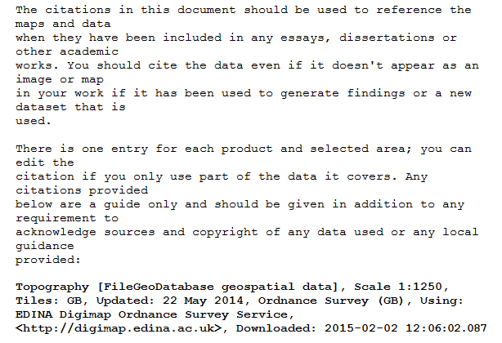
Citations
Check your download file for citations text file
Users can copy and paste citation information
One entry for each map product
image shows OS MasterMap Topography

Slide 25
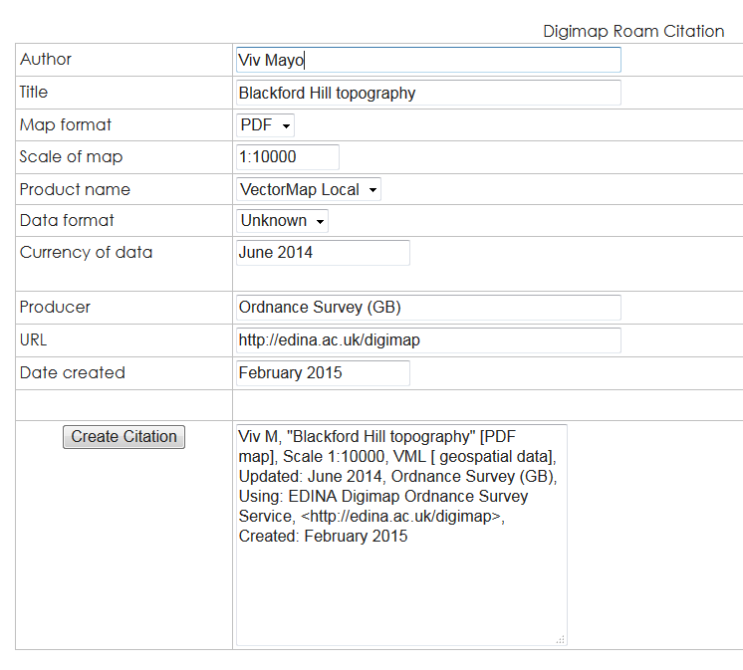
Citations
Citation tool available to create citations:
http://edina.ac.uk/projects/sharegeo/Citation/Tool/services.html

Slide 26
What are the restrictions?
No commercial use
Check EULA sections 5.1 and 5.2 and their sub-clauses for specific restrictions
Users cannot create campus maps for web and mobile devices that contain georeferenced data
Cannot publish electronically maps that contain vector data (e.g. Roam maps produced from vector data) that will be accessible by non Authorised Users
No use of OS data in mobile applications unless for Educational Navigation Product/Service – restrictions apply. Check section 3.4 of EULA
No use of OS data where there is paid for or free advertising

Slide 27
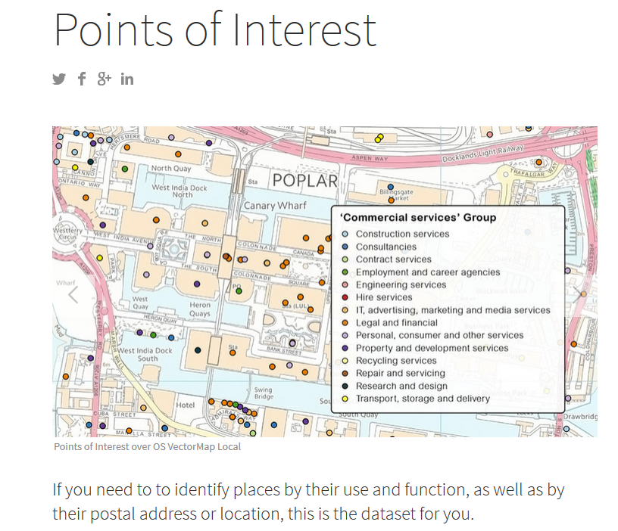
Points of Interest data
Additional acknowledgement required:
This material includes data licensed from PointX© Database Right/Copyright [year of supply or date of publication].
Licence states:
not to be used for any form of sales, market research etc,
or geocoding or correcting any gazetteers or address lists.
cannot share with anyone.

Slide 28
Liability
Users have unlimited liability for infringements of IPR, whether
by the user or
by someone else as a result of the user’s failure to comply with the obligations imposed by the licence
Derived data:
rules applying to Licensed Data also apply to data derived from Licensed Data.

Slide 29
Termination of licence
If licence is suspended, terminated, or expires:
Must immediately cease accessing/using Digimap
Within 7 days must destroy data in your possession
Within 7 days must remove any Educational Navigation Products/Services that you have developed
Can retain:
Printed copies of materials
Printed screenshots of Educational Navigation Products/Services
Mapping images embedded within electronic copies of materials or educational navigation products (must be raster, not georeferenced)

Slide 30
For support staff – institution’s responsibilities
Data security requirements – outlined in Schedule 3 of OS Institutional Sub-Licence.
http://www.jisc-collections.ac.uk/Catalogue/Agreements/YearlyAgreements/2075
Also defines roles for Site Representative and Responsible Officers for Data Security.
In summary:
Ensure no unauthorised access to the Digimap service takes place
Ensure no unauthorised access to the Licensed Data takes place
Nominate:
a site representative who will be the main point of contact
a Responsible Officer for Data Security and Deputy
Communicate any actual or possible licence breaches to EDINA
In the event of licence breaches, investigate and instigate disciplinary procedures

Slide 31
Licence breaches
Established set of procedures once an “incident” has been identified. Includes timescales – must be resolved within 6 weeks.
Details given in Security Appendix 3 of Sub-licence.
User related or Institution related
Example of User-related incident might be a single user sharing their password with friends or sharing data they’ve downloaded with others who are not Authorised Users
Example of Institution-related incident might be a systematic failure of the institution to terminate access once individuals cease to be members of the institution (e.g. terminating graduate accounts)

Slide 32
Where can I get support?
Full text and FAQs on licence agreements:
http://digimap.edina.ac.uk/webhelp/digimapsupport/about.htm#access/licence_agreements.htm
Digimap chat facility on all help pages
Our help desk:
edina@ed.ac.uk
0131 650 3302

Slide 33
Your questions

Slide 34
Poll
Today’s webinar:
I learnt something new
I didn’t learn anything new
Was a good use of my time
Was a poor use of my time
Other

