Slide 1
Digimap Collections Introduction for site reps
25 October 2017
Emma Diffley, EDINA Geosupport

Slide 2
Introduction for site reps
Digimap
Overview
What can I do with Digimap?
Technical requirements
Copyright
Administrative
Institutional Responsibilities
Support

Slide 3
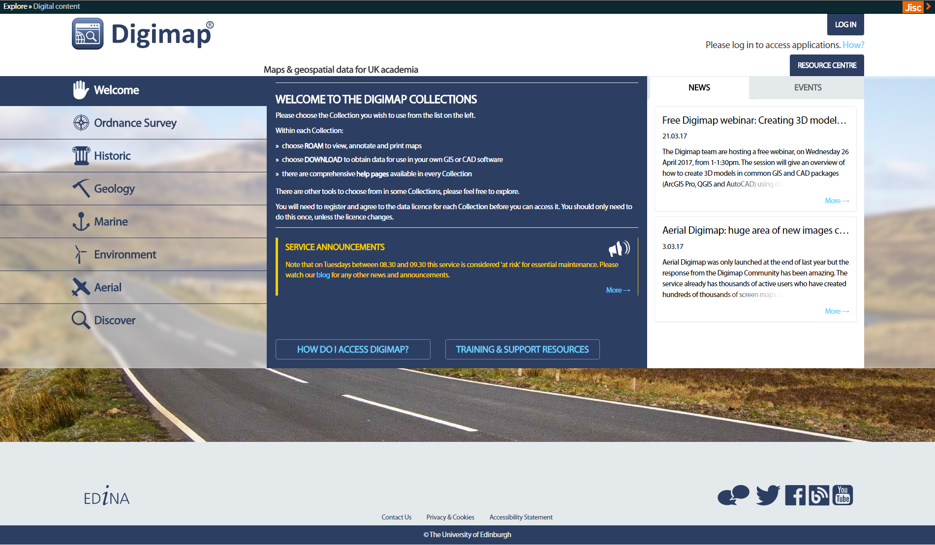
Digimap Collections
6 Digimap collections of mapping data
EDINA develops the service and hosts the map data
5 Collections’ data licensed via Jisc Collections (Aerial and Lidar are licensed directly via University of Edinburgh)
Institutions subscribe to each Digimap Collection separately
Users must register individually to gain access to any Digimap Collection

Slide 4
Subscriptions for 2017/18
Payment and licensing via Jisc Collections
Costs depend on Jisc banding scheme and collection
see Jisc Collections: http://www.jisc-collections.ac.uk/Catalogue/
Annual fee for each academic year, 1 August to 31 July
Fees revised annually by Jisc
Contact Jisc Collections helpdesk with subscription questions:
help.digitalresources@jisc.ac.uk
or 0203 006 6088.
For a free trial contact Jisc Collections:
help.digitalresources@jisc.ac.uk

Slide 5
Subscriptions to Aerial Digimap
Costs depend on Jisc banding scheme and collection
See Aerial Digimap Help pages:
http://digimap.edina.ac.uk/webhelp/aerial/aerialdigimaphelp.htm#getting_started/subscribing.htm
Annual fee for each academic year, 1 August to 31 July
Fees revised annually
Contact EDINA helpdesk with subscription questions:
edina@ed.ac.uk
or 0131 650 3302
Lidar Digimap is currently free with a subscription to Aerial Digimap

Slide 6
Who provides the map data?
Collection | Data provider | Agreement duration (annual opt out points)
Digimap OS | Ordnance Survey | 2016-2017
Historic Digimap | Landmark | 2016-2019?
Geology Digimap | British Geological Survey | 2016-2017
Marine Digimap | SeaZone | 2016-2019
Environment Digimap | Centre for Ecology and Hydrology | 2015-2018
Aerial Digimap | Getmapping plc | 2016-17

Slide 7
Technical requirements
Browser-based service
No installation requirements
Which browsers work?
Latest versions of Firefox, Chrome and Safari
Internet Explorer 11 and Edge
Mobile devices
Most functionality works with tablets
new version of Roam improves this
Use on mobile telephones less useful so lower priority for EDINA

Slide 8
Software guidance
Onward use of downloaded data will typically require one of:
GIS (geographic information system)
CAD (computer aided design)
Image processing software
Suitable software licences available through eduserv CHEST (e.g. ArcGIS) or freeware (e.g. QGIS)
Local support will be required for these packages
this is not necessarily the site rep’s responsibility
Some information about software given in Digimap Help pages
not exhaustive
provides guidance on most widely used software

Slide 9
Licences
On subscribing, a sub-licence between Jisc Collections/UoE and your institution comes into effect
Each Digimap Collection has a separate licence
Users must accept the licence terms for a collection before they can use it; only done once
Digimap Ordnance Survey Collection and Environment Digimap differ in structure:
Institutional sub-licence
Additional EULA (End User Licence Agreement) between end user and Ordnance Survey or CEH
All licences available in full here:
http://digimap.edina.ac.uk/webhelp/digimapsupport/access/licence_agreements.htm

Slide 10
Summary of terms of use
Maps produced from Digimap are for:
Teaching, Educational Research or Academic Research by registered users.
Limited Administrative use e.g. provide a campus map in a prospectus
Users can….. (not an exhaustive list!):
print maps
publish maps on paper and the web (exceptions for social media)
publish maps in journals
share data with other Authorised Users
download and store map data on any device
display, view, interrogate, manipulate, modify and search the map data
Further information in our Copyright & Licensing Webinar
WE WOULD STRONGLY RECOMMEND YOU ATTEND/WATCH THIS

Slide 11
Publishing maps
there are some restrictions on the format of published maps
all maps must carry an appropriate copyright acknowledgement, for example:
“© Crown Copyright and Database Right 2017. Ordnance Survey (Digimap licence).”
Copyright statement is different for each Collection and sometimes different for each map. Please check Digimap Help pages or sub-licences

Slide 12
Licensed vs Open Data
Some Collections have both Licensed Data and Open Data
Licensed Data is only for use for Educational Purposes and is covered by the Digimap licences
Open Data is covered by separate Open Licences:
OS data operates under the Open Government Licence
BGS data operates under the BGS OpenGeoscience Licence
Open Data products are also available from other websites
Commercial use permitted
Some other websites may charge, especially for “value added” versions
There is no overlap. Data are either covered by the Digimap licence or the open licence

Slide 13
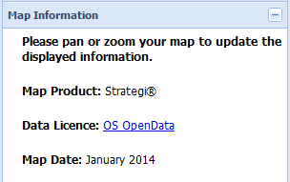
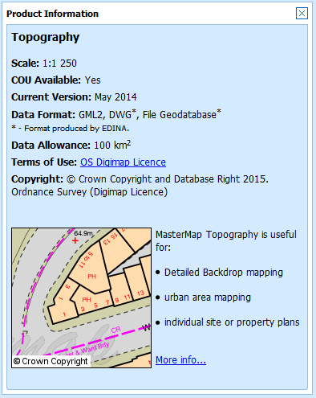
How do I know if it’s Licensed Data or Open Data?
Roam service:
Information is available in the Map Information panel.
Data Download service:
Find out in Product Information boxes.
Click on Info next to product name in Select Data panel.
Text file sent with each download detailing which licence covers each data product.

Slide 14
Poll
User queries – what Digimap questions do you receive? Tick all that apply.
Login/registration
Using Roam or Data Download
Copyright
Using data in GIS/CAD
I don’t receive any queries

Slide 15
Institutional Responsibilities
Where are these specified?
Collection | Section of Licence Agreement
Ordnance Survey | Section 7 + Appendix 3
Marine Digimap | Section 5 + Appendix 3
Geology Digimap | Section 5
Historic Digimap | Section 5
Environment Digimap | No specific section
Aerial Digimap | Section 5

Slide 16
Responsibilities
Institutions must:
Ensure there is no unauthorised access to the Digimap service
Institutional systems must be in place to grant/deny access according to a user’s status with the institution
Ensure there is no unauthorised access to the Licensed Data
Nominate local support staff
Communicate any actual or possible licence breaches to EDINA
In the event of licence breaches, investigate and liaise with EDINA to implement any disciplinary procedures

Slide 17
How do users get access?
Overview:
Login via UK Federation
Institutions must be able to assert User Accountability, i.e. trace any usage of the service back to an individual
Service providers can help with this if you are outsourcing your IdP
Institutional Identity Providers (IdP) must release appropriate attributes:
Check UK Federation Metadata
http://www.ukfederation.org.uk/content/Services/2008-01-04-digimap
EDINA does not issue passwords or accounts
EDINA has no control over the set-up of your local authentication system. You must seek advice from the UK Federation Helpdesk, or your service provider if you are outsourcing your IdP provision

Slide 18
Who can use Digimap?
Anyone who qualifies as an Authorised User
Definitions given in each Licence Agreement
vary slightly between agreements

Slide 19
OS definition of Authorised User
Authorised User – an individual who:
is authorised by an institution to have access to its information services via Secure Authentication
has completed EDINA’s registration process for the Digimap service and has accepted the terms of the licence AND is:
a current student,
member of staff (whether permanent, temporary or retired)
consultant or contractor of the Institution who is employed for purposes of teaching or undertaking research

Slide 20
More about OS Authorised Users
Users do qualify as Authorised Users if they are studying overseas
Must continue to meet all other criteria while they are overseas
Students and staff members registered at an overseas campus DO qualify as Authorised Users
Consultants or contractors only qualify for the period necessary to fulfil the teaching or research for which they were engaged
Distance learners also qualify as Authorised Users even if they are overseas
Must meet all other criteria

Slide 21
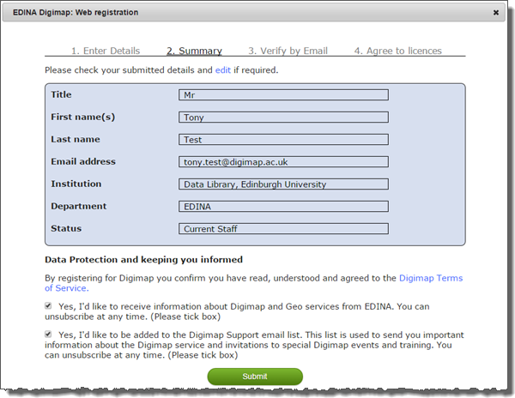
User registration
Individual registration required
Instant access granted
User email must be correct and must be one in use
Change of user details submitted via MyDigimap area, at top right of Digimap Collections page
After registering, users must accept the terms of each licence agreement before they can use any collection

Slide 22
Frequently Asked Questions
How do users get access?
Login using local authentication credentials, register, accept terms of licences
Does everyone have to register?
Yes
Can we have direct access via IP?
No
Why are some users being asked to register again?
Registrations expire if they are not used for 12 months
How can I ensure that unauthorised individuals do not access Digimap?
Talk to your IT staff
Different groups of users have different attributes to their login credentials which either permit or deny access
Some institutions do not regard retired staff as full “members”, others do; both will be able to assign appropriate access privileges.

Slide 23
Local Support staff
On subscription:
EDINA will ask you to nominate local support staff
Confirmation of main site rep
Additional site reps (optional)
Responsible Officer for Data Security and Deputy (mandatory)
One person can undertake multiple roles
EDINA will add the contact details to a Digimap help page: http://digimap.edina.ac.uk/webhelp/digimapsupport/service_info/site_rep_list.htm
As a site rep you will receive email from EDINA regarding events, service issues and individual users (if queries arise)

Slide 24
Site Representative role
The Site Representative(s) will be the contact point for the Digimap Service within the Authorised Institution
They will also be responsible for general promotion of the service and support for the service relating to local infrastructure and procedures
It may be convenient for some Authorised Institutions to have more than one representative, particularly where the Authorised Institution is located across more than one site
Maximum number of Site Representatives is not expected to exceed 5

Slide 25
Responsible Officer for Data Security
The Responsible Officer for Data Security (and Deputy) will take responsibility for ensuring the observance of the conditions for use of the Licensed Data under the terms of this Sub Licence Agreement by all Authorised Users of their Authorised Institution
They have a duty to report to EDINA any suspected security weaknesses of the Digimap service and to advise EDINA immediately of any actual incidences of misuse of the Licensed Data.
The Responsible Officer for Data Security (and Deputy) also has a duty to ensure that action plans for resolution of incidents are implemented fully and to the satisfaction of Jisc Collections and Ordnance Survey
High level role, concerned with appropriate implementation of institutional systems
Not responsible for individual users use of Licensed Data

Slide 26
Licence breaches
Incidents categorised as of two types:
User-related incident, e.g. a single user sharing their password with friends or sharing data they’ve downloaded with others who are not Authorised Users
Institutional-related incident, e.g. a systematic failure of the institution to terminate access once individuals cease to be members of the institution (e.g. terminating graduate accounts)
Procedures detail:
how EDINA will record any reported incidents and report them to Jisc Collections and the data owners
timescales for resolution
when access would be suspended for an individual or institution, if satisfactory resolution not achieved

Slide 27
Frequently Asked Questions
Can the Site Representative and the Responsible Officer for Data Security be the same person?
Yes but doesn’t have to be the same person
Should we have more than one Site Representative listed at our institution?
If you have multiple sites it may be useful to have multiple site reps

Slide 28
EDINA Helpdesk
Lots of knowledge
Don’t hesitate to contact with any questions
Aim to respond to all user queries within 24 hours (except at weekends)
Contact details:
email: edina@ed.ac.uk
telephone: 0131 650 3302

Slide 29
Chat facility
Open to any user
On all Digimap help pages
Available in office hours

Slide 30
Digimap Resource Centre
http://digimap.edina.ac.uk/webhelp/resources/index.html
Access to all help pages
Links to lots of resources

Slide 31
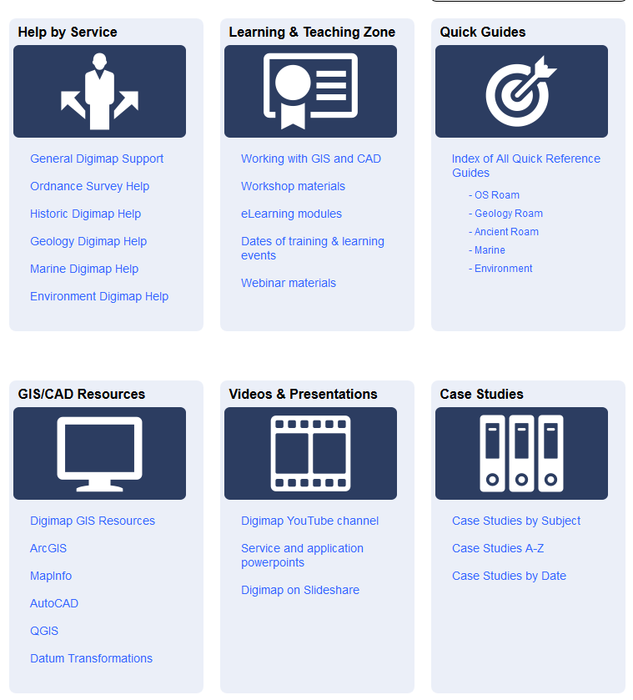
Digimap Resource Centre
All help pages
Case studies
YouTube
PDF Guides
Powerpoints
Training materials
GIS/CAD help
FAQs

Slide 32
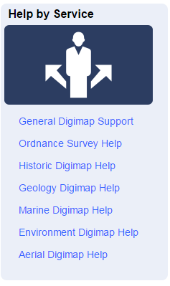
General Digimap Support area
Useful reading for those new to Digimap:
Access information, including subscription and login help
Summary of collections
Terms of service
Case studies

Slide 33
Digimap support email list
All site representatives are added to a service-specific mailing list for all EDINA site representatives
Allows EDINA to communicate service information to site reps
All lists are moderated to prevent spam

Slide 34
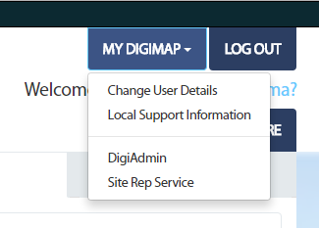
Usage statistics
EDINA emails login numbers to site reps every month
More detailed usage statistics available through a Site Rep Service area. Request access from EDINA helpdesk if you don’t have it
Please contact us with any queries about usage statistics

Slide 35
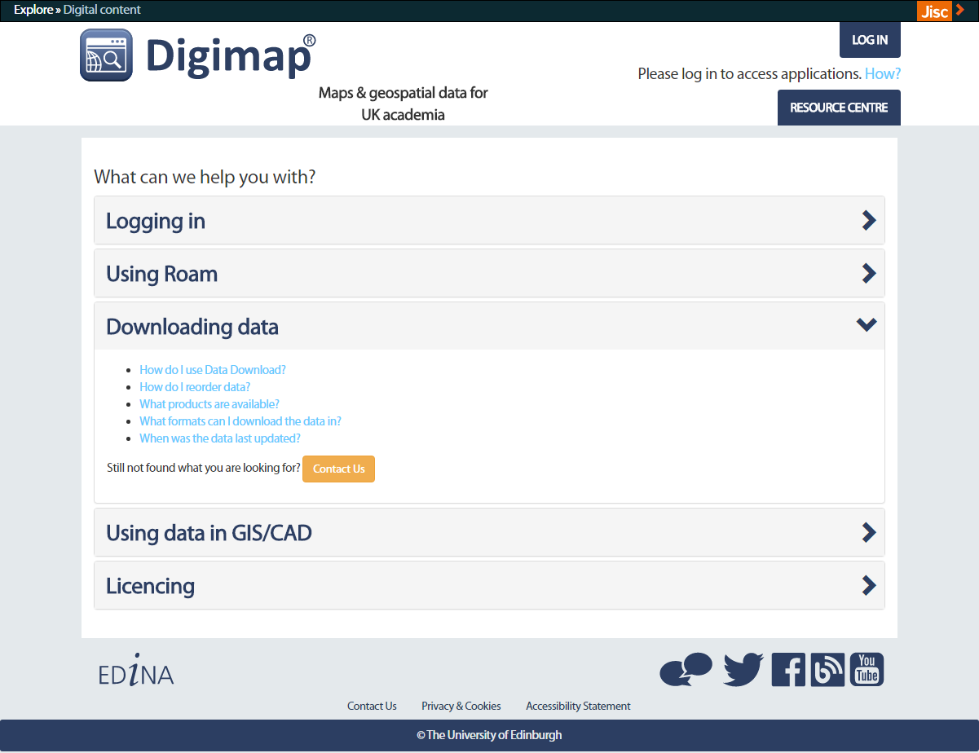

Slide 36
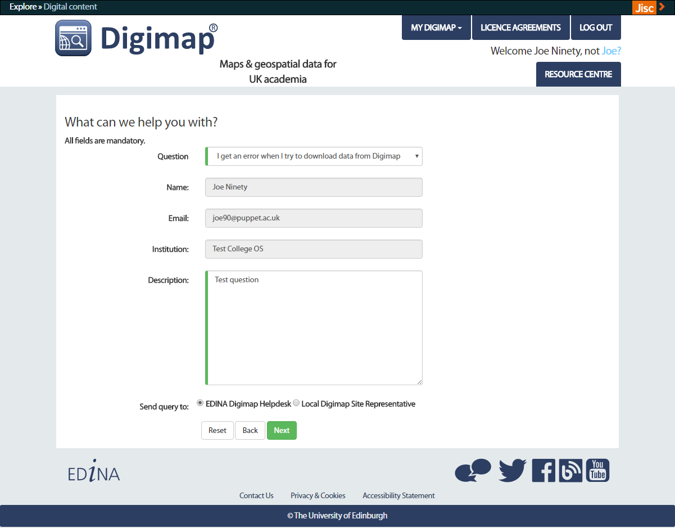

Slide 37
Social media
http://digimap.blogs.edina.ac.uk/
https://www.facebook.com/EDINADigimap
https://twitter.com/EDINA_Digimap
https://www.youtube.com/user/EDINADigimap
We use our social media to:
alert users to significant downtime periods or unexpected outages
announce updates to the services
offer free training
promote new help and support resources
signpost users to other relevant and interesting information

Slide 38
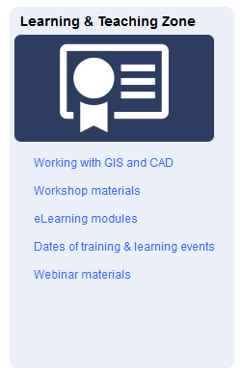
Training
Training courses:
We provide introductory training for institution staff on Digimap
We are not funded to provide GIS training
All via webinars
Regular webinars:
Schedule on Digimap blog at: http://digimap.blogs.edina.ac.uk/events/
Usually 30 mins to 1 hour long, depending on topic
Open to all users
Details of forthcoming webinars advertised on our social media channels
Training materials:
See the Learning & Teaching Zone of the Digimap Resource Centre

Slide 39
Site Reps Guidance document
Document with introductory guidance for Site Reps
Signposts to more detailed information
Feedback is very welcome
http://digimap.edina.ac.uk/webhelp/digimapsupport/about.htm#site_rep_information/site_rep_guidance.htm

Slide 40
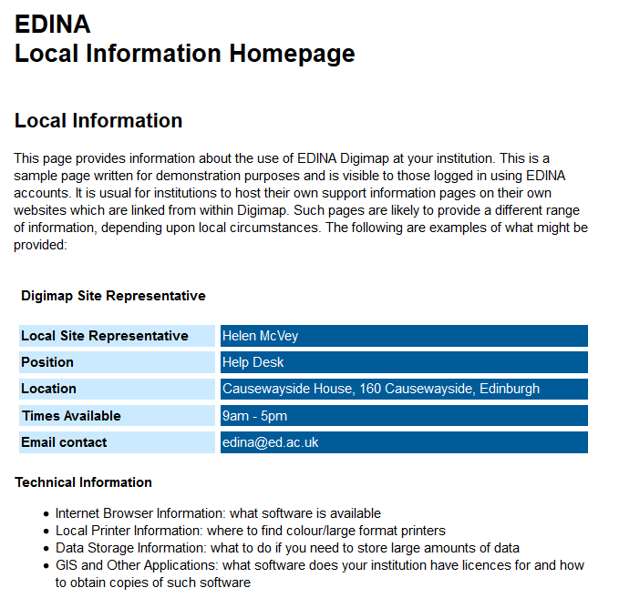
Setup local support web pages
Send us a link to any Digimap support page for your users
We will ensure your users see them under Local Support Information

Slide 41
Your questions

