Slide 1
Digimap – Urban map data for CAD
25 November 2015
Ian Holmes, EDINA Geo User Support

Slide 2
Content
What data is available in CAD format?
Where do I get the data?
How do I use the data?
Copyright and Resources

Slide 3
Poll
What is the one thing you most want to learn today?
What data is available in CAD format?
How do I get the data from Digimap?
Tips on using the data in CAD?
Other

Slide 4
What data is available in CAD format?
Vector datasets:
MasterMap Topography Layer [DWG]
Building Height Attribute: extension to MasterMap Topography Layer [DWG]
VectorMap Local [DWG]
Strategi [DXF]
Meridian 2 [DXF]
Height datasets:
Terrain 5 DTM [ASCII] and contours [DWG]
Terrain 50 DTM [ASCII] and contours [Shape, GML – will load in to Map 3D]
Land-Form PROFILE DTM and contours [DXF]
Land-Form PANORAMA DTM and contours [DXF]
Backdrop mapping [TIFF]
Various products e.g. 1:50,000 raster, all in TIFF format
http://digimap.edina.ac.uk/webhelp/os/osdigimaphelp.htm#data_information/data_formats/formats_available.htm

Slide 5
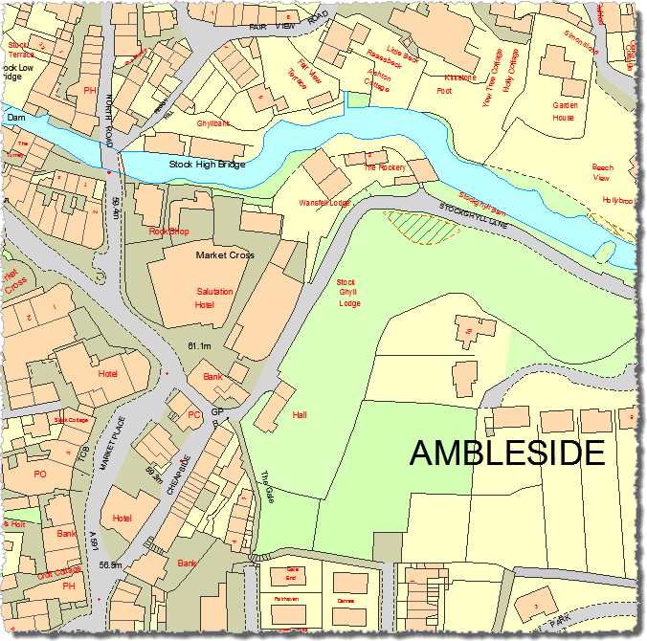
OS MasterMap
MasterMap Topogaphy Layer (DWG format)
Vector map product, most detailed mapping available of GB.
Topography Layer – GML, DWG and File Geodatabase formats.
Building Heights – DWG, CSV or KML format.
Sites Layer – GML format only.
Integrated Transport Network (ITN) layer – GML format only.
Urban Paths (ITN layer) – GML format only.
© Crown Copyright and Database Right 2015. Ordnance Survey (Digimap Licence)

Slide 6
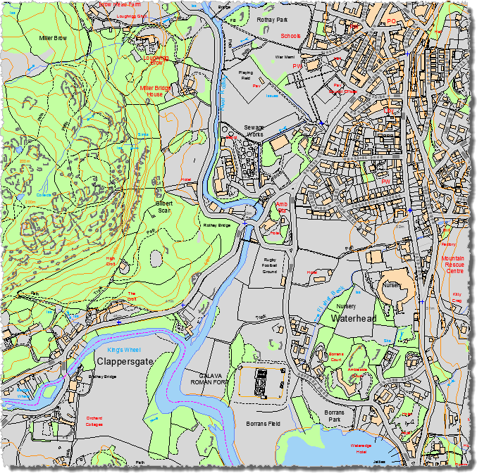
VectorMap Local data
VectorMap Local (DWG format)
Scale 1:10,000
Formats – GML, DWG, SHP
Supplied in 5x5km tiles
Includes contours and spot heights
© Crown Copyright and Database Right 2015. Ordnance Survey (Digimap Licence)

Slide 7
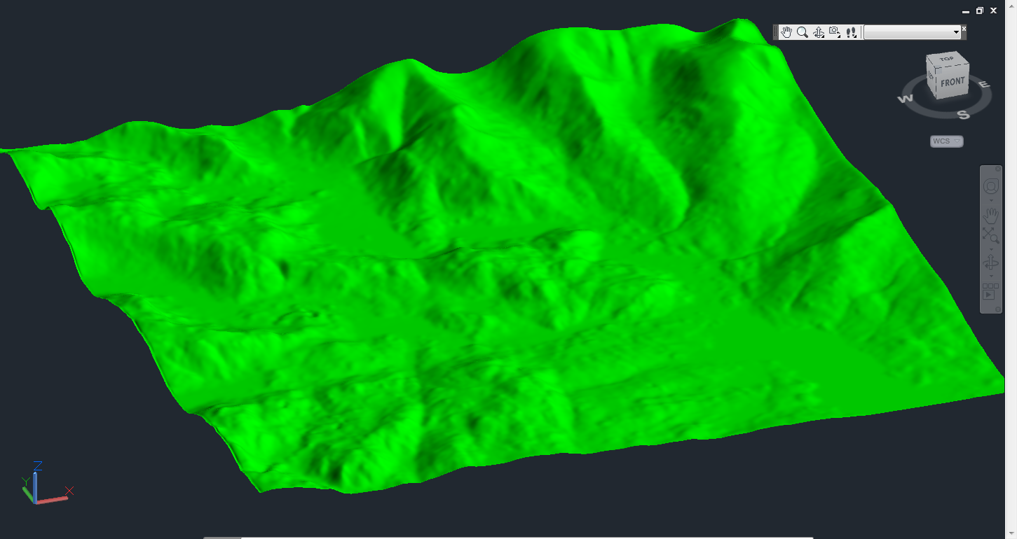
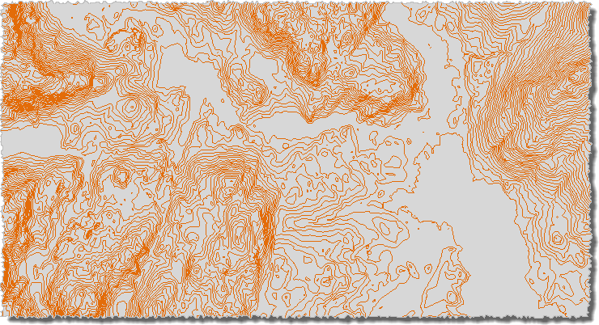
Height Data
Terrain 50 DTM
Various Raster (DTM) and Vector (contour) datasets available:
Terrain 5
Contours [DWG, Shape, GML], 5 metre interval
DTM [ASCII] – 5m cell size
Terrain 50
Contours [Shape, GML], 50m interval
DTM [ASCII] – 50m cell size
Land-Form PROFILE [DXF] – withdrawn by OS
Land-Form PANORAMA [DXF] – withdrawn by OS
© Crown Copyright and Database Right 2015. Ordnance Survey (Digimap Licence)
Terrain 50 Contours
© Crown Copyright and Database Right 2015. Ordnance Survey (Digimap Licence)

Slide 8
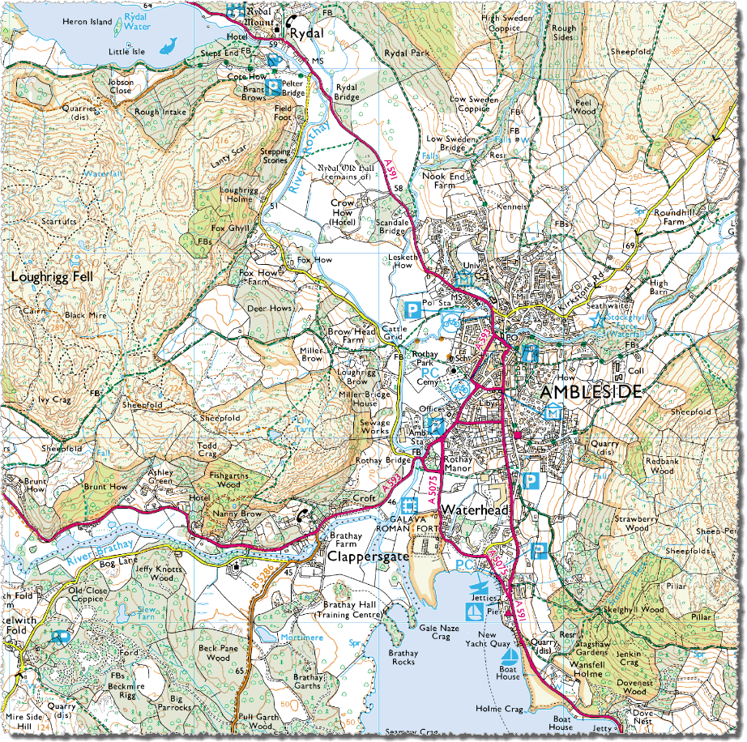
Backdrop mapping
1:25,000 Colour Raster
10 products available.
Raster maps – useful as backdrop.
All in TIFF image format.
Largest scale is raster version of MasterMap Topography Layer at 1:1,000.
Smallest scale is MiniScale at 1:1,000,000.
© Crown Copyright and Database Right 2015. Ordnance Survey (Digimap Licence)

Slide 9
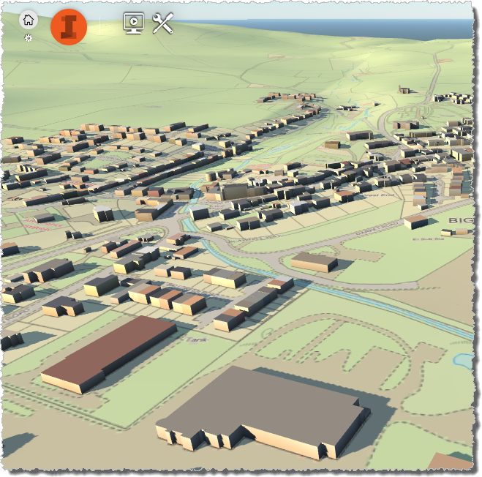
Building Height Attribute data
Released by OS in March 2014
Enhancement to Topography layer
Covers around 10,000 km² of major towns and cities in GB - see where:
http://bit.ly/1zvKI9q
Alpha release – no guarantee error free
In future will be included in Topography layer
DWG, CSV or KML format
EDINA supplies as 5x5km grid tiles
© Crown Copyright and Database Right 2015. Ordnance Survey (Digimap Licence)

Slide 10
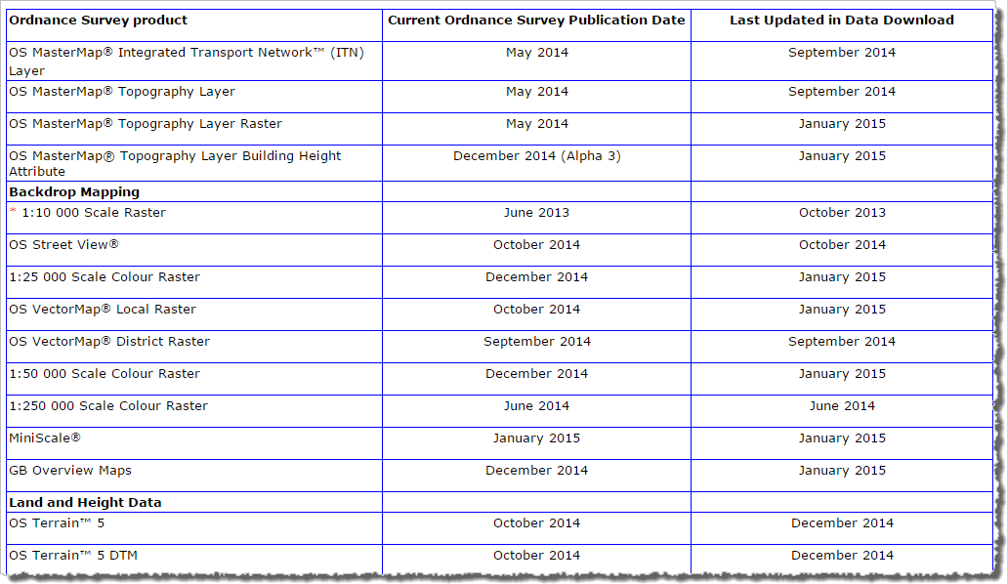
Update Frequency
Digimap > OS Help > Data Information > Data update dates
http://digimap.edina.ac.uk/webhelp/os/osdigimaphelp.htm#data_information/os_data_issues/os_update_dates.htm

Slide 11
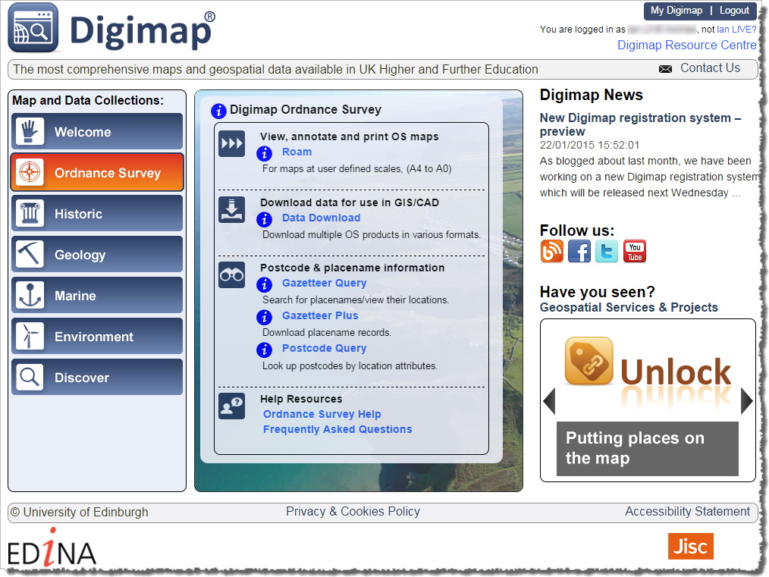
Where do I get the data?
Data Download – download OS mapping data for use in GIS/CAD

Slide 12
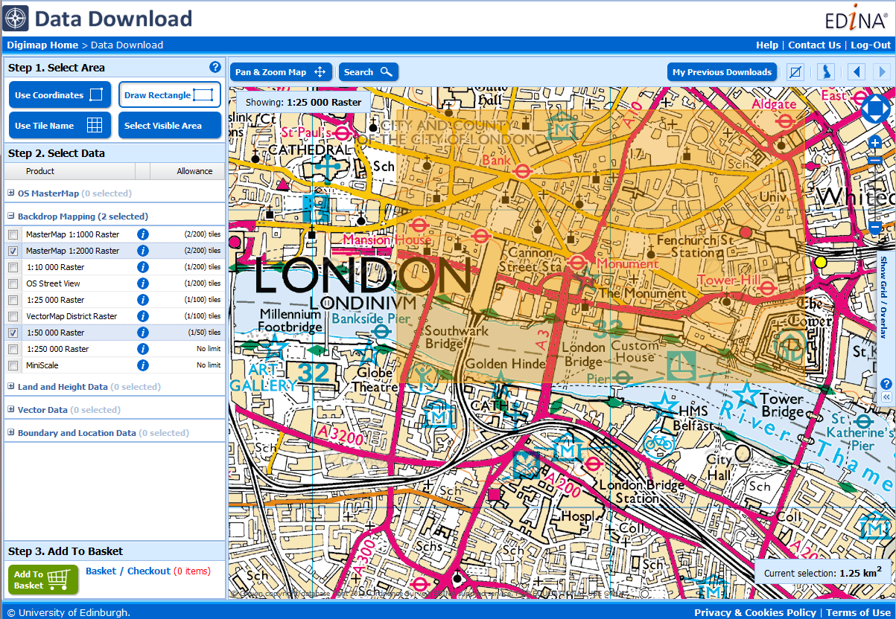
Data Download
All available OS map data
Download several map products in one order
5 categories of map data
3 steps to order map data

Slide 13
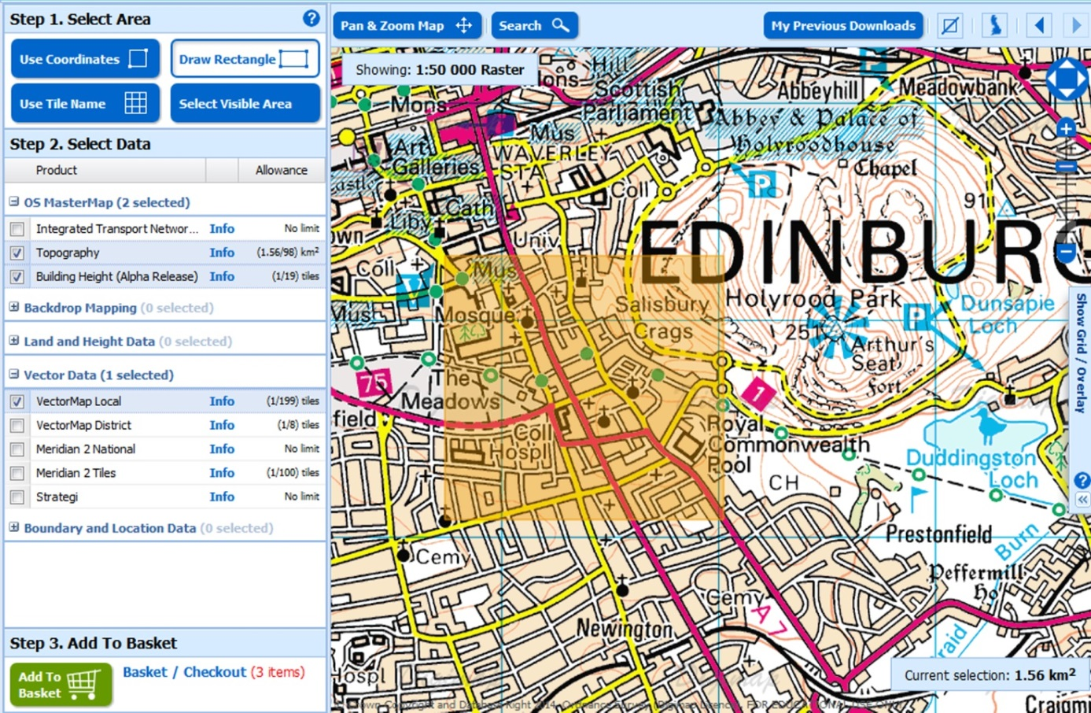
Using Data Download
Three step process:
Select area
Choose data
Add to basket
Options to change format, version and layers
Notes:
It’s straightforward to use Data Download – ordering map data involves 3 steps:
Select your area on the map – there are 4 methods for selection. The shaded orange area you see here is our selected area.
Select the map data that you wish to download. You can open any category of map data by clicking on the name. Then it’s a matter of ticking the box next to any map data you wish to download. You can download as many as you like in an order, provided you do not exceed the allowances. There is an allowance for each map data product – in order that our servers can process orders as quickly as possible.
Third step is to add to basket. Once you click the add to basket button, your basket pops up on screen. You can then select from different formats, date versions and map layers, where available. Options will different depending on map product.

Slide 14
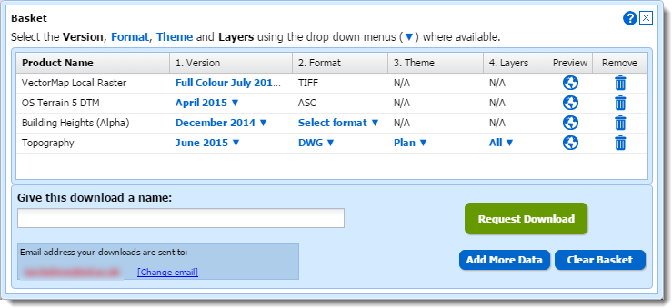
Basket options
Dataset options:
Version – dataset version as released by Ordnance Survey
Format – note different datasets available in different formats
Theme – some datasets are available in different styles e.g. full colour and line drawing
Layers – use this to download some features from the full dataset, e.g. just building features from OS MasterMap Topography Layer

Slide 15
How do I use the data?
Add VectorMap Local to AutoCAD
Add OS MasterMap topography to AutoCAD
3D visualisation with Building Height Attribute in InfraWorks

Slide 16
Poll
What software do you use regularly with map data? Tick ALL that apply.
AutoCAD
AutoCAD Map 3D
VectorWorks
ArcGIS
Other

Slide 17
Add VectorMap Local to AutoCAD
Download data in DWG format
Open in AutoCAD

Slide 18
Add OS MasterMap topography to AutoCAD
DWG format:
Will open directly in AutoCAD products
Includes default OS representation
Attributes stored as Extended Attribute Data (Xdata), which is not easy to interrogate
GML format:
Can be imported in to AutoCAD
Minimal representation
Control over which features are imported
More detailed attribute analysis possible
Can control the order in which layers are drawn

Slide 19
3D visualisation with Building Height Attribute (BHA)
Download the following from Digimap:
Building Height Attribute in DWG format;
DTM surface (e.g. Terrain 5 or Terrain 50);
Any other backdrop mapping as required (e.g. 1:25,000 Colour Raster, VectorMap Local Raster, or MasterMap Raster).
Can be viewed in a variety of packages including AutoCAD Map 3D or InfraWorks.

Slide 21
Building Height Attribute
Base heights: AbsHMin
‘Roof’ height: AbsH2
All attributes included as Xdata
Need to use with a DTM surface otherwise buildings will be floating in mid air

Slide 22
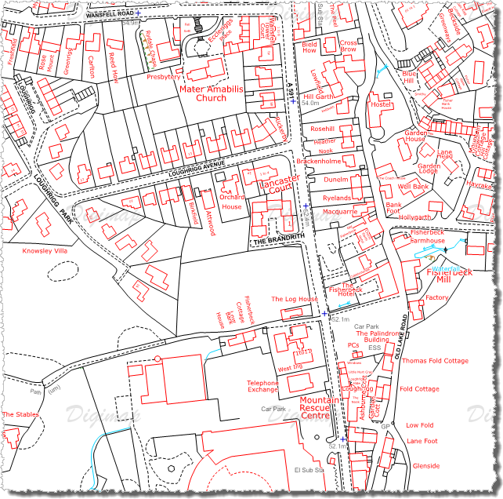
Recent developments
Building Height Attribute (3D buildings) in DWG format
Outline/plan version OS MasterMap in DWG format
OS Terrain 5 contours in DWG format
If there is anything you would like to see added to the service, please send your suggestions to edina@ed.ac.uk!

Slide 23
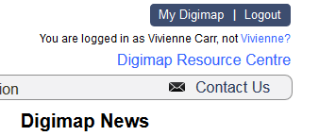
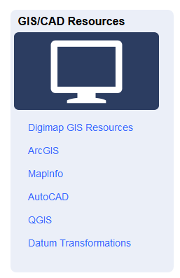
Resources
Digimap Resource centre: http://digimap.edina.ac.uk/webhelp/resources/index.html

Slide 24
AutoCAD pages

Slide 25
Permitted uses of data from Digimap
Educational use:
teaching, learning, academic and sponsored research and/or private study (includes distance learning)
Limited Administrative Use:
publish mapping images in promotional literature or web, to show campus location/extent, event locations, directions, promote Digimap service
Incorporate mapping images in Youtube videos, for demonstration or promotion of the service

Slide 26
Acknowledgement
Copyright acknowledgement required:
© Crown Copyright and Database Right [insert date]. Ordnance Survey (Digimap Licence)
Copyright acknowledgement is included on all maps printed from Digimap Collections.
Remember to include copyright acknowledgement if you download data from Digimap and create maps!

Slide 27
Can I publish my work on the web?
You can:
Publish copies of works on the web, provided mapping images are:
In a raster format
Not georeferenced
No larger than necessary
Include additional information
Adequate steps taken to ensure third parties cannot access, use and extract any OS data from such materials
Post images to Twitter and YouTube, but not Facebook.

Slide 28
Support with copyright
Lists of Frequently Asked Questions: http://digimap.edina.ac.uk/webhelp/digimapsupport/about.htm#access/licence_agreements.htm
Your site representative: http://digimap.edina.ac.uk/webhelp/digimapsupport/about.htm#service_info/site_rep_list.htm
EDINA Help Desk:
edina@ed.ac.uk
0131 650 3302

Slide 29
Poll
Today’s webinar:
I learnt something new
I didn’t learn anything new
Was a good use of my time
Was a poor use of my time
Other

